Slide 1

Office of Professional Regulation new member orientation
Notes:
Welcome and thank you for coming.

Slide 2
OPR’s Purpose
The Office of Professional Regulation (OPR) is a division of the Office of the Secretary of State.
OPR’s mission is to protect the public from incompetent or unethical practitioners through a system of licensure that assures a minimum barrier to enter a profession to practice competently.
We achieve this by supporting boards and advisor groups that oversee licensure of 50 professions and approximately 82,000 licensees.
Serving on a professional board or as an advisor with licensed practitioners and members of the public is a rewarding opportunity. Your contributions help us provide an important service to your community.

Slide 3
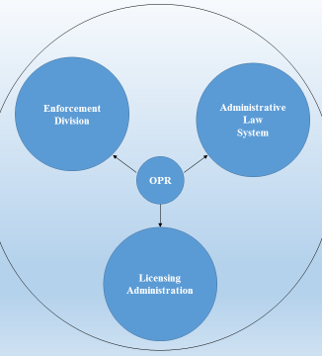
OPR’s Functions
OPR’s core function is public protection.
License Administration
  OPR’s licensing team is responsible for ensuring applicants have met the minimum standards as outlined in the Statutes and Rules to protect the public and practice competently.
Enforcement
  OPR’s enforcement team reviews complaints of unprofessional conduct and removes bad actors from the marketplace or conditions, reprimands or warns licensees to put the public on notice of findings of conduct.
Quasi Judicial Court System
  This is done through OPR’s Administrative Law System.

Slide 4
Board and Advisor Governance Models
Of OPR’s 51 professions, 14 are governed by the board model and 37 are governed by the advisor model.

Slide 5
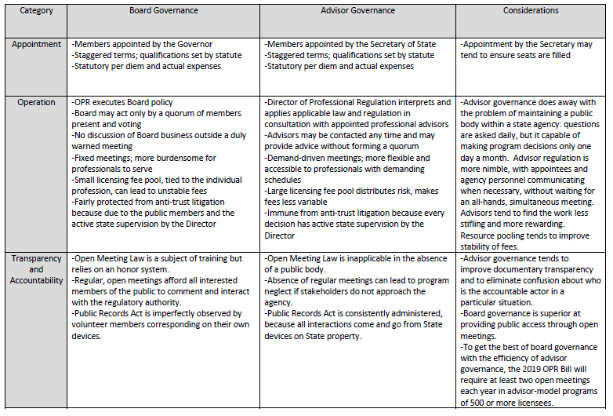
Notes:
Read on your own…

Slide 6
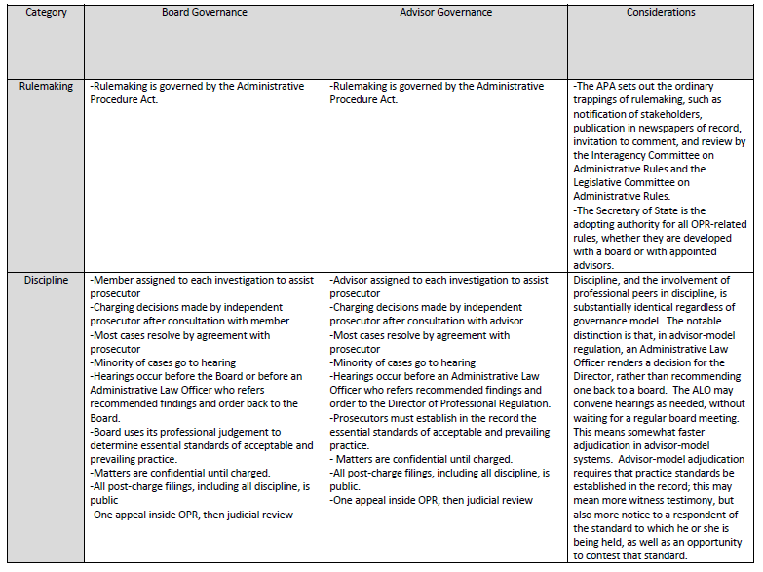

Slide 7
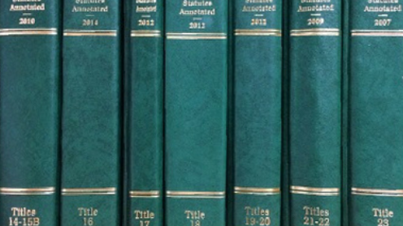
Statutes, Rules & Policies

Slide 8
OPR Statutes are Created by the Legislature
OPR Statutes Govern ALL Professions
3 V.S.A. §§ 121-132
Profession Specific Statutes
26 V.S.A. §§ 1-5427
Duties of the Office
Fees
Unauthorized practice
Power of Boards and appointments
Renewals
https://legislature.vermont.gov/statutes/chapter/03/005
General Provisions
Board/Advisor Composition
Licenses
Unprofessional Conduct
https://legislature.vermont.gov/statutes/title/26
Notes:
Everything OPR does is outlined in Statute and Administrative Rule. OPR and the professions we regulate are governed by title 3 and title 26. Title 3 covers all professions. Title 26 is profession-specific.

Slide 9



Statutes and Administrative Rules
The General Assembly may delegate rule making authority to administrative agencies
Vermont Statutes Annotated (V.S.A.) are laws written and enacted by the Vermont General Assembly.
Administrative Rules are drafted by the Office in consultation with the Boards and Advisors.
Rules must operate within the scope of statutory authority granted to the promulgating body.
Rulemaking is carried out through the Administrative Procedures Act.
The Secretary of State is the adopting authority for all OPR rules.
Notes:
The general assembly creates OPR’s statutes. Some statutes give OPR rulemaking authority in certain areas. The SOS is the adopting authority for rules.

Slide 10
Administrative Procedure Act
Draft Rules*
Pre-file with Interagency Committee on Administrative Rules (ICAR)
Proposed Rule filing with Secretary of State (SOS)
Public Hearing and Comment Period
Final Proposed Rule filed with Legislative Committee on Administrative Rules (LCAR) and SOS
LCAR Review
Adoption
Effective Date 45 days after adoption
8-month adoption deadline
*Draft Rules: OPR staff research and draft rules. Proposed rule text is discussed and voted on in open meetings. Members of the public and outside parties always may comment and may participate more actively where appropriate. The rulemaking process requires stakeholder engagement. This process can take months to years.
Notes:
This is the timeline and process for rulemaking. Filing with ICAR starts an 8-month adoption deadline. A lot goes into rule pre-filing to ensure we have the best product possible.

Slide 11
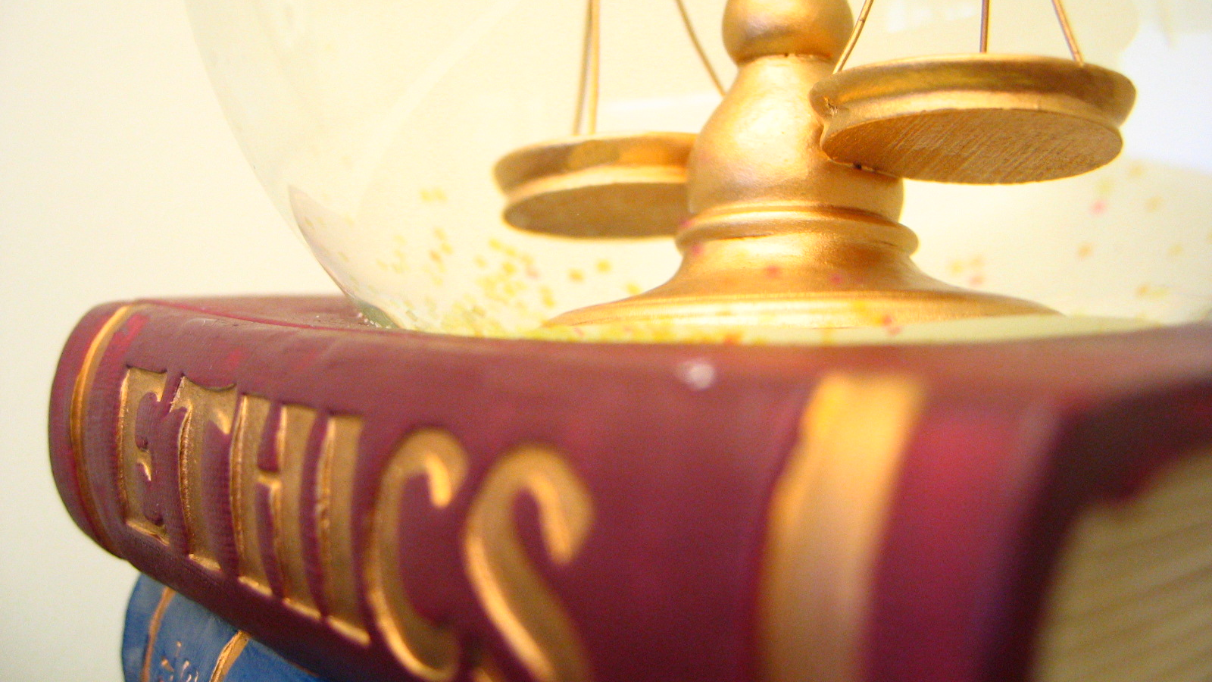
The Open Meeting Law, Public Records Act, & Executive Code of Ethics

Slide 12
Open Meeting Law: 1 V.S.A. §§ 310–314
The Law
What this means
Requires all meetings of public bodies to be open to the public at all times, unless a specific exception applies. The purpose of the law is to promote transparency, accountability, and better decision-making in government by:
Providing advance public notice of meetings, including meeting agendas;
Discussing all business and taking all actions in open meeting, unless an exception in statute applies;
Allowing members of the public to attend and participate in meetings; and
Posting meeting minutes that reflect the true business of the meeting.
https://legislature.vermont.gov/statutes/section/01/005/00310
Agendas must be posted before a public meeting. OPR standard is to notice predictable business seven days before a meeting. Enforcement matters can be added until the meeting.
A quorum of board members cannot discuss board business outside of an open meeting (no “reply all” email chains or “serial” meetings).
Materials are available to the public.
Minutes stand as the official record of ordinary (non-disciplinary) business. This should be a concise and accurate statement of voted business (not a transcript).

Slide 13
Open Meeting Law: For Advisors
    The Director is the official state actor for advisor professions which means advisors are not a public body and Open Meeting Law does not apply.
    There are no quorum issues.
    OPR does hold 1-2 public meetings as a standard for advisor professions. Additional meetings are as needed to advise the Director on policy and profession-related matters.
    Code of Ethics and Public Records Act are still applicable.

Slide 14

Bottom line….
Communicating outside of an open meeting undermines the purpose of the law and exposes personal communications to records requests.
We have a process for handling internal and external communications, such as:
Licensing Questions & Complaints
Media and Public Inquiries
Associations, Conferences, Lobbyists, Legislators
Speaking (or not) for the Board or Advisor Group
If you are not sure about a communication, please contact the Office.

Slide 15

Public Records Act: 1 V.S.A. §§ 317
The Law
What this means for the Board/Advisor
Any person has the right to request a public record from government agencies, including Boards. The definition of a “public record” is very broad: “any written or recorded information, regardless of physical form or characteristics, which is produced or acquired in the course of public agency business.” 1 V.S.A. § 317(b).
https://legislature.vermont.gov/statutes/section/01/005/00317
Meeting materials are public: agendas, minutes, drafts, handouts, disciplinary records, etc.
While there may be legal exceptions, it should be assumed that all business related to OPR is a public record.
Emails, calls, and texts concerning board/advisor business are public records, even if sent or received from personal email. This has important implications for members’ personal privacy. Best practice is to copy the licensing administrator on emails related to board/advisor business, so those records live on a State server independent of your personal account.

Slide 16
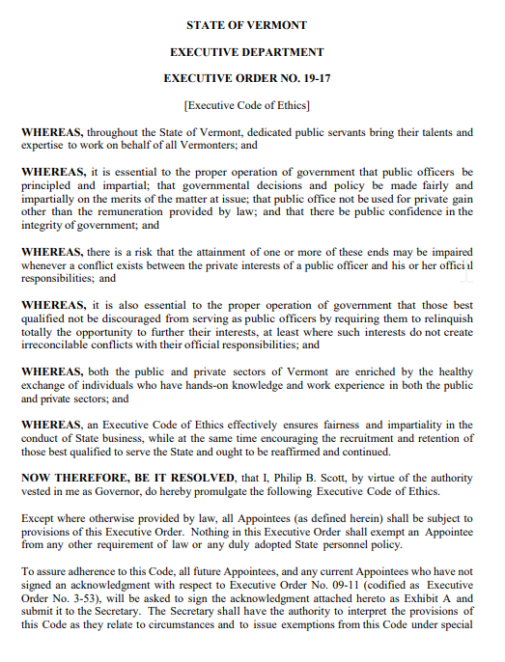
Executive Code of Ethics
Decisions should be impartial and based on merits of the matter
Civil and respectful tone in the public discourse
Treat each other, employees, staff, volunteers and the public with dignity, respect, empathy and courtesy
Avoid and identify conflicts of interest
EO 19-17 - Executive Code of Ethics.pdf (vermont.gov)

Slide 17

Meetings

Slide 18
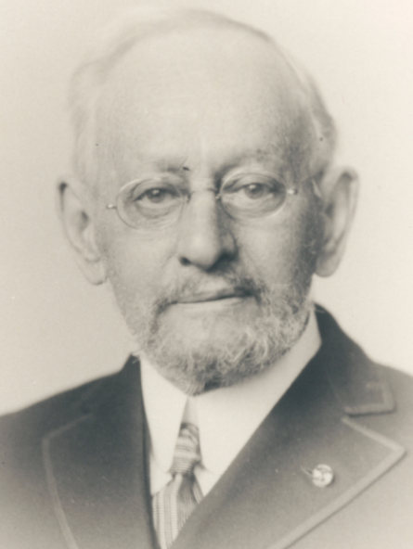
Robert’s Rules of Order
Robert's Rules of Order are the most widely recognized source of parliamentary rules for fair, efficient, democratic, and orderly meetings.
Boards may settle on the degree of procedural formality appropriate to their work. Consistency matters, and some degree of formality is necessary to operate effectively and generate accurate minutes.
OPR counsel will provide procedural guidance as necessary.

Slide 19
Remote Meetings Best Practices
Room | Quiet space Professional (neutral) background Member alone on camera, if possible
Ability to view screen (this is how you will see exhibits) | Please ensure you can view the screen, this is how you will view exhibits Board members are also expected to review materials before the meeting
Camera | Turned on when speaking or listening to a participant address the Board Set at eye level (optimal angle) Avoid backlighting (washes out your face) Temporarily turn off your camera when tending to “off camera” issues such as eating, breaks, interruptions, etc.
Audio | Stay muted unless talking Do not talk over others; try to wait for recognition by the chair or presenter Raised hand is a good way to get the chair’s attention Do not have personal conversations on breaks
Attire | Business casual
Technical Issues | Report technical issues discretely and avoid interrupting the meeting
Deliberative Session | Be prepared to join a deliberative session using information sent by staff Completely leave the public board meeting to avoid inadvertently broadcasting deliberations Keep your camera on when possible, to help the hearing officer verify attendance and participation Members who recuse and do not participate in the deliberative session should turn off their camera and mute themselves until the Board returns from the deliberative session

Slide 20
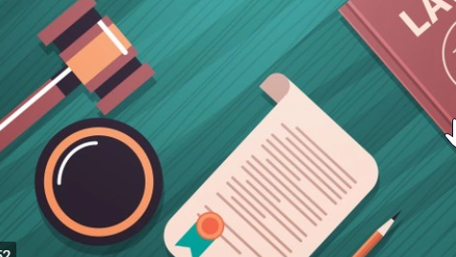
Enforcement

Slide 21
Investigations
Complaint is filed
Screening
Investigation
Investigative Report

Slide 22
Prosecution
I-Team
(if needed)
Hearing and Decision (by Board Members or ALO)
Investigation Review
Charges Filed/Case Closed
*Everyone plays a different role on the Investigative Team:
Board Member/Advisor: Provides subject matter expertise and helps the Team understand Board trends
Case Manager: Manages flow of each complaint, ensures compliance with Orders
Investigator: Investigative resource, including credibility determinations
Prosecutor: Manages all litigation decisions
Sanctions, including ceilings and floors, should be discussed through the I-team process.
The I-Team process is a confidential process and should never be discussed with anyone outside the I-Team

Slide 23

Case Management
OPR case managers review ongoing compliance and accountability with Board and ALO orders.

Slide 24
OPR’s Online Licensing System: NGLP

Slide 25
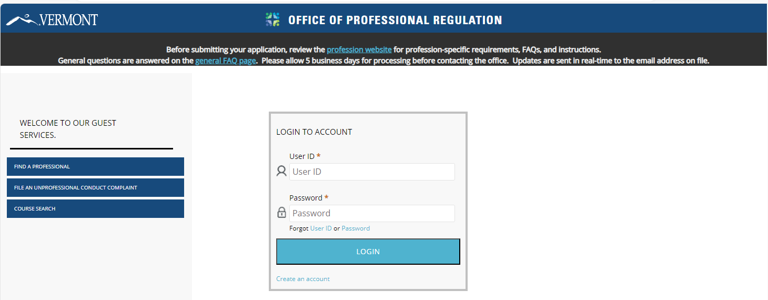
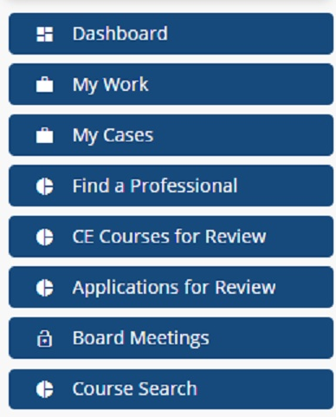
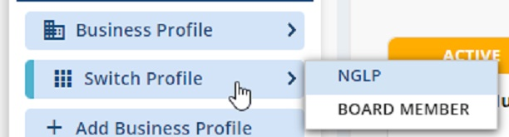
Accessing NGLP
The Board Member Portal is here you will find
information related to meetings and materials,
and cases being assigned to you.
.

Slide 26
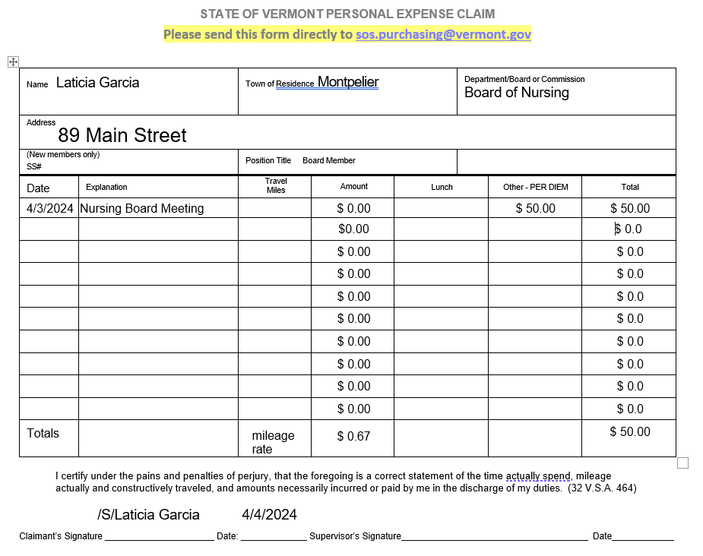
Board and Advisors are eligible for payment
  Daily per diem for public meetings board. The per diem is $50.00.
  I-teams preparation and I-team meetings are eligible for the hourly rate of $6.25/hour for up to 8 hours.
  Mileage reimbursement for travel to required meetings. Rate changes annually. Remote options are always available!
  Not sure? Please ask!

Slide 27
Your role is important!
  Many guiding principles and laws
  Take time to learn the role
  Look to General Counsel and staff for guidance
  Look to your case manager for questions on navigating i-team responsibilities.
  Ask questions!

