Slide 1
Vermont Climate Council
2025 Update to Vermont’s
Climate Action Plan
Subcommittee Top Recommendations

Slide 2

Rural Resilience & Adaptation Subcommittee focuses on:
Identifying, evaluating and analyzing existing and new strategies and programs that build resilience and prepare the State’s communities, infrastructure, and economy to adapt to the current and anticipated effects of climate change.
Rural Resilience and Adaptation
Core Focus Areas
Community Capacity and Planning
Infrastructure and the Built Environment
Public Health

Slide 3
Overview of Pathways and Strategies
Pathway 14: Increase capacity for climate resilience planning and implementation, and address inequities of under-resourced communities.
3 Strategies under this Pathway
12 Actions under this Pathway
Pathway 15: Proactively and strategically invest to enhance resilience in transportation, communications, water/wastewater, and energy infrastructure and prioritize our most vulnerable communities and environmental- justice populations.
2 Strategies under this Pathway
16 Actions under this Pathway
Pathway 16: Support the reduction of municipal, school district, residential, university, and hospital fossil fuel use in rural areas through equitable best practices that address the unique challenges of rural communities.
Zero Strategies under this pathway as the Cross-Sector Mitigation SC took lead
Actions addressing weatherization and electrification included in strategies 14a and 14d
Notes:
PW 14
Had 4 Strategies (14a-d) and now has 3 ; 14a and 14b have been combined and 14c and 14d have 5 combined actions.
Had 9 actions and now has 12; New actions for business support and coordination around recovery, resilience and funding; new actions to better integrate hazard mitigation and resilience planning into existing municipal planning processes. Actions around recovery and funding more relevant to recent events and evolution of funding programs.
Actions under 14d propose better identification of best practices in stakeholder identification and engagement. Action to support RPCs capacity and funding relate to improving capacity for training local communities on stakeholder participation. e.g. staff from the CCRPC are providing this support to the Essex Junction Communications Director on how to engage and support stakeholder participation in municipal planning and implementation. This could be institutionalized at all the RPCs.
PW 15
Had 4 Strategies and now has 2 ; Overlap in existing strategies; 2 remaining were reframed – one to include actions related to Planning and Assessments and one to include actions related to implementation.
Had 34 actions and now has 16; Removed 7 because they were complete, being implemented, or were no longer considered as resilience actions (being covered in other Subcommittees) and more than a dozen w/ww actions were combined into 6 or 7 actions. Further refining, eliminating should be considered.
Actions relate to….how they address stakeholder input….etc [Note anything worthy of calling out] Modifications included identifying an actor, adding specificity and clarity,
PW 16
Had 2 strategies. It was agreed that the CSM SC would take the lead on Pathway 16 and RRA SC would assist as necessary.
Had 18 actions. Actions related to public education and community support for weatherization and electrification are included in actions under 14a/b in building capacity and providing funding for RPCs to assist community energy committees, planning commissions and councils/select boards promote and extend programs. Some actions might be covered under pathway 15 (water and wastewater audits) and with CSM mitigation on weatherization, etc. The CCP TG also has addressed RBES and CBES under Pathway 18.
The actions under Pathway 15, as supported by the RRA SC does need more refinement, mainly specificity about how weatherization and electrification efforts can be supported at the local level. Concerns were raised by community energy committee members at the RPC-facilitated stakeholder meetings about lack of support and need to more active. This could be better elaborated under Strategies 14a and 14b. It is implied now, but could be better outlined.

Slide 4
Overview of Pathways and Strategies
Pathway 17: Change Vermont's land-use policies so current and future land development will be adaptive and resilient to climate change impacts.
1 Strategies under this Pathway
0 Actions under this Pathway
Pathway 18: Ensure that all people have access to safe, accessible, energy efficient, and affordable housing.
3 Strategies under this Pathway
10 actions under this Pathway
Pathway 19: Provide for equitable adaptation to the public health impacts of climate change
4 strategies under this pathway
12 actions under this pathway
Notes:
PW 17
- Some existing actions will remain; some were revised; some were absorbed into PW 14 and 15 and others will be addressed in Compact Settlement [Accurate Statement ??????]
PW 18
Had 3 Strategies and now has 3;
Had 10 actions and now has 10;
Actions relate to….how they address stakeholder input….etc [Note anything worthy of calling out]
PW 19
Is new and has 5 strategies and X actions
Actions relate to improving resilience in housing, including understanding impacts of recent floods on displaced people who lost housing. Examples of actions include identifying and increasing funding and financing products for homes starts within communities that are planning and investing in development-ready infrastructure, building development partnerships, and updating zoning bylaws to welcome new homes, exploring opportunities to develop and support resilient zoning and local codes, and building geospatial housing inventories that indicate housing needs in disaster safe areas.

Slide 5

Secure sustainable, long-term funding to expand and maintain a permanent Flood Resilient Communities Fund (Community Resilience and Disaster Mitigation Fund) for the design and implementation of local and regional climate change adaptation projects and community resilience. Funding may be used as local match for federally funded hazard mitigation programs as well as non-FEMA eligible hazard mitigation activities.
Establish permanent, dedicated funding for Regional Planning Commissions to hire and retain staff for climate resilience planning work, hazard mitigation application development, and management of hazard mitigation grants on behalf of municipalities or other eligible grant recipients as well as cover overhead costs related to completing Local Hazard Mitigation Plans.
Map areas that are suitable for new, climate safe housing, set regional targets for new housing units created, and increase funding mechanisms where communities are investing in development-ready infrastructure.
Create and facilitate a business support network that connects and engages all relevant organizations necessary to support business resilience and disaster response that builds off and supports structures that already exist such as Chambers of Commerce, Community Organizations Active in Disaster, Downtown Organizations, and Vermont Businesses for Social Responsibility.
Increase State capacity to manage funding programs and provide technical assistance for the development and implementation of climate resilience plans, with a focus on maximizing the efficacy of Local Hazard Mitigation Plans, and augmenting existing programs with the Municipal Planning and Resilience Grant Program, the Municipal Climate Planning Framework and Guide, and the Municipal Climate Toolkit.
Community Capacity and Planning Priority Actions
Notes:
CCP TG Lead please add some bullet points about priorities so that that I can use as talking points. What do these priorities address, what was challenging about this list, what needs to be thought about as the Plan is developed?
Feel free to insert or provide a link to a relevant picture as well.

Slide 6

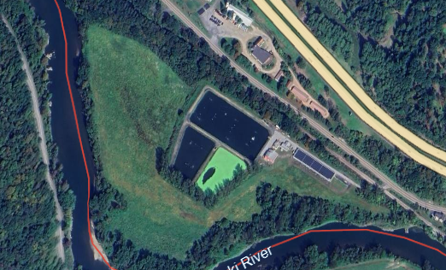
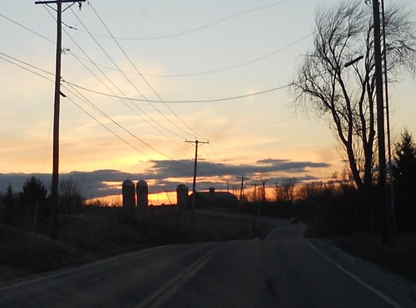
Infrastructure and the Built Environment Priority Actions
Improve Municipal Vulnerability Index to be an index in addition to being an indicators tool so that it can be used to prioritize infrastructure investments across the state based on relative vulnerability.
Infrastructure providers, working with stakeholders including regulatory agencies as appropriate, should assess vulnerabilities, adopt cost-benefit analysis methodologies, prioritize investments, and develop metrics and targets to measure progress.
Replace aging electric and communication infrastructure with the most appropriate resilient alternative when cost effective.
In the absence of and/or in addition to dedicated federal funding, create a dedicated transportation flood resilience funding program to proactively address identified transportation risks and vulnerabilities.
Provide a sustainable funding source for addressing drinking water, stormwater, and wastewater infrastructure vulnerabilities identified and prioritized through asset management plan and vulnerability assessments development.
Notes:
IBE TG Lead please add some bullet points about priorities so that that I can use as talking points. What do these priorities address, what was challenging about this list, what needs to be thought about as the Plan is developed?
1- Ensure it includes currently missing data such as historic utility outage data, to the extent available, and ANR's Environmental Justice mapping tool, when complete.
3 - For example, during normal replacement schedules for aging and unreliable lines, evaluate and where cost effective and feasible, improve resilience by relocating lines underground or through other options.
Feel free to insert or provide a link to a relevant picture as well.

Slide 7
Public Health Priority Actions
Provide funding for resilience equipment, supplies, and services that help reduce the health impact of climate-related hazards for income-qualifying households needing extra assistance.
Increase funding for state-contracted community mental health services, to provide funded partners with more capacity to address anxiety, depression, distress, and trauma caused by climate change and climate-related disasters.
Provide funding and technical assistance to municipalities and local organizations to reduce health impacts of climate change for the disproportionately affected populations they serve, through preparedness, facility adaptation, and support for individuals and households.
Explore and implement strategies to enhance local emergency preparedness, response, and recovery capacity (e.g., expand funding and authority of RPCs and/or county government; increase direct state funding, training, and technical assistance to municipalities).
Provide funding and technical assistance to local partners to develop community resilience hubs that can serve as places for learning, collaboration, resource access, and refuge in response to climate-related hazards and other community needs.
Notes:
Public Health TG Lead please add some bullet points about priorities so that that I can use as talking points. What do these priorities address, what was challenging about this list, what needs to be thought about as the Plan is developed?
Feel free to insert or provide a link to a relevant picture as well.

Slide 8














Communities
Provide planning guides and tools | Sustainable, long-term funding for permanent resilience | Technical assistance for climate resilience plans and recovery assistance | Increase funding and financing products for homes starts | Increase funding to RPCs and municipalities to support planning and target funding
Infrastructure
Improve MVI to also be an indicators tool to prioritize infrastructure investments based on relative vulnerability. | PUC/PSD, investigate resilience planning, …, setting targets for grid resilience. Utilities integrate resilience planning into their IRPs. | Collaborate to id critical facilities and develop preparedness, survivability, and recovery plans, procedures, and investments | Utilities should deploy technology for management, control, and optimization of distributed energy resources | Development and implementation of asset management programs for all public water systems and publicly owned wastewater treatment works.
People
Provide funding for household resilience | Strategies to enhance local emergency preparedness and response | Identify and address gaps in mental health services | Increase state capacity to provide support | Communication and education
Notes:
Completed when revised priorities delivered and TBD if it is helpful or not

Slide 9
Overview of Pathways and Strategies (3)
Pathway:
X (Number of) strategies under this pathway
Number of actions under this pathway
Pathway:
X (Number of) strategies under this pathway
X (Number of) actions under this pathway
Note: summarize text to minimize words on the screen

