Slide 1
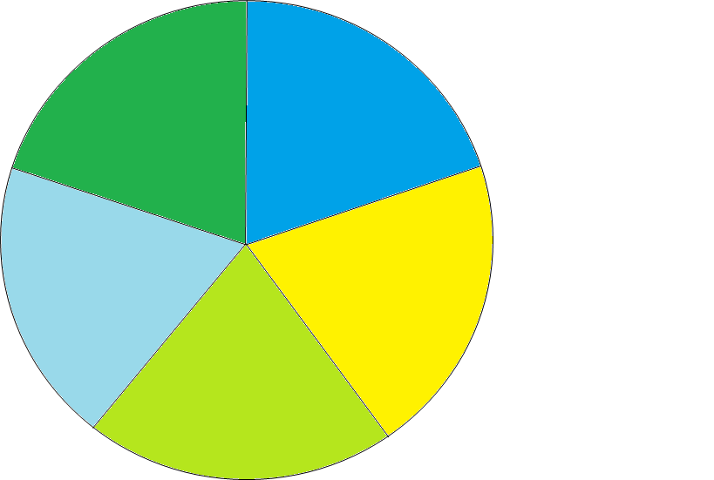
Prioritization Supported by the
Foundational Criteria in the GWSA
Resilience and Adaptation Strategies
Justice and Equity
Co-Benefits
Mitigation Strategies
(emissions reduction)
Technical Feasibility
Cost Effectiveness
Sequestration Strategies
Impact -
Progress towards the GWSA requirements/ goals

Slide 2
Pathways Strategies Actions Cross-Sector Mitigation, Agriculture and Ecosystems and Rural Resilience and Adaptation
Framework for Climate Action Plan
Pathways and Strategies
Council got a sneak peek in July
All will be included in Initial CAP
Less is more recognizing that we must meet statutory obligations
Discussion over best language here – Is goals better?
Actions are the “operational” tasks that are needed to implement the pathways and strategies. Actions may be written around existing, or propose new, policies, programs, projects, initiatives, plans, etc.
Prioritization will happen for all actions using a step-wise approach
Synthesis of impact, feasibility, cost-effectiveness (?) and co-benefits (?) will direct high priority actions to implement first
These prioritized actions will be priority for equity screening

Slide 3
Using the Foundational Criteria
A suggested process for incorporating foundational criteria into analysis and prioritization:
Consolidate pathways, strategies and actions (use expert judgement to combine ideas etc.)
Focus your analysis of the first four Foundational Criteria (Impact, Feasibility, Cost-Effectiveness and Co-Benefits) to determine priority actions
Apply the scoring rubric on the high priority actions with support of consultant.
Show your work – use a transparent process to evaluate strategies/actions against the criteria;
Use expert judgement – cite data when possible – to judge each action against each criteria (most will use a high, medium, low ranking)
Use this analysis to highlight which actions implementers should focus on – this is your prioritization tool
Present your analysis by action
Speak to each action that is a HIGH priority as to how it addresses the five Foundational Criteria.
Refine MED and LOW priority actions based on a timeline, assuming they should be carried forward for future consideration.
Once actions are prioritized, consider further break down of actions by buckets such as: legislative change; rule making/policy change; and individual actions by every-day Vermonters

Slide 4
Definitions for Discussion
Impact - Progress towards GWSA Requirements/Goals
Consideration of actions’ contribution to achieving 2025, 2030 and 2050 emission reduction requirements and/or resiliency, adaptation and sequestration goals (High, Medium, Low)
Equity
Application of scoring rubric (relative score – i.e., how score compares against scores of other actions)
Technical Feasibility
Definition being finalized by Science and Data based
Cost-Effectiveness
Definition being finalized by Science and Data
Co-Benefits
Action meets multiple goals for emission reductions, sequestration, resilience and adaptation (High, Medium, Low)

Slide 5
Discussion on Impact
Impact - Progress towards GWSA Requirements/Goals
Consideration of actions’ contribution to achieving 2025, 2030 and 2050 emission reduction requirements and/or resiliency, adaptation and sequestration goals (High, Medium, Low)
High impact = significant benefit to: the environment (built and/or natural?) OR people/vulnerable populations OR risk reduction OR the economy
Medium = moderate benefit to: the environment (built and/or natural?) OR people/vulnerable populations OR risk reduction OR the economy
Low = minor benefit to: the environment (built and/or natural?) OR people/vulnerable populations OR risk reduction OR the economy
OR
High impact = positive benefit at the landscape (or regional) level to: environment, people/vulnerable populations, risk reduction, economy
Medium impact = positive benefit at the community (or municipal) level to: environment, people/vulnerable populations, risk reduction, economy
Low impact = positive benefit at the individual (or household) level to: environment, people/vulnerable populations, risk reduction, economy

