Slide 1
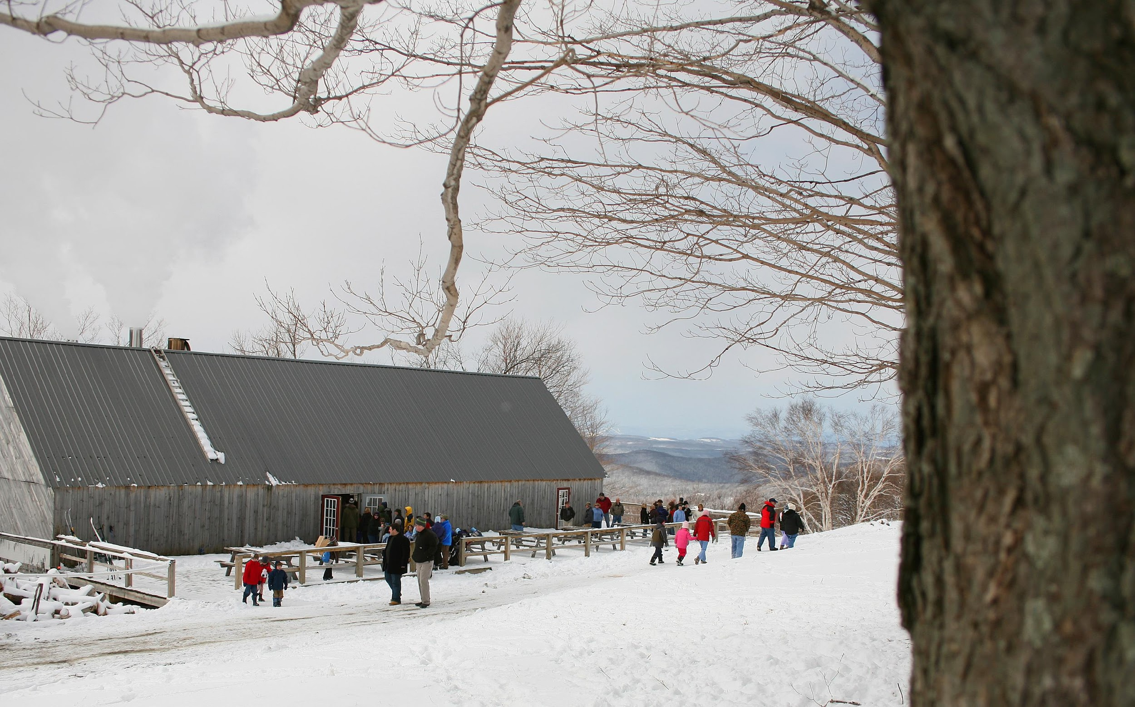
The Global Warming Solutions Act and the Vermont Climate Action Plan
INSERT NAME AND TITLE
INSERT DATE

Slide 2
Climate Change in Vermont
More rain and flooding, changes to agriculture, different forests
healthvermont.gov
Not everyone is impacted equally

Slide 3
Global Warming Solutions Act (GWSA), Act 153 of 2020:
Enacted: September 23, 2020
First meeting of the Vermont Climate Council: November 20, 2020
Subcommittees Began Meeting in February, 2021
Cross-Sector Mitigation, Rural Resilience and Adaptation, Agriculture and Ecosystems, Just Transitions and Science and Data
Initial Climate Action Plan adopted: December 1, 2021

Slide 4
The Vermont Climate Action Plan
Aim to cut climate pollution in half by 2030
Prioritize those who are most affected
Shaped by five subcommittees
with public input
in coordination with CEP
Updated at least every 4 years
Implementation section to inform decision-making
Framework for measuring progress

Slide 5
GWSA Charge to the Climate Council
Reduce greenhouse gas emissions from the transportation, building, regulated utility, industrial, commercial, and agricultural sectors;
Encourage smart growth and related strategies;
Achieve long-term sequestration and storage of carbon and promote best management practices to achieve climate mitigation, adaption, and resilience on natural [and] working lands;
Achieve net zero emissions by 2050 across all sectors;
Reduce energy burdens for rural and marginalized communities;
Limit the use of chemicals, substances, or products that contribute to climate change; and
Build and encourage climate adaptation and resilience of Vermont communities and natural systems.

Slide 6
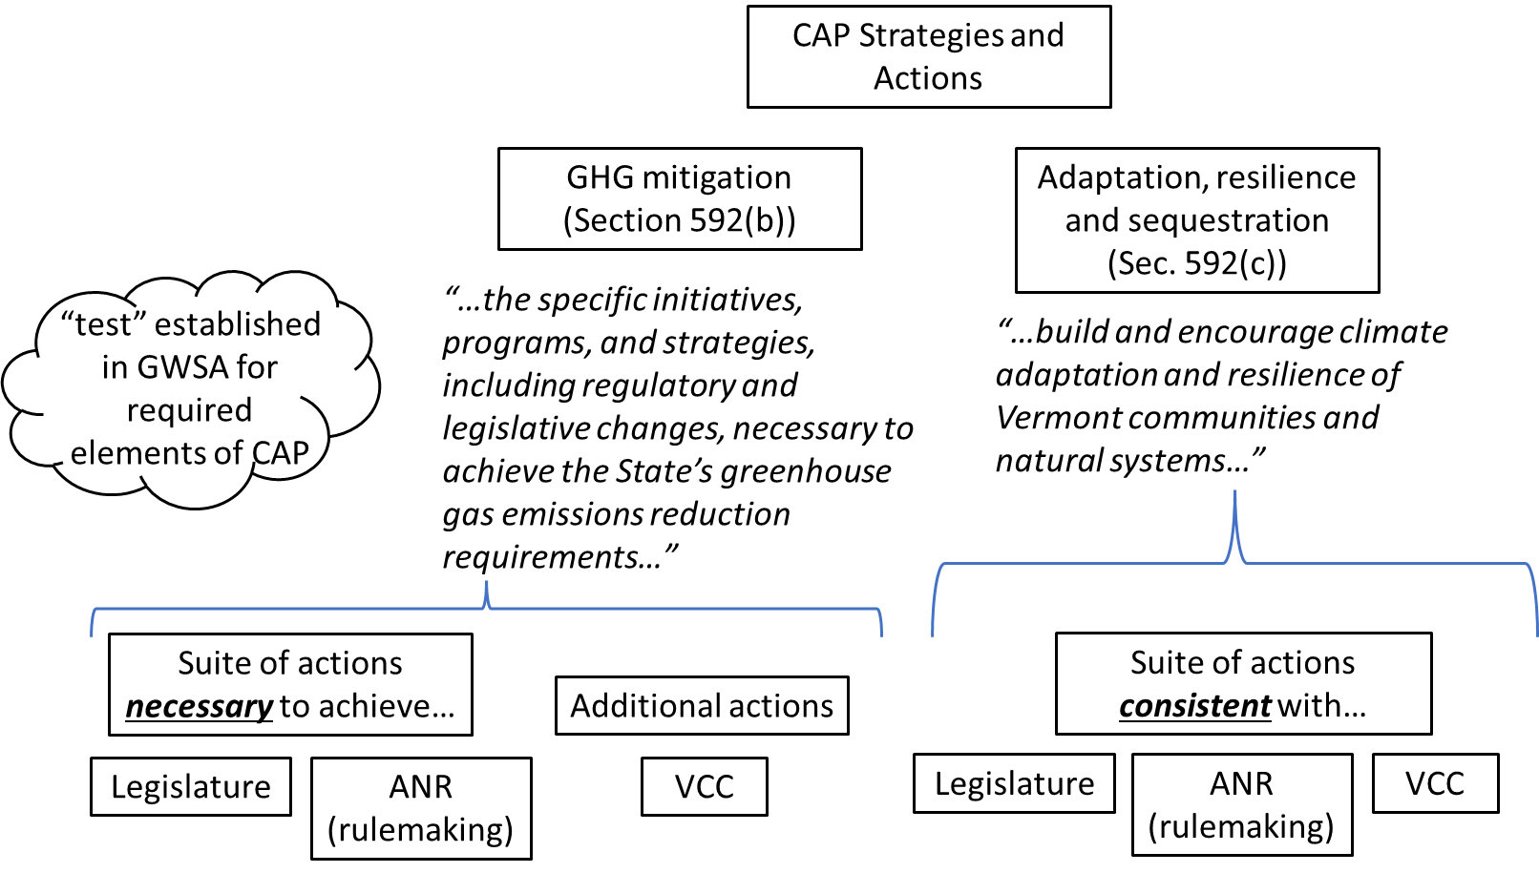
The Climate Action Plan

Slide 7
Equity Lens: Guiding Principles for a Just Transition
A framework for the Climate Council and subcommittees to evaluate, adjust and prioritize recommendations based on how they will impact Vermont’s impacted and frontline communities.
01
02
03
04
05
06
Ensuring inclusive, transparent, and innovative engagement
Creating accountable & restorative recommend-ations
Moving at the speed of trust
Incorporating solidarity to create inclusionary spaces
Prioritizing the most impacted first
Developing supports for workers, families, and communities

Slide 8
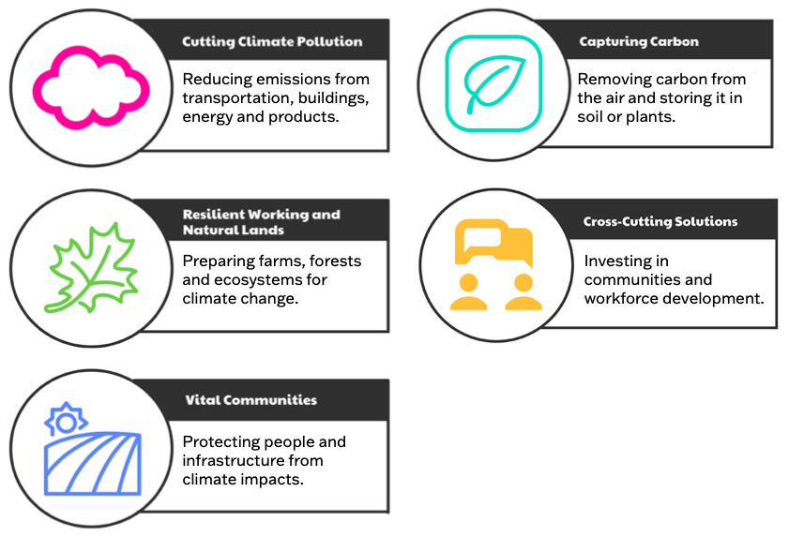
Five
Impact
Areas

Slide 9
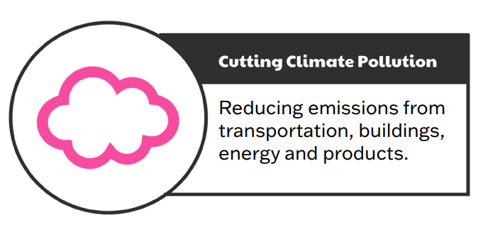

Slide 10
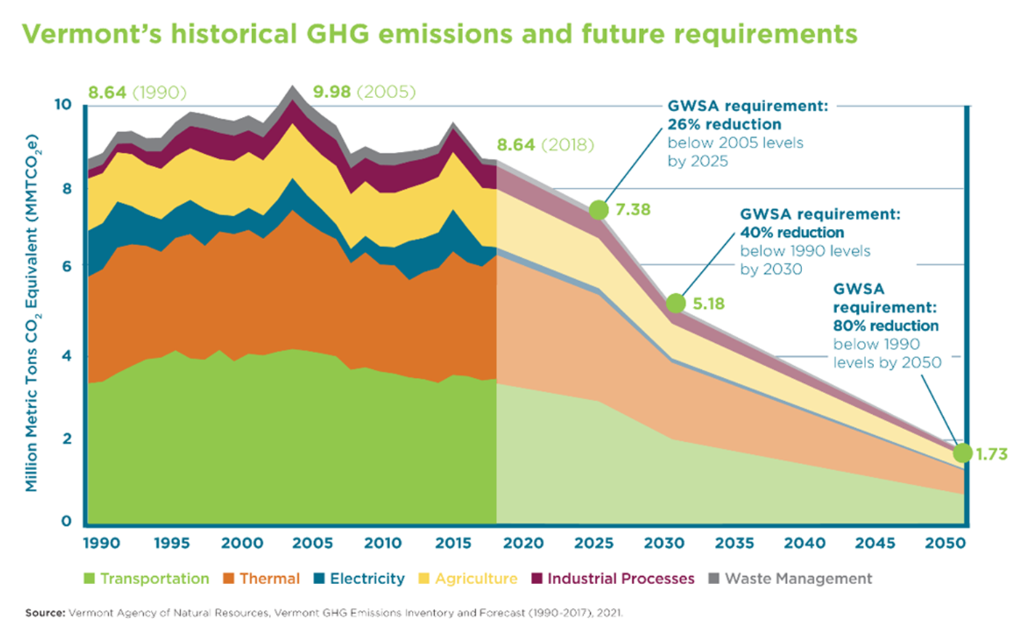
GWSA Emission Reduction Requirements

Slide 11
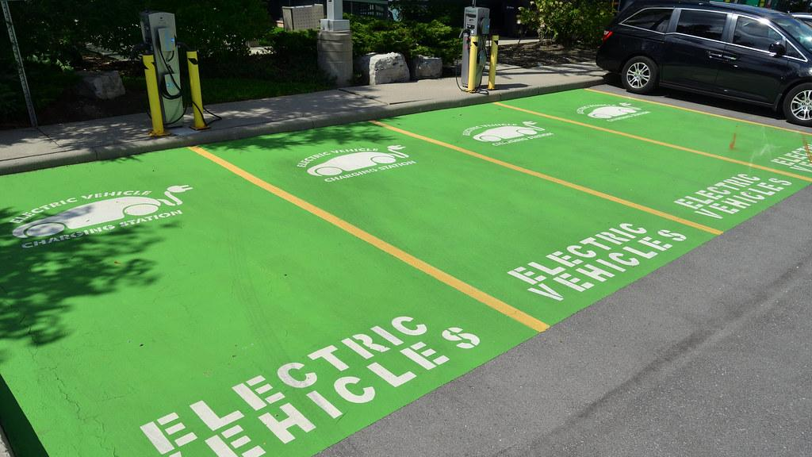
Efficient Transit and Electric Vehicles
Provide incentives to help Vermonters purchase electric vehicles
Build more charging stations for electric vehicles
Join the Transportation and Climate Initiative Program (TCI-P) when regional market viability exists**
TCI-P would cap emissions from transportation fuel in the region and invest funds from the sale of carbon allowances to reduce emissions
“As of the date of the adoption of this CAP, the future of the TCI-P is uncertain, and it is not immediately clear how Vermont’s adoption of the action to participate in the TCI-P would be implemented without partnership from other states in the region.”
Adopt California’s Advanced Clean Car and Clean Truck Rules
Requires manufacturers to sell an increasing number of zero-emission vehicles thru 2035.
Implemented thru ANR-led rulemaking
GWSA requires rules to be filed with ICAR by July 1, 2022
** non-consensus item
Notes:
Provide Vermonters with better opportunities to choose electric vehicles and increase public transit choices, including routes in rural communities that promote fewer passenger car trips and encourage smart growth

Slide 12
Efficient Transit and Electric Vehicles
Electrify medium and heavy-duty vehicle auxiliary systems (i.e., bucket trucks and electric transport refrigeration units)
Create infrastructure that supports more walking, biking, public transit options
Educate drivers on benefits of electrification and other transportation options to reduce vehicle miles traveled (VMT)
Notes:
Provide Vermonters with better opportunities to choose electric vehicles and increase public transit choices, including routes in rural communities that promote fewer passenger car trips and encourage smart growth

Slide 13
Efficient Transit and Low- and Zero-Emission Vehicles (ZEVs)
Of the nearly 433,000 vehicles registered in Vermont (328,000 cars; 105,000 light-duty trucks), currently about 1% (<5,000) are ZEVs
Notes:
Provide Vermonters with better opportunities to choose electric vehicles and increase public transit choices, including routes in rural communities that promote fewer passenger car trips and encourage smart growth

Slide 14
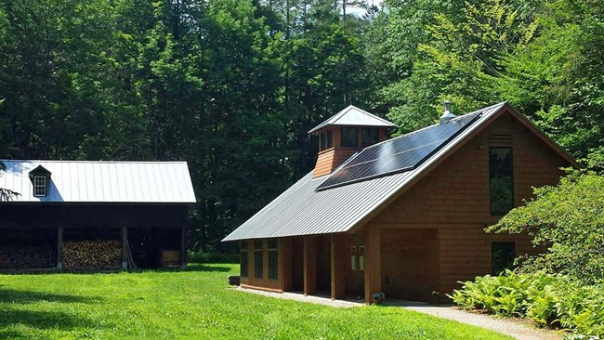
Better Buildings and Homes
Expand weatherization (“weatherization at scale”)
Develop and implement a Clean Heat Standard
Performance standard driving transition to less carbon-intensive heating practices
Incentivize adoption of clean, energy-efficient heating options, such as heat pumps and modern wood heat
Institute a rental property efficiency standard (RPES)
Regularly update and ensure compliance with the statewide residential building energy code
NPS Photo Credit L Shahi
Notes:
Increase the comfort and efficiency of our buildings and get them ready to support the use of carbon-free energy for transportation and heating
Photo: The U.S. Green Building Council awarded its highest rating for Leadership in Environment and Energy Design (LEED) to the new Forest Center at Marsh-Billings-Rockefeller National Historical Park. Both the Forest Center, a classroom and meeting space and the adjacent 1876 Wood Barn, home to a new exhibit on the Forest, share the Platinum LEED certification.

Slide 15
Better Buildings and Homes
NPS Photo Credit L Shahi
Notes:
Increase the comfort and efficiency of our buildings and get them ready to support the use of carbon-free energy for transportation and heating
Photo: The U.S. Green Building Council awarded its highest rating for Leadership in Environment and Energy Design (LEED) to the new Forest Center at Marsh-Billings-Rockefeller National Historical Park. Both the Forest Center, a classroom and meeting space and the adjacent 1876 Wood Barn, home to a new exhibit on the Forest, share the Platinum LEED certification.

Slide 16
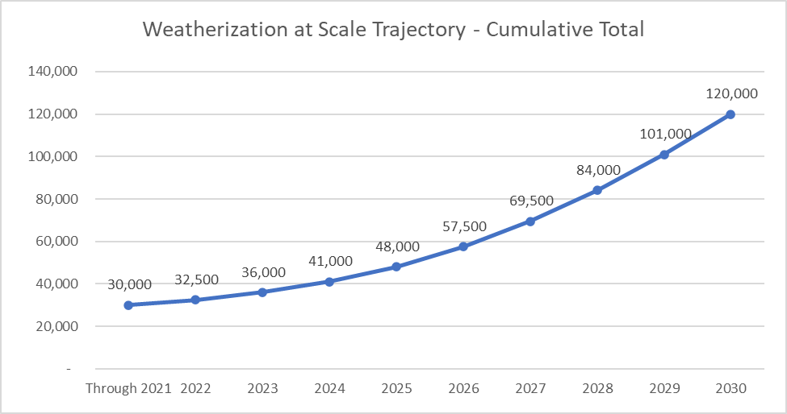
Weatherization at Scale
NPS Photo Credit L Shahi
Notes:
Increase the comfort and efficiency of our buildings and get them ready to support the use of carbon-free energy for transportation and heating
Photo: The U.S. Green Building Council awarded its highest rating for Leadership in Environment and Energy Design (LEED) to the new Forest Center at Marsh-Billings-Rockefeller National Historical Park. Both the Forest Center, a classroom and meeting space and the adjacent 1876 Wood Barn, home to a new exhibit on the Forest, share the Platinum LEED certification.

Slide 17
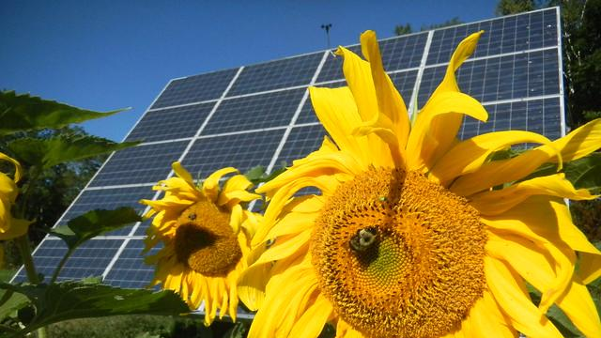
Clean, Reliable Energy
Shift away from fossil fuels and fossil fuel-dependent equipment
Pursue 100% Carbon-free or renewable electricity by 2030
Up from current goal of 75% by 2032
Total demand for electricity is expected to double from roughly 5.5 TWh in 2020 to more than 12 TWh by 2050
Enable all Vermonters to choose electrification
Upgrade electrical service in homes/businesses
Invest in load management and grid optimization
This Photo CC BY-SA
Notes:
Provide access to clean, affordable and reliable energy, such as better opportunities to choose electricity or other carbon-free choices for heating and transportation

Slide 18
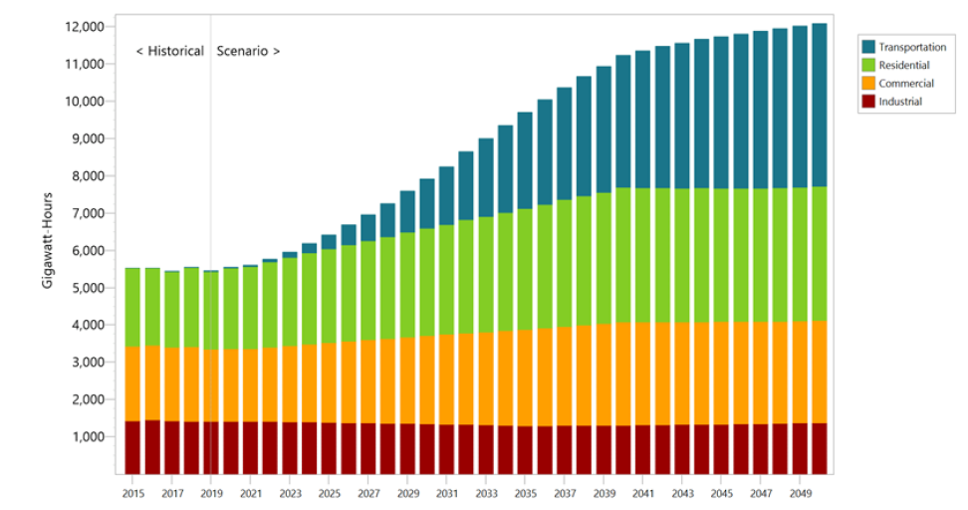
Modeled Electricity Demand in Vermont, thru 2050

Slide 19
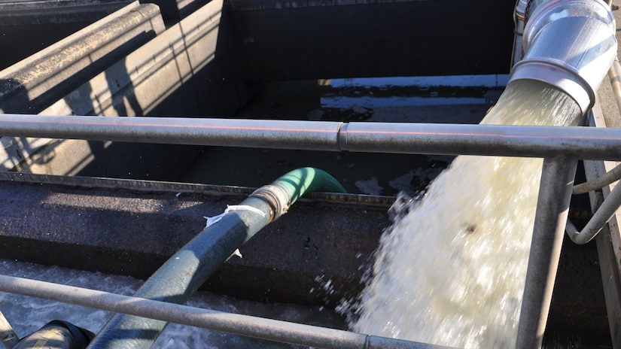
Other Greenhouse Gas Reduction Opportunities
Improve manure management and implement methane capture on farms
Reduce emissions of refrigerants with high global-warming potential
Reduce emissions of fluorinated gases from semiconductor manufacturing
Ensure flares are operational at all existing municipal wastewater digesters
Notes:
Reducing climate pollution from wastewater treatment facilities, facilities with large refrigeration systems, and semiconductor manufacturing

Slide 20
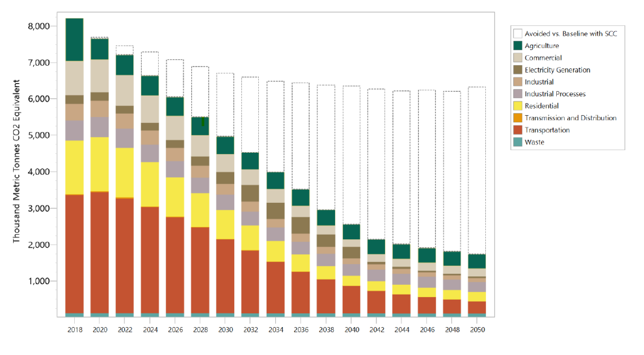
GWSA Requires Aggressive Scale and Pace

Slide 21
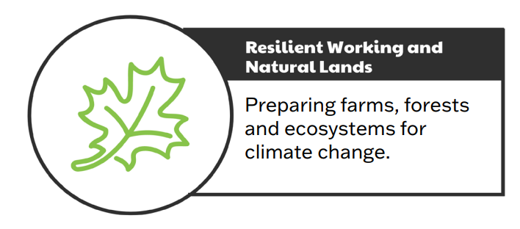

Slide 22
Resilient working and natural lands
Invest in agricultural and working lands management practices that mitigate emissions and improve resilience
Many of the same practices that are important for clean water are also beneficial for climate (i.e., cover crops, reduced tillage, expanded buffers, managing for resilient forests)
Expand nature-based solutions and understanding of traditional ecological knowledge (TEK)
Invest in strategic conservation
Promote healthy, connected river corridors, floodplains, and wetlands
Support and empower Vermont’s natural and working lands owners, managers, and caretakers, and expand local markets
Notes:
Increasing the resilience and health of agriculture and ecosystems, including helping farmers cut climate pollution and support sustainable food systems

Slide 24
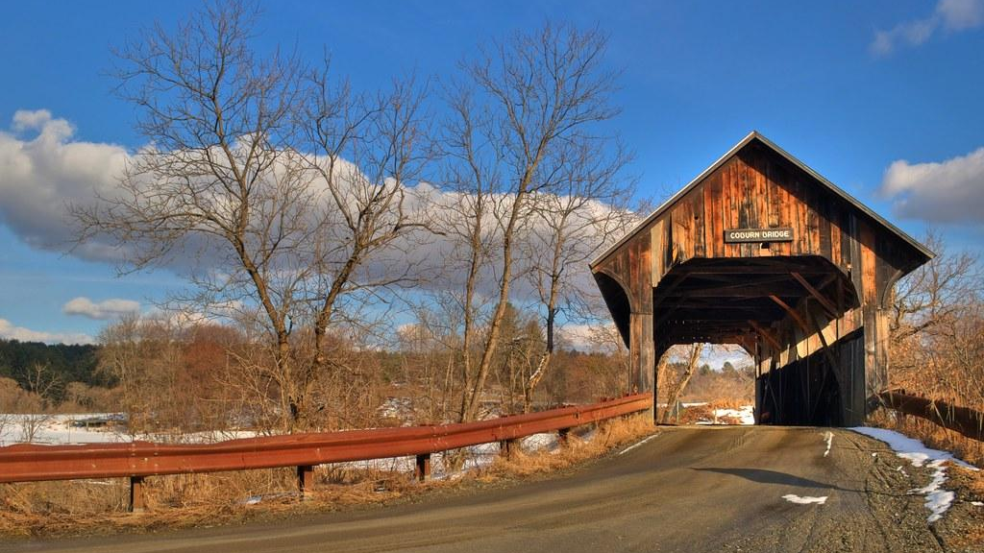
Vital Communities
Prioritize planning practices and investments that help Vermont communities prepare for climate impacts
Develop a climate toolkit
Update land-use policies to better support adaptive, resilient, compact settlement
Increase resilience of key infrastructure (transportation, energy, communications, water/wastewater)
Support the reduction of municipal, school district, residential, university, and hospital fossil fuel use
Ensure all have access to safe, accessible, energy efficient, and affordable housing
This Photo by Unknown Author is licensed under CC BY-NC
Notes:
Building stronger, resilient and thriving rural communities, including reduced fossil fuel use and increased access to safe, efficient and affordable housing, jobs and services

Slide 25
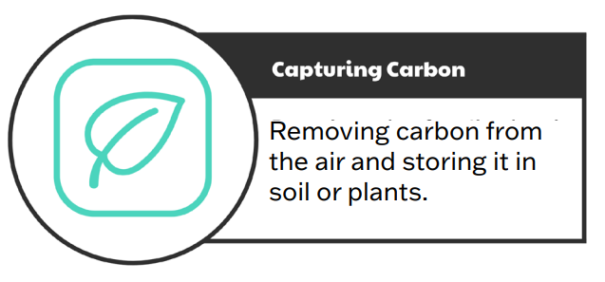

Slide 26
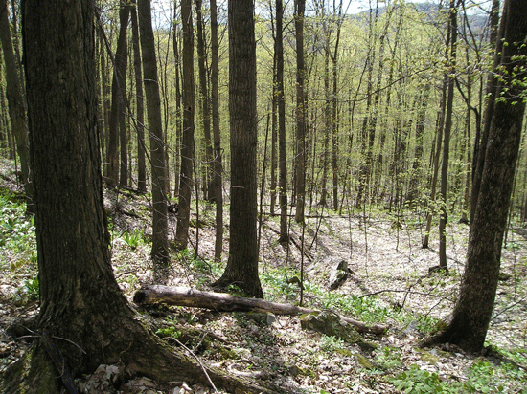
Capturing Carbon
Develop and implement programs which incentivize management practices which maintain or increase carbon storage
Changes to Use Value Appraisal (UVA) program **
Carbon markets
Payment for ecosystem services
** non-consensus item

Slide 27
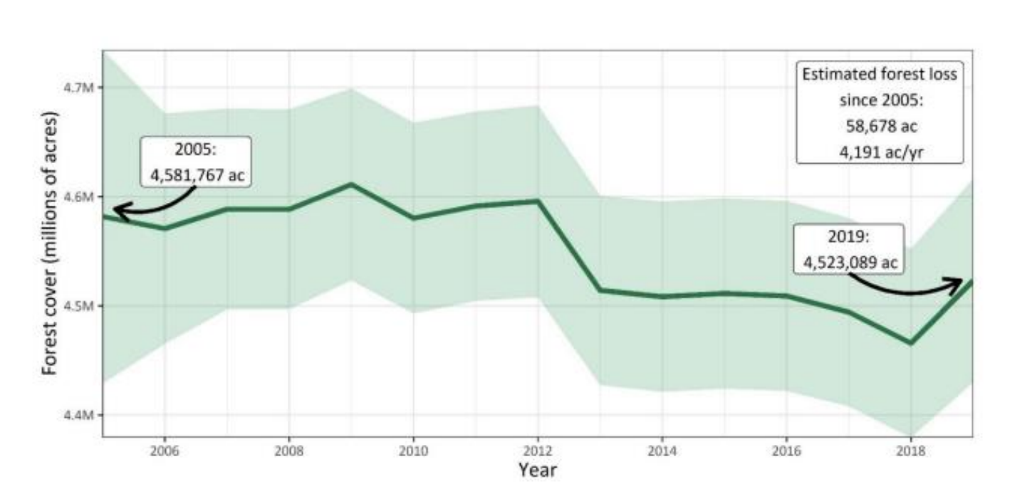
Estimated Forest Acreage in Vermont
(Kosiba, 2021)

Slide 28
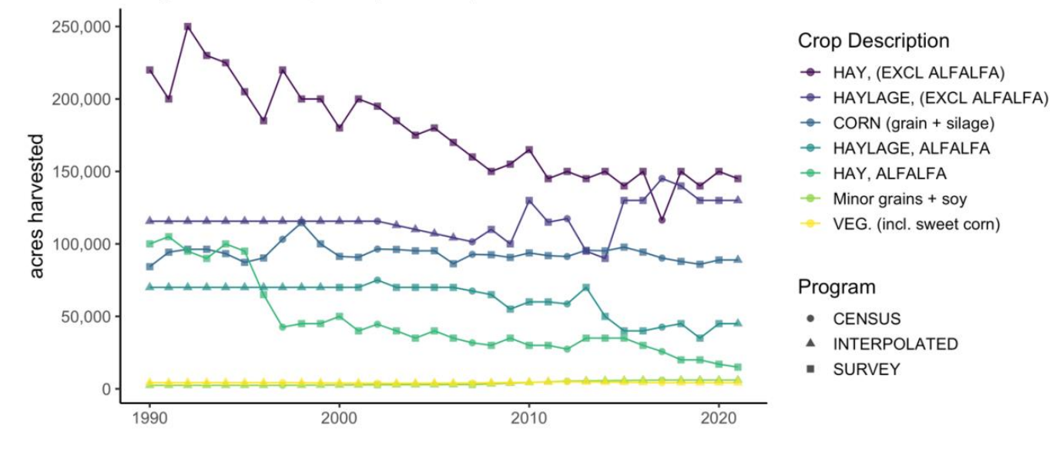
Estimated Cropland Acreage in Vermont
(USDA NASS, 2021)

Slide 29
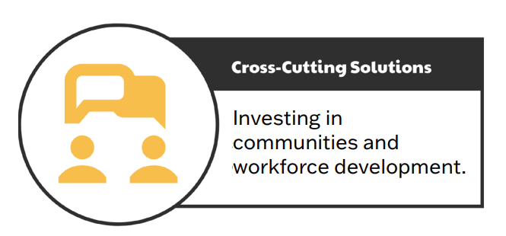

Slide 30
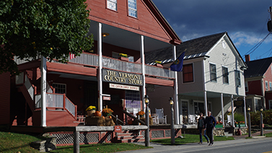
Cross-Cutting Solutions
Support compact settlement patterns
Infrastructure investments, tax incentives
Regulatory changes (Act 250, designated centers, local zoning)
No net loss of natural or working lands **
State land-use policy/plan **
Ensure state government, community and partner capacity needed to support implementation
Establish statewide environmental justice policy
Expand training and resources for workforce development
Launch comprehensive climate education programs
Encourage personal actions
** non-consensus items

Slide 31
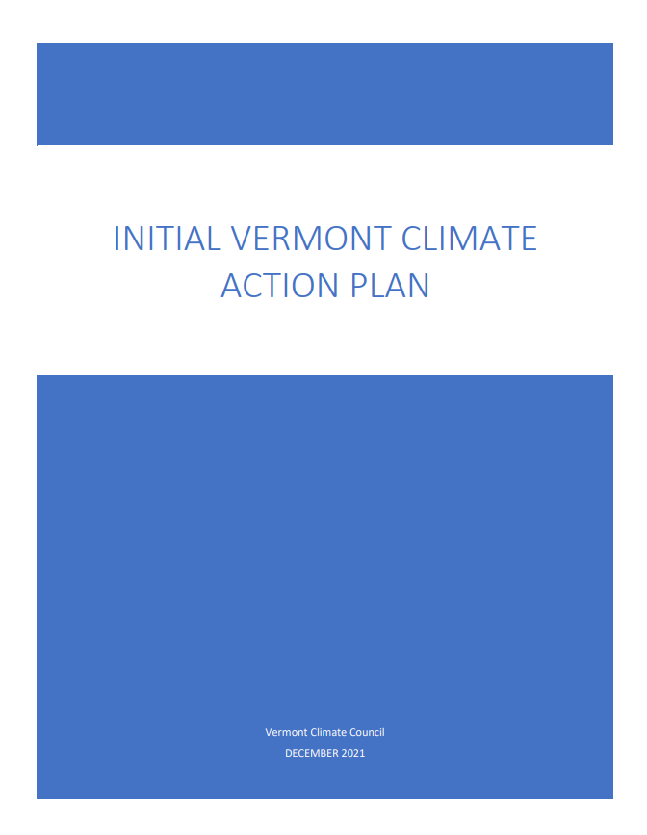
What Will You Find in the CAP?
The GWSA established a suite of ambitious goals and requirements
VCC developed a broad and far-reaching set of recommendations
Initial Climate Action Plan identifies:
26 pathways
Written broadly; high-level
64 strategies
Statements of measurable activity
234 specific action steps
Operational tasks

Slide 32
With the CAP Adopted, What Happens Now?
VCC
Develop strategies for transportation sector GHG emissions reductions
Make recommendations for utilization of ARPA funds to Legislature and the Governor
Request budget to support further technical analyses/study
Prioritize work needed to build equity into climate action and ensure a just transition
ANR
Complete Pathways Analysis
Initiate rulemaking re: CA Clean Car & Truck standards
JFO
Prepare “…an analysis of the economic, budgetary, and fiscal costs and benefits of the Plan…”
Legislature
see next slide
It is essential to extend the VCC’s commitment to co-creation of and broad-based public engagement in building out the policies and programs needed to implement the CAP

Slide 33
With the CAP Adopted, What Happens Now?
Activity largely moves back into the Legislature to:
Identify a suite of high-impact policy priorities that will support durable environmental outcomes
Weigh investments in GHG emissions reductions against the tangible steps to lessen the effects of climate change on Vermonters
Fully appropriate ARPA funds for climate action
Identify opportunities to utilize one-time monies to augment federal funds to achieve the speed and scale of implementation actions required by the GWSA
Understand additional analyses and contractor support needed to fully achieve the requirements of the GWSA, including:
Advancing improvements to the emissions inventory and carbon budget
Establishing an approach for data collection and management to track progress
Creating a municipal climate toolkit, including vulnerability index
Continuing and expanded public outreach and engagement
Ensure diverse appointments to the Council as vacancies arise, and support those appointees with just compensation

