Slide 1
Task 4: Pathways Analysis:
CAP Mitigation Pathway Results
Presentation to Vermont Climate Council
November 2, 2021
Notes:
Photo Source: https://commons.wikimedia.org/wiki/File:Spring_Field_in_Bethel,_Vermont.jpg

Slide 2
Agenda
CAP Mitigation Pathway
Sector Analysis – By Time Period
  Transportation
  Buildings
  Non-Energy
  Electricity
Economic Results – Comparison Pathways
Sensitivities
Questions and Discussion

Slide 3
Pathways Analysis
Build upon analyses completed by the State and Stockholm Environment Institute to deliver:
Task 4a: Initial Pathways Analysis (Sept. 30)
  Recommendations and Excel table:
  Sectoral, jurisdictional and existing climate initiatives
  Impact of the VCC recommended strategies on emissions reductions
  Preliminary 2025, 2030 and 2050 pathway recommendations and corresponding LEAP inputs
Task 4b: Draft and Final Pathways Report and Executive Summary (Nov. 15)
  2025 Pathway: Immediate and short-term policies, programs, and initiatives to meet reduction targets.
  2030 Pathway: Additional policies, programs, and initiatives to be advanced this decade to meet reduction targets.
  2050 Pathway: Strategic framework for additional activities necessary to achieve 2050 emissions targets.
Deliverables
50-page report, 10-page Executive Summary

Slide 4
Pathways Terminology

Slide 5
CAP Mitigation Pathway

Slide 6
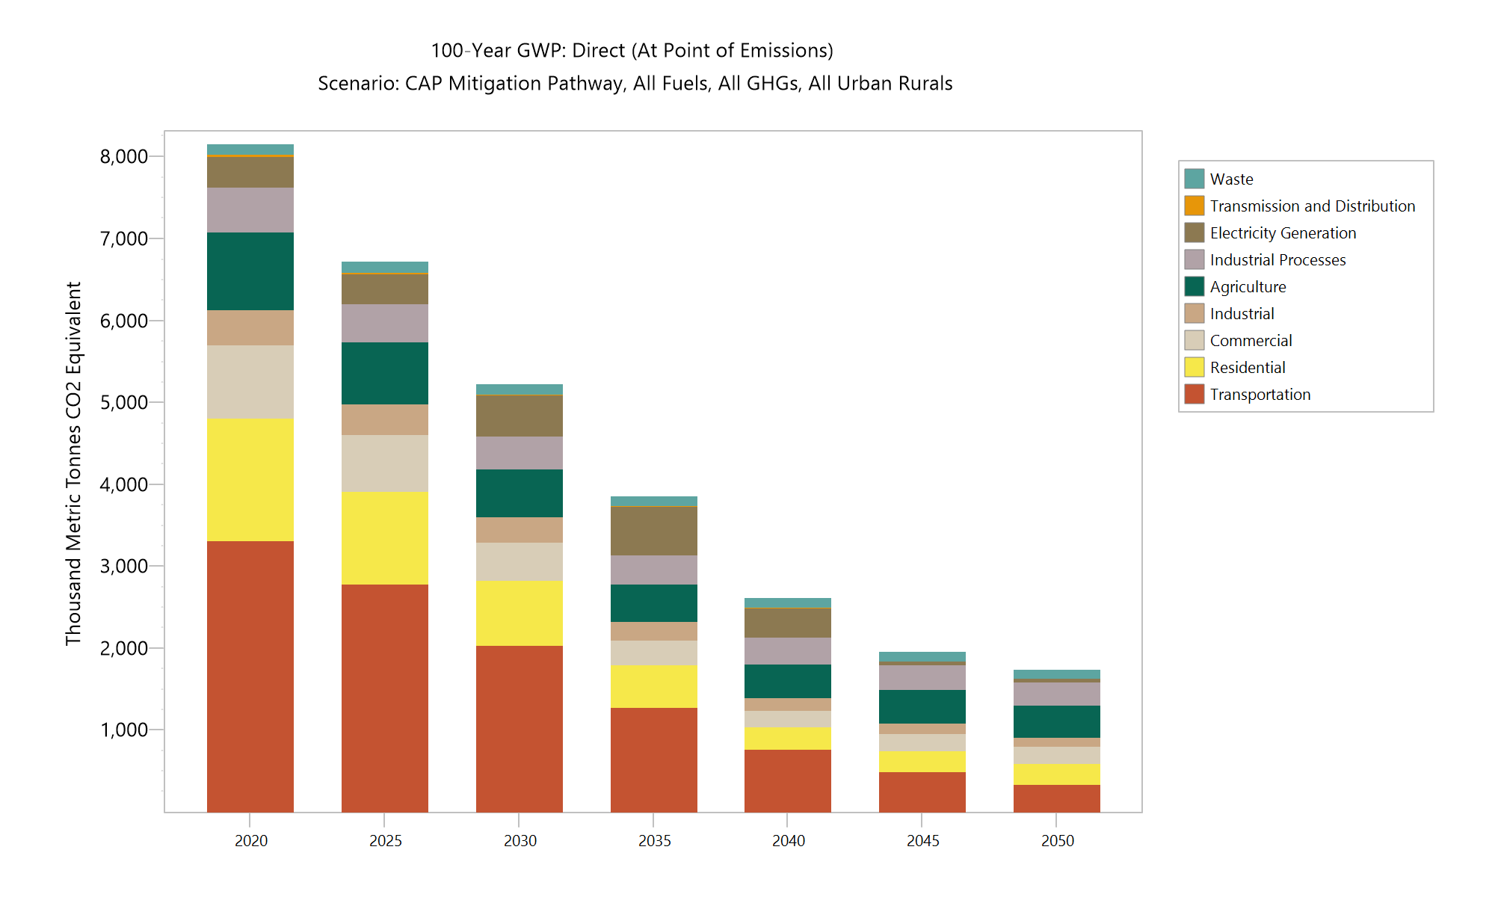
CAP Mitigation Pathway and GWSA Targets
7,380 – 2025 GWSA target
5,180 – 2030 GWSA target
1,730 – 2050 GWSA target

Slide 7
Sector Modeling
Transportation

Slide 8
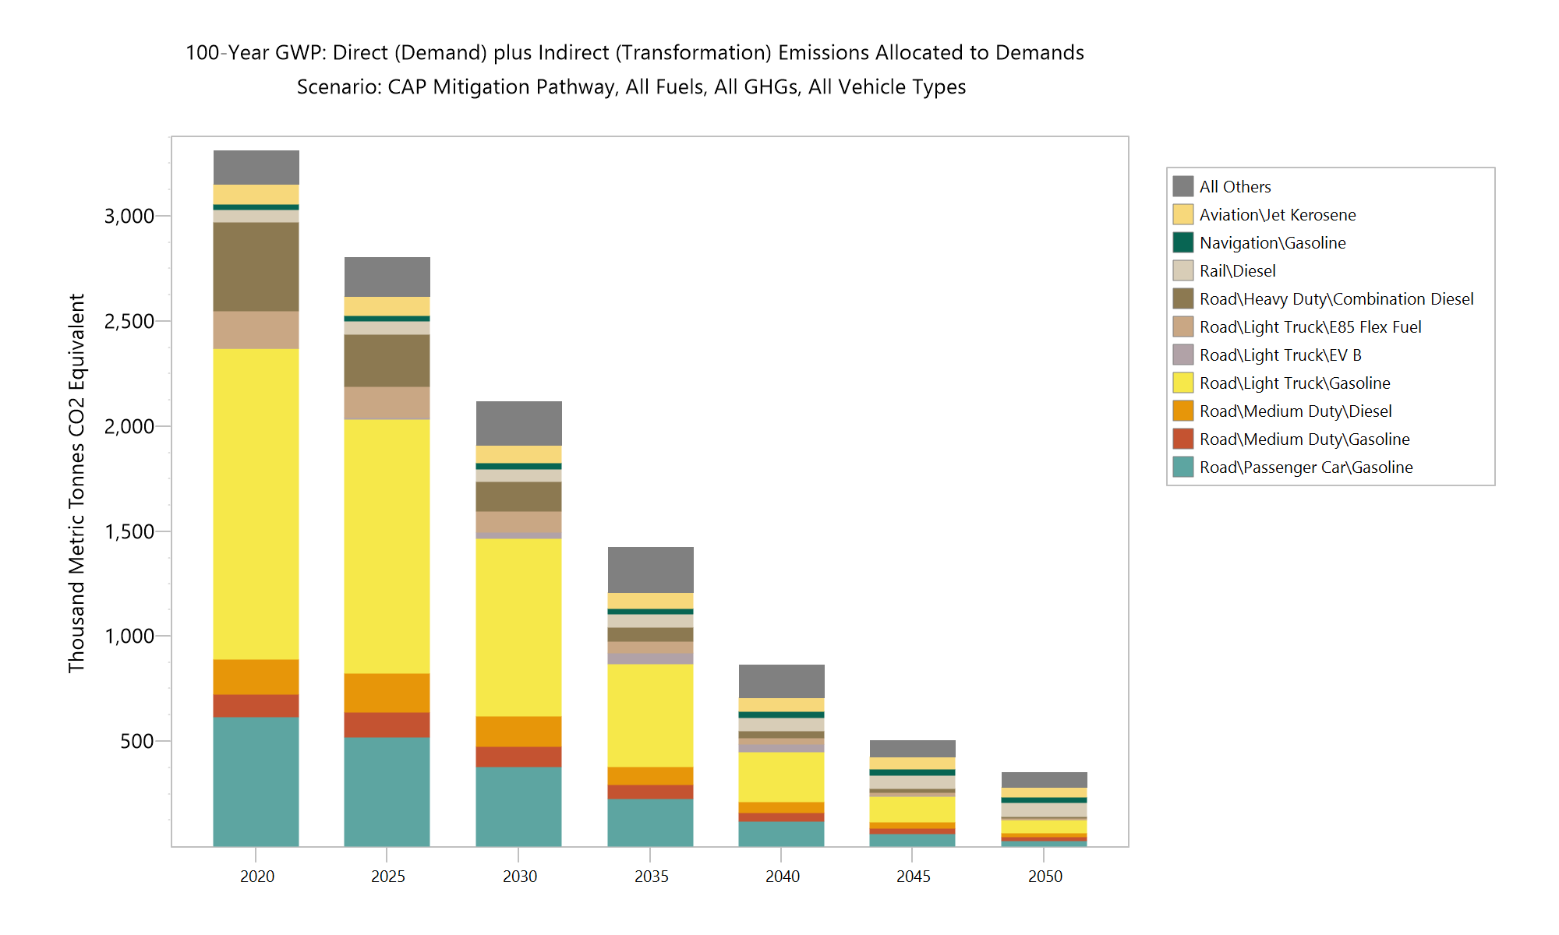
Transport Sector – CAP Mitigation Pathway
Sector Emission Reductions:
15% by 2025
36% by 2030
89% by 2050
Primarily from Electric Vehicles
Increased efficiency
Cleaner fuel
Other contributors
Biofuels
VMT reductions

Slide 9
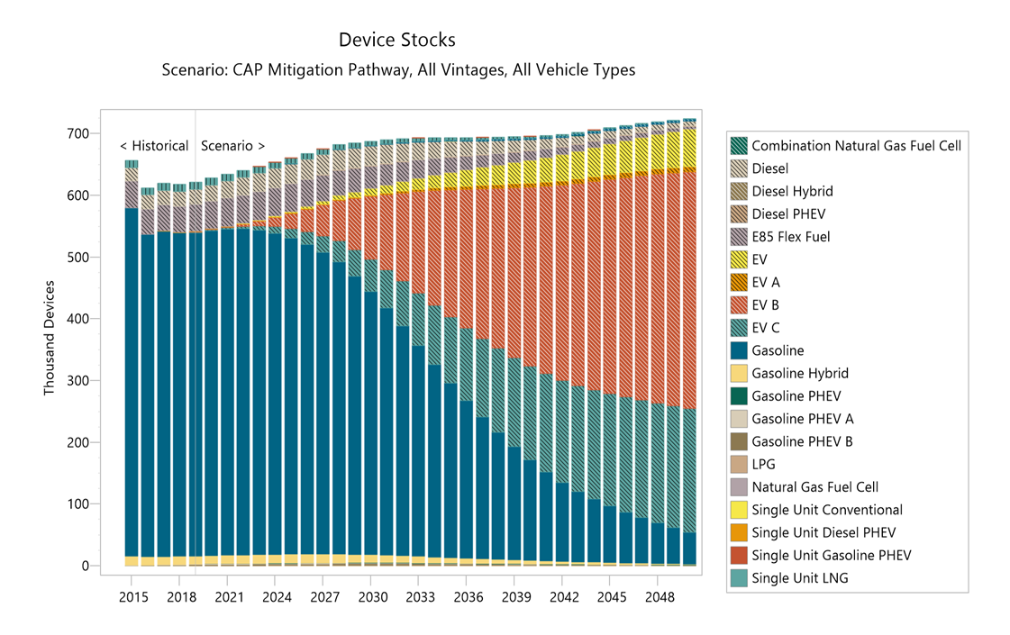
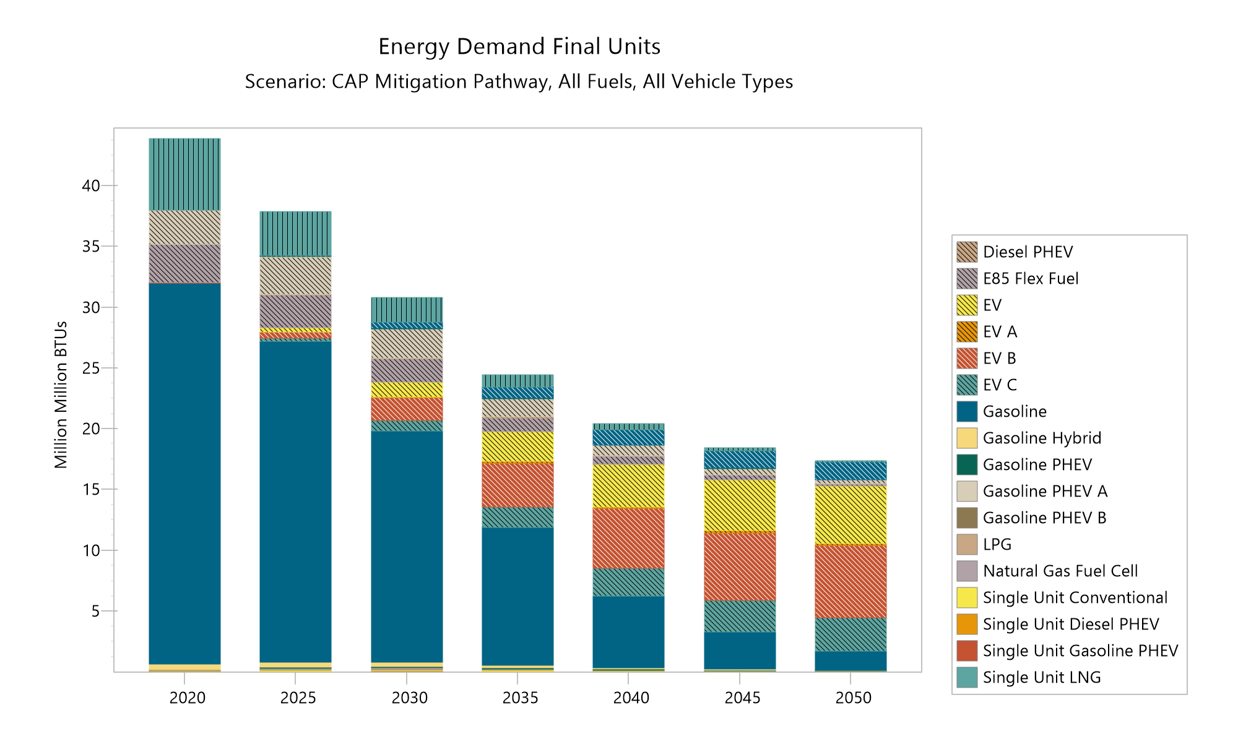
Transport Sector – CAP Mitigation Pathway
Notes:
160,000 Evs by 2030.

Slide 10
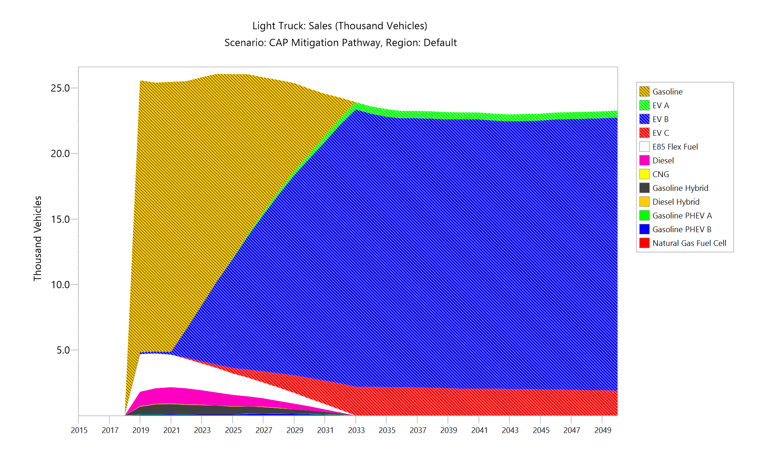
Transport Sector – CAP Mitigation Pathway
By 2025:
43,400 EVs, increase of more than 39,000 over today.
By 2025 EVs are almost 40% share of light duty vehicle sales.
All major automakers have invested in EV technology and are expected to release additional EV models in the next three years, including new electric pickup trucks and sports utility vehicles, which are currently under-represented in the vehicle market.
Precedes California Advanced Clean Cars II – which would require manufacturers to deliver increasing share of Light Duty Evs in 2026, ramping up to 100% in 2035.
Notes:
160,000 Evs by 2030.

Slide 11
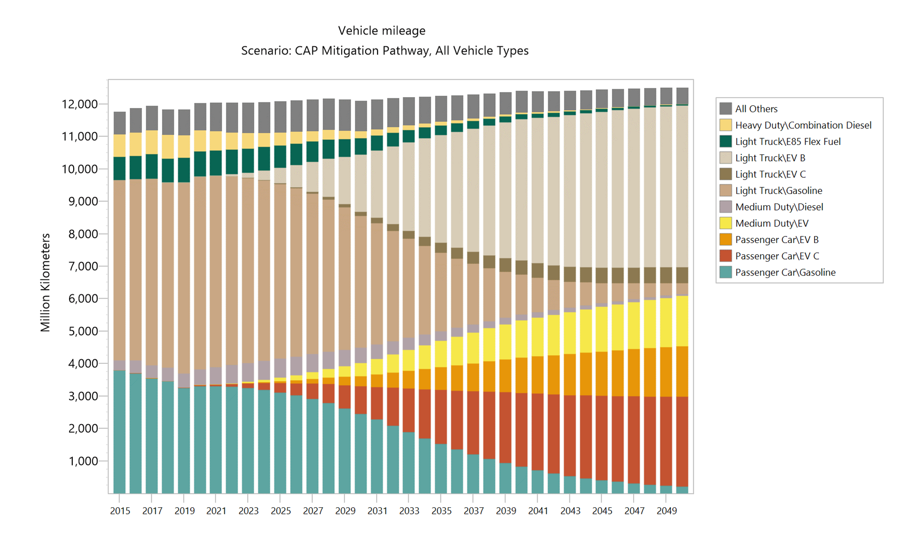
Transport Sector – CAP Mitigation Pathway
By 2030:
166,000 EVs, almost 4x greater than baseline projection of 43,000.
By 2030 EVs account for 29% of vehicle miles travelled.
Vehicle mile demand management initiatives result in 3.5% reduction in vehicle miles travelled compared to baseline.
50% of EV charging is managed to reduce peak impacts.
Sales of new ICE vehicles phased out by 2033.
Notes:
160,000 Evs by 2030.

Slide 12
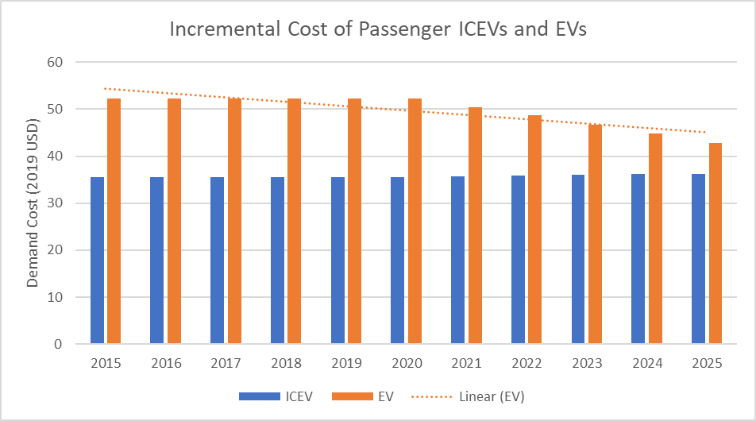
Transport Sector – CAP Mitigation Pathway
By 2025 and 2030:
Shift in the technologies and markets is underway and revolutionary.
Incentives and extensive public messaging and promotion to support rapid adoption.
Particular attention to equity and reducing transportation energy burden.
Participation with regional and national initiatives necessary but not likely sufficient.
Initiatives to include managed charging and smart rate designs.
Revenue options include Transportation Climate Initiative and Federal funds.
All said and done, required pace of change is daunting – but essential component of meeting the Climate Imperative Challenge.
Notes:
160,000 Evs by 2030.

Slide 13
Transport: Pathway Key Policies, Strategies & Actions
Supporting the CAP Mitigation Pathway:
Transportation Climate Initiative, and associated initiatives such as:
Replace your Ride
Transit
Smart growth and other Transportation Demand Management, and
Feebates
Managed Charging
Source TCI-P updates program webinar, March 2021

Slide 14
Sector Modeling
Buildings

Slide 15
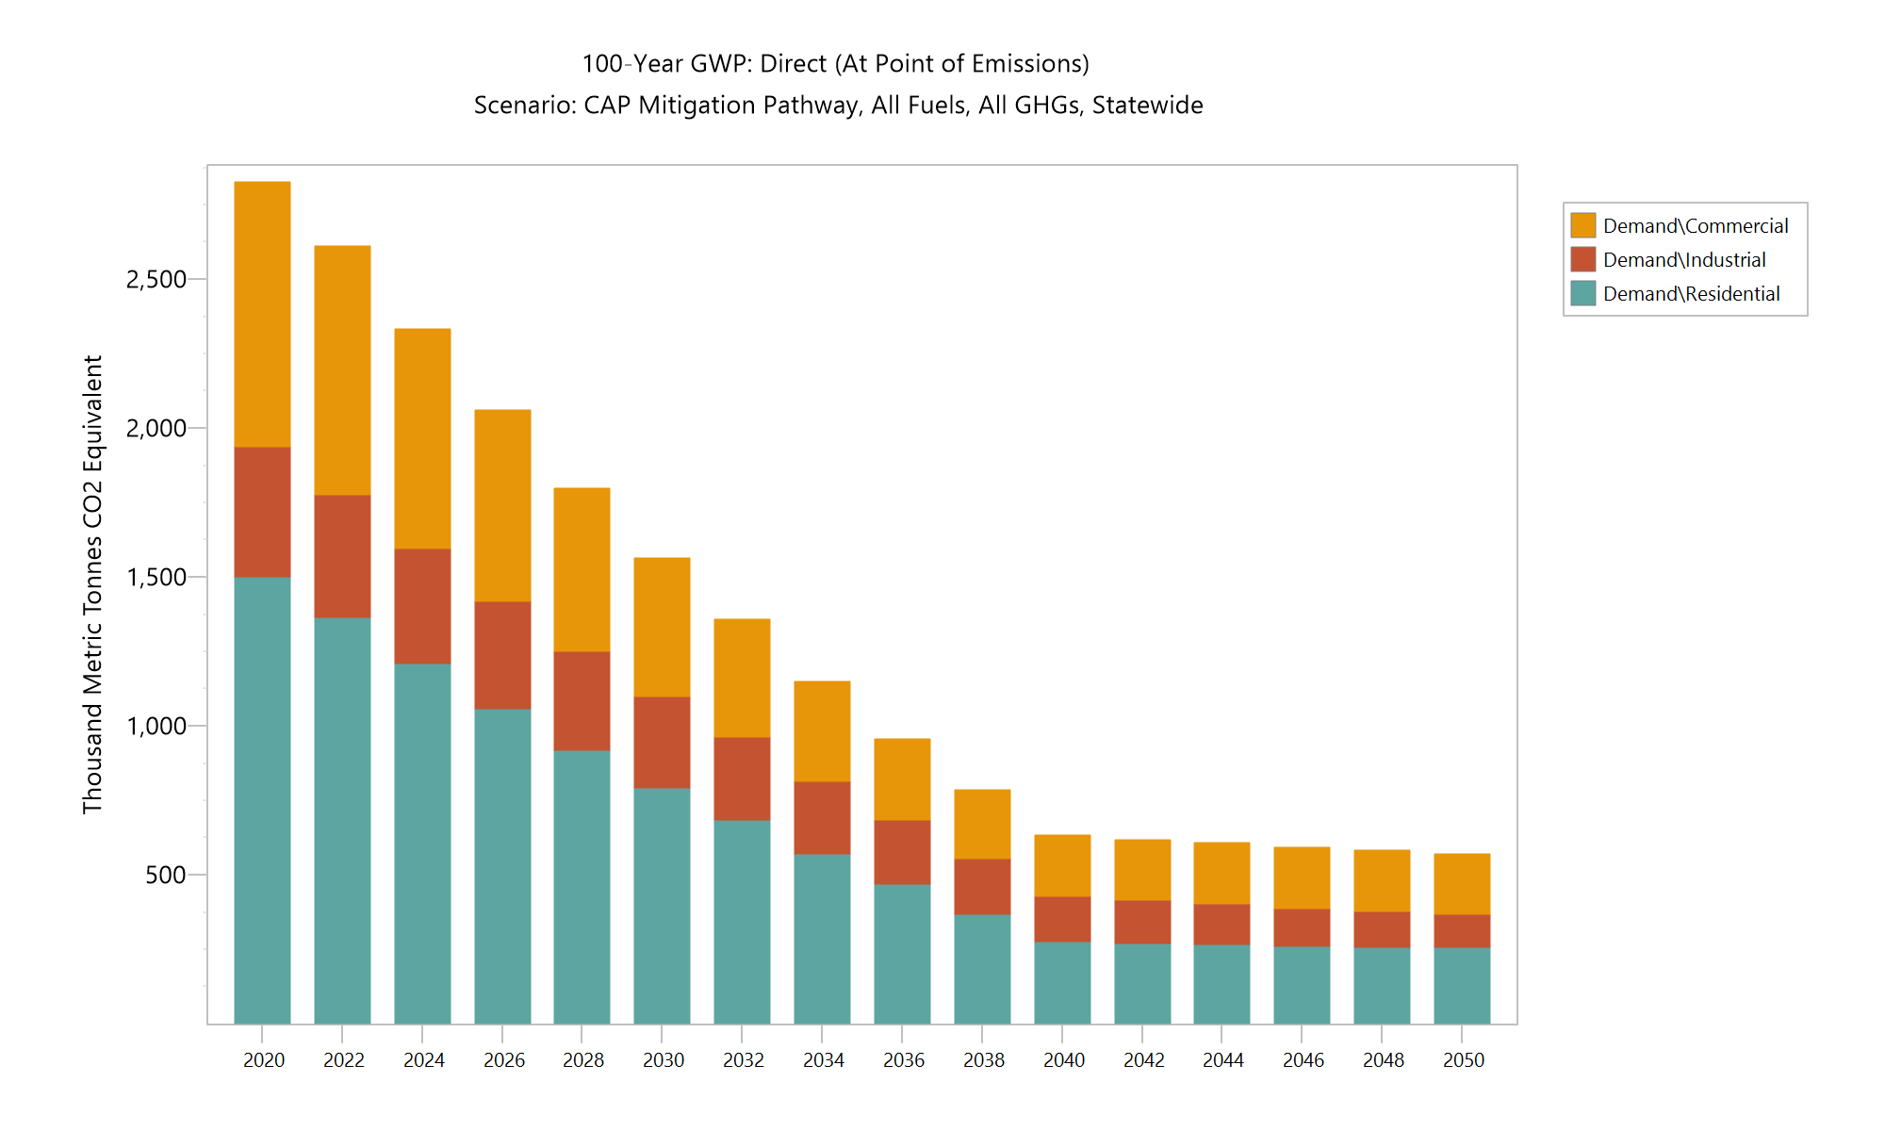
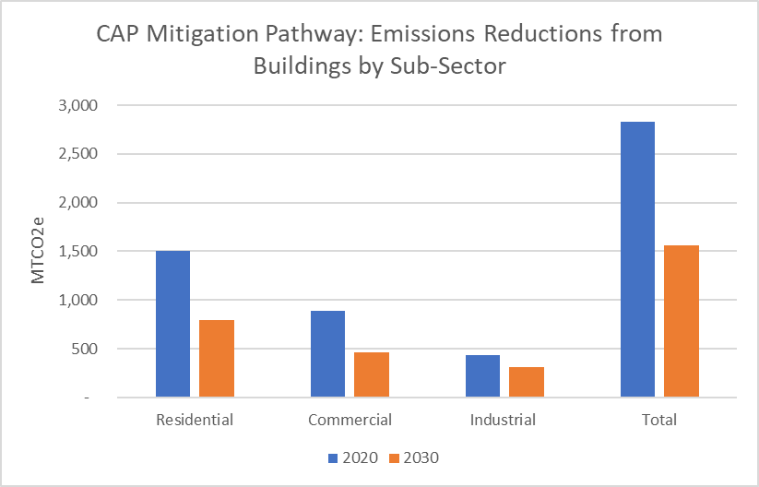
Buildings Sector – CAP Mitigation Pathway
Emissions reductions from 2020 to 2030 45%, and by 2050 80%.
~55% from residential, 33% Commercial, 12% Industrial

Slide 16
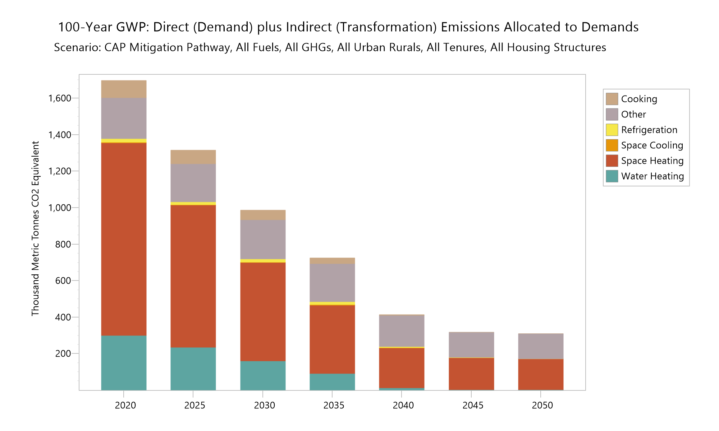
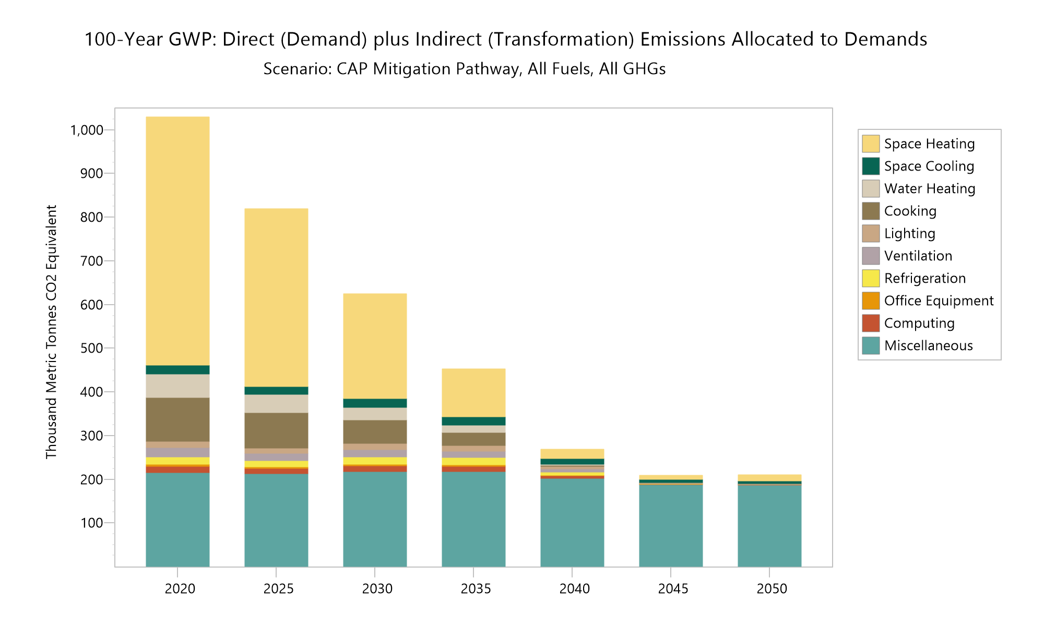
Buildings Sector – CAP Mitigation Pathway
Residential, primarily space heating
Heat pumps, shell efficiency.
Phase out of fossil cooking and water heating
Blended heating oil and increased RNG blending
Commercial, primarily space heating
Heat pumps, phase out of water and cooking fossil
Blended heating oil and increased RNG blending

Slide 17
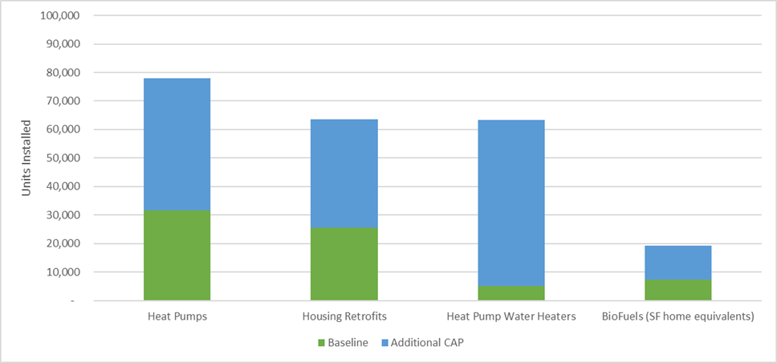
Residential Buildings CAP Mitigation Pathway
By 2025:
Nearly 80,000 heat pumps, almost 50,000 above baseline.
More than 60,000 heat pump water heaters.
More than 60,000 Weatherized units - more than 2x baseline.
1.9 Trillion Btu’s of biofuels, equivalent to meeting the needs of almost 20,000 average single-family units.

Slide 18
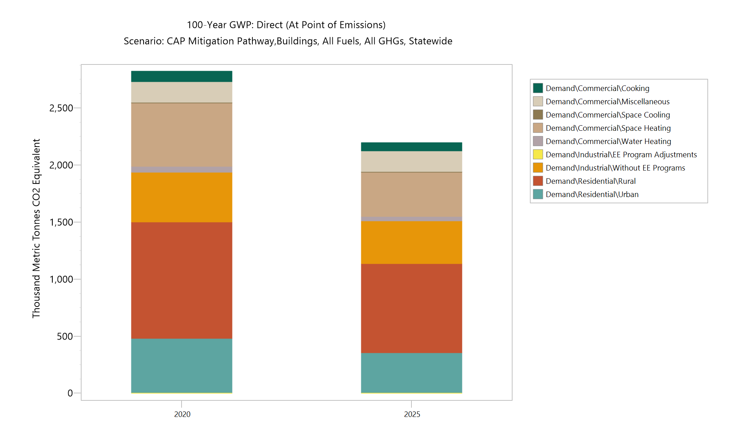
Buildings CAP Mitigation Pathway
By 2025:
Support income qualified heat pumps and weatherization.
Heat pumps gaining rapid market share, more than 11,000 in 2020, but continued rapid adoption required.
Workforce development essential to scale activity in building sector – wages and training.
Coaching and financing important supports.

Slide 19
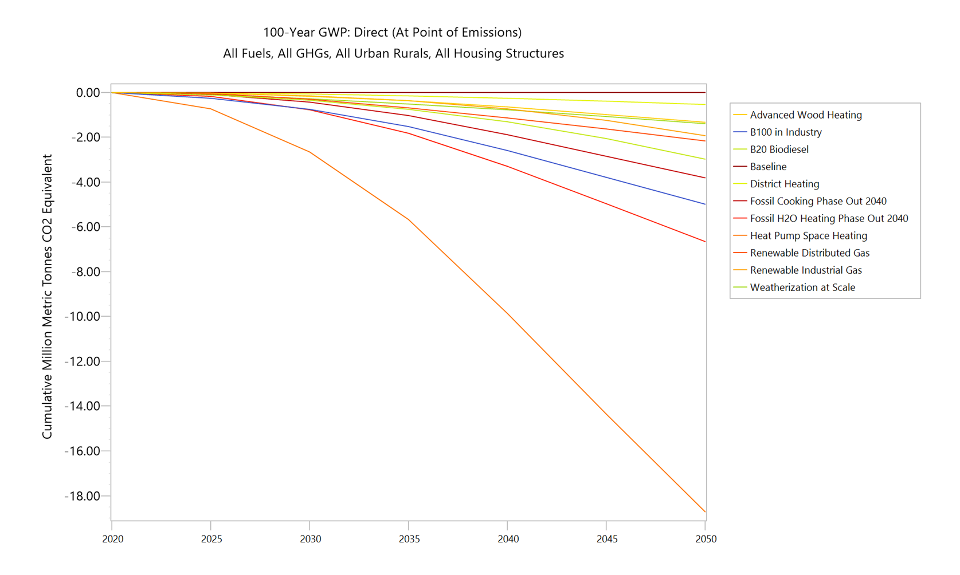
Buildings CAP Mitigation Pathway
By 2030:
More than 142,000 residential heat pumps – an increase of 84,000 above baseline.
Phasing out of water heating and cooking underway.
Weatherization of 120,000 units.
Biofuels increasing contribution to reductions.
Cumulative Emissions Reduction by Element
Compared to Baseline

Slide 20
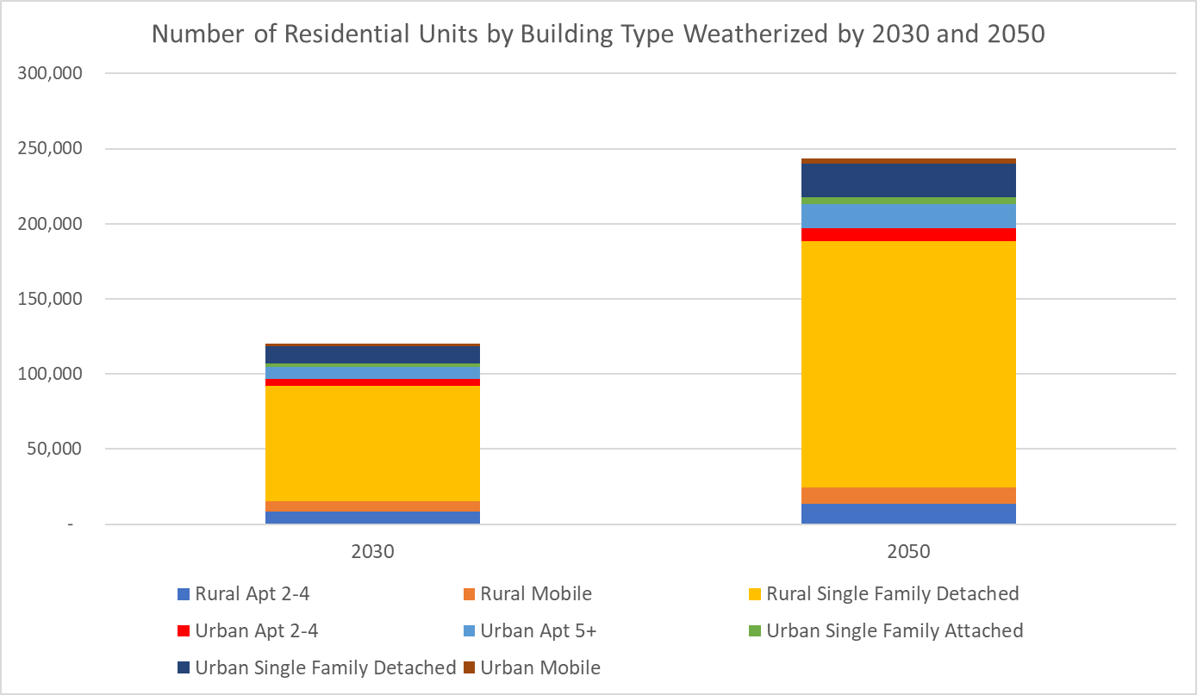
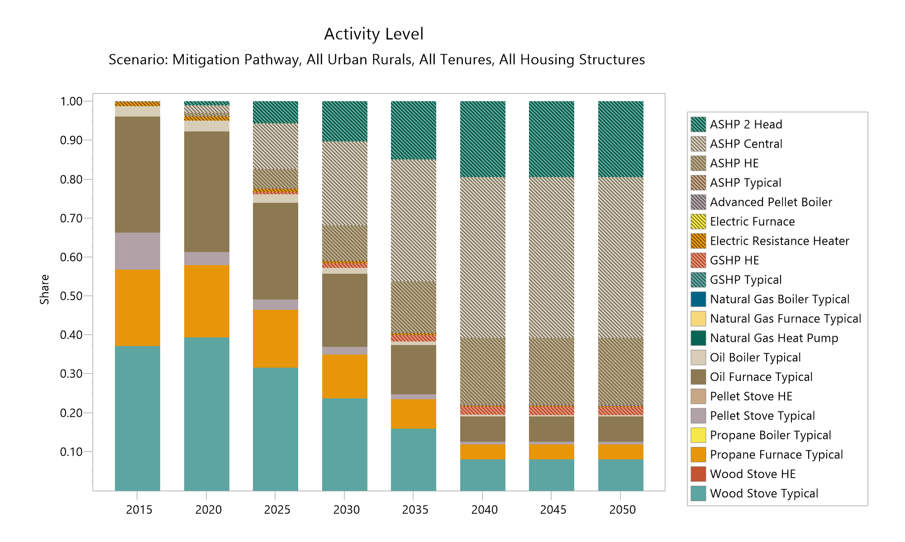
Residential Buildings Weatherization and Heat Pumps – CAP Mitigation Pathway

Slide 21
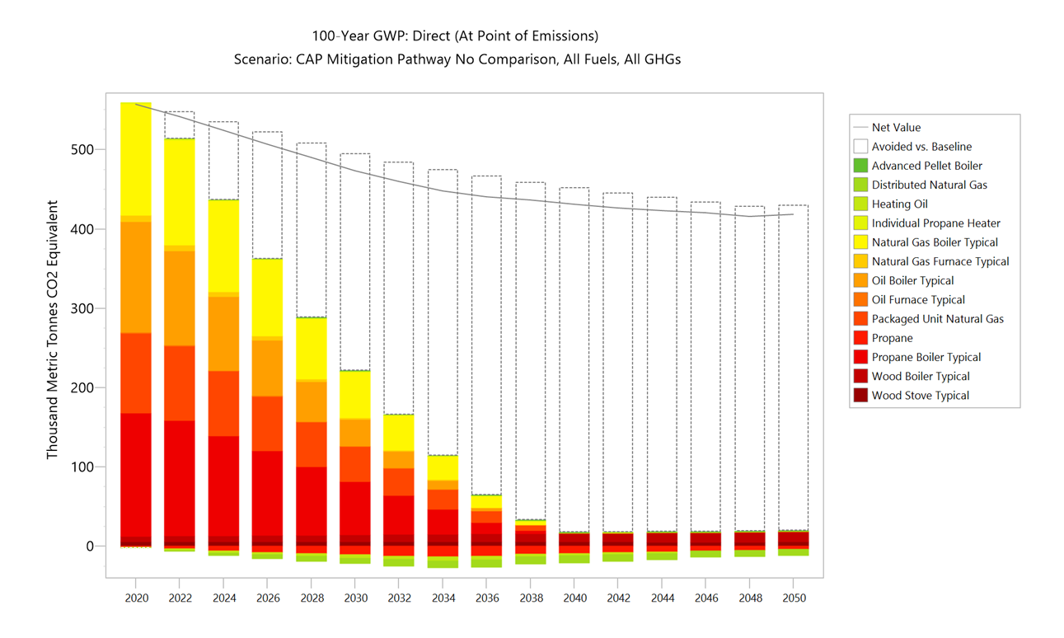
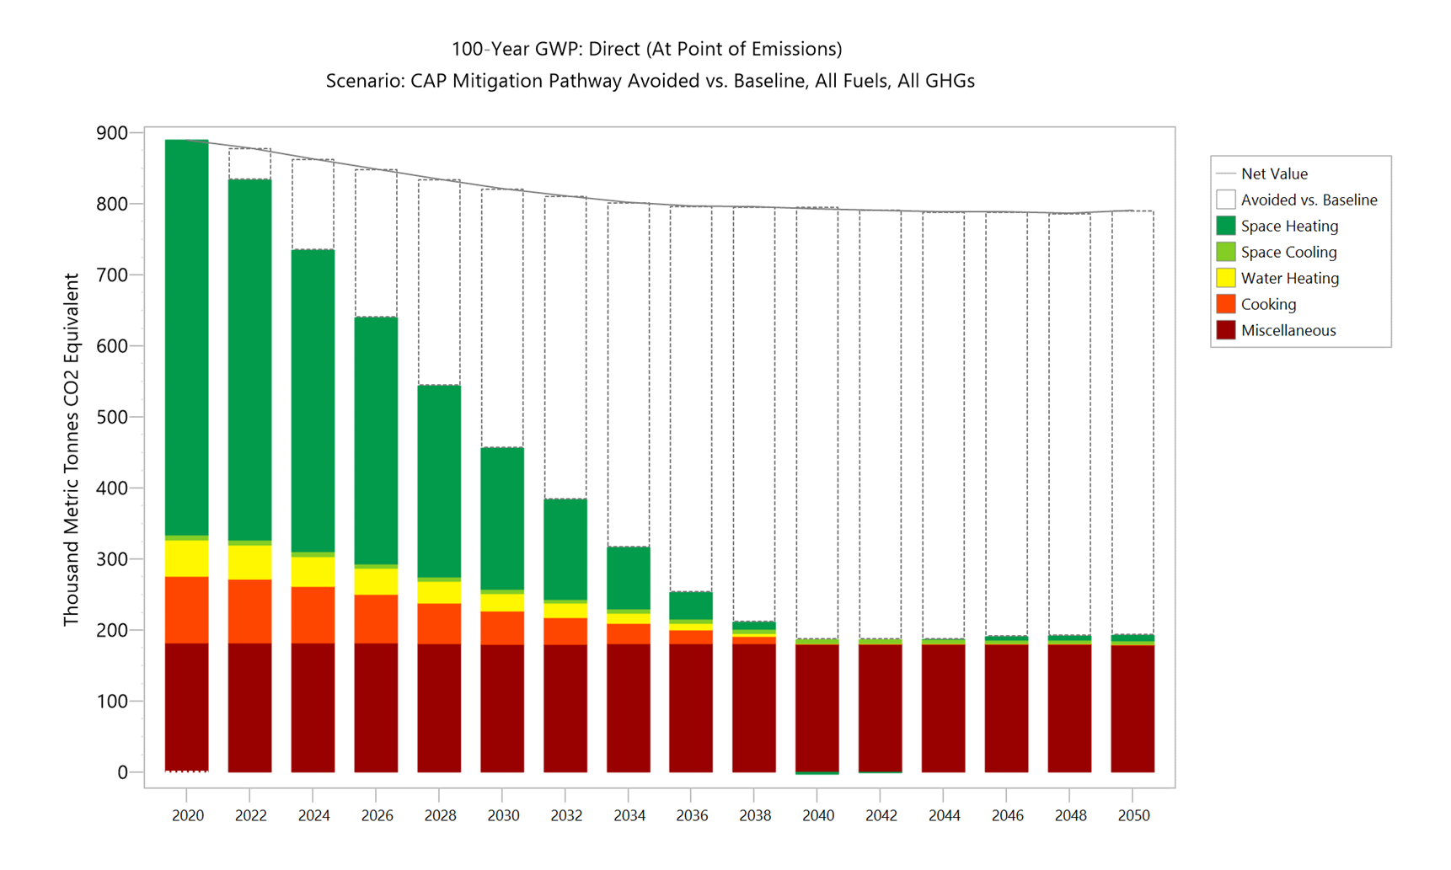
Commercial Buildings CAP Mitigation Pathway
Commercial Emissions by End Use
Commercial Emissions by Heating System Type

Slide 22
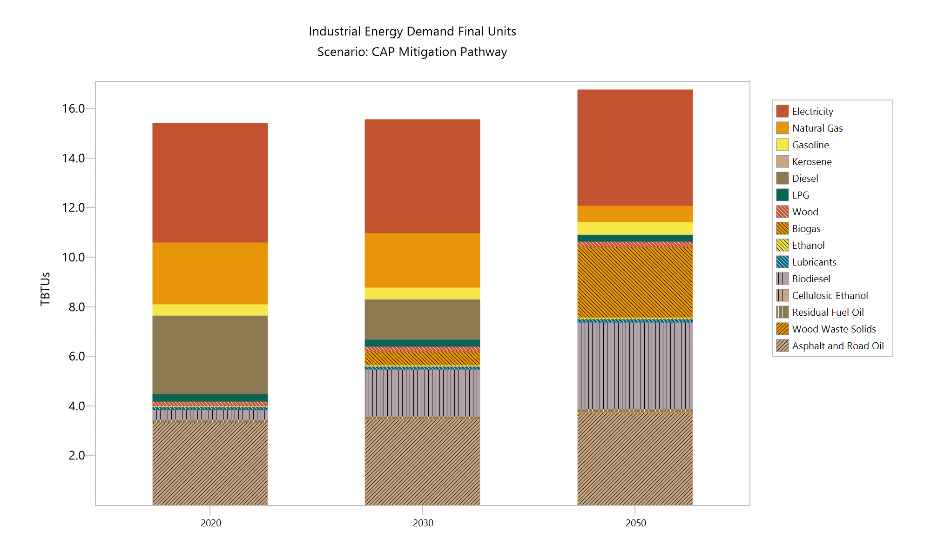
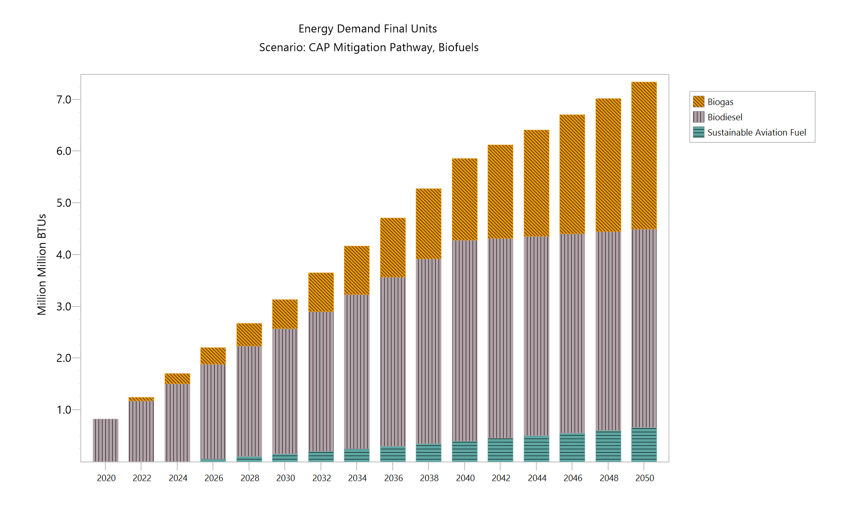
Industry CAP Mitigation Pathway
Industry Final Energy Demand
Biogas and Biodiesel All Sectors

Slide 23
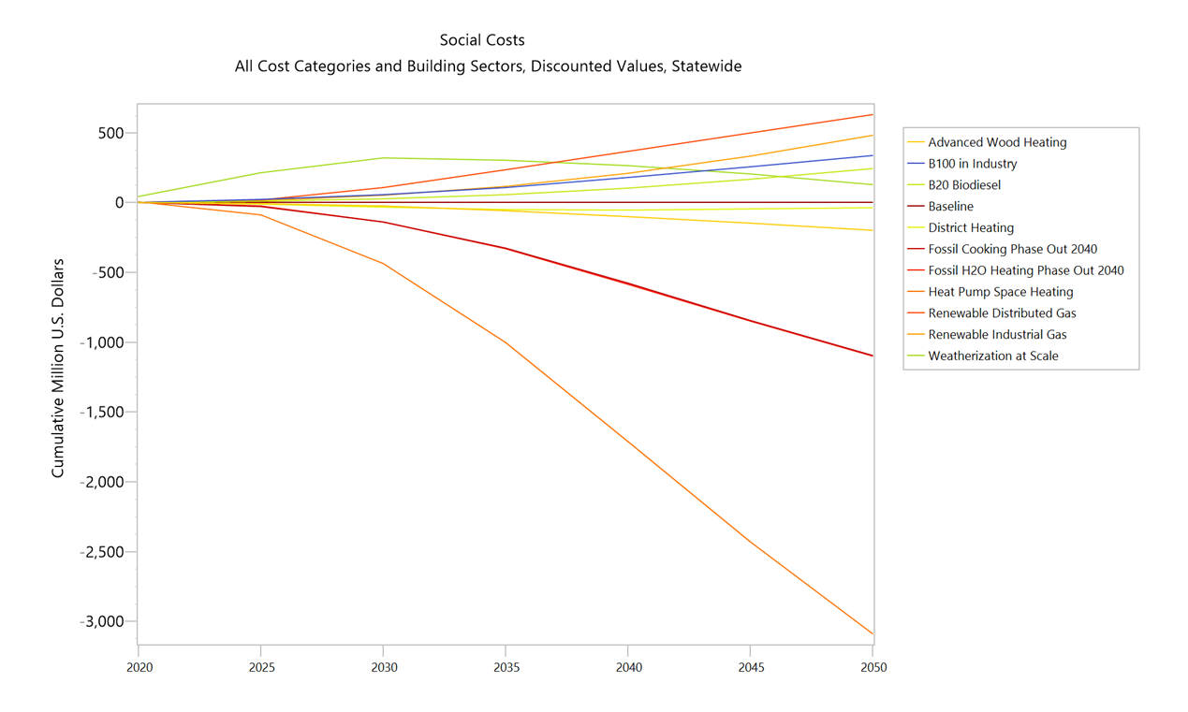
Buildings CAP Mitigation Pathway
By 2050:
Modernized building infrastructure.
Electrified end uses
Grid interactive and connected buildings to coordinate multiple loads across multiple sites.
Storage for resilience.
Reduced energy burdens for buildings.
Greater on-site generation.
Discounted Social Costs by Element
Compared to Baseline

Slide 24
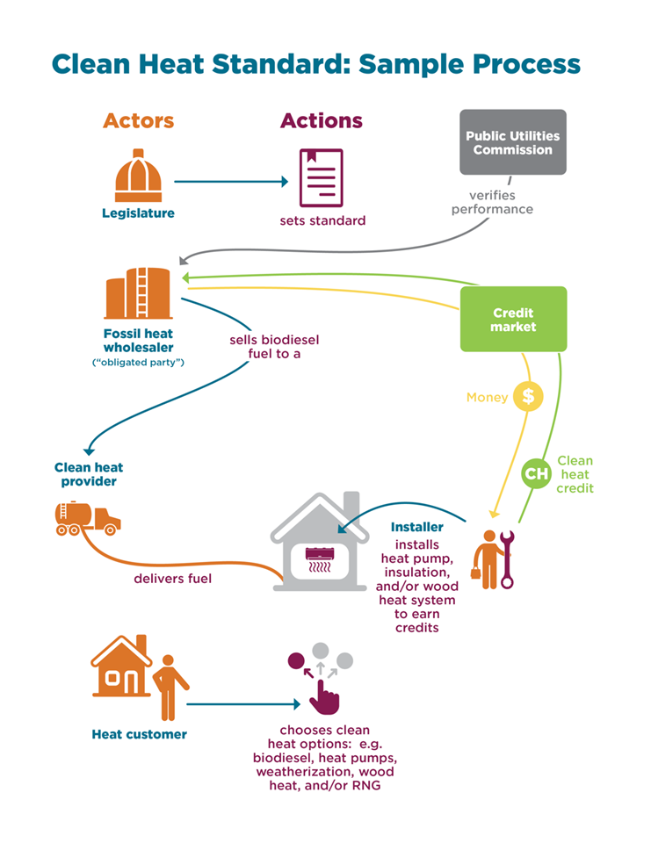
CAP Mitigation Pathway Buildings: Key Policies, Strategies & Actions
CAP Mitigation Pathway supported by:
Clean Heat Standard,
Rental Efficiency Initiative,
Weatherization at scale,
Fossil cooking and water heating phase out,
Net zero new construction standards for residential and commercial,
Increased demand response and coordinated load management

Slide 25
Sector Modeling
Non-Energy

Slide 26
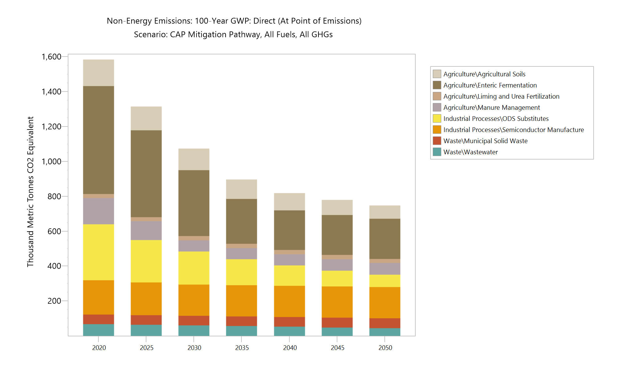
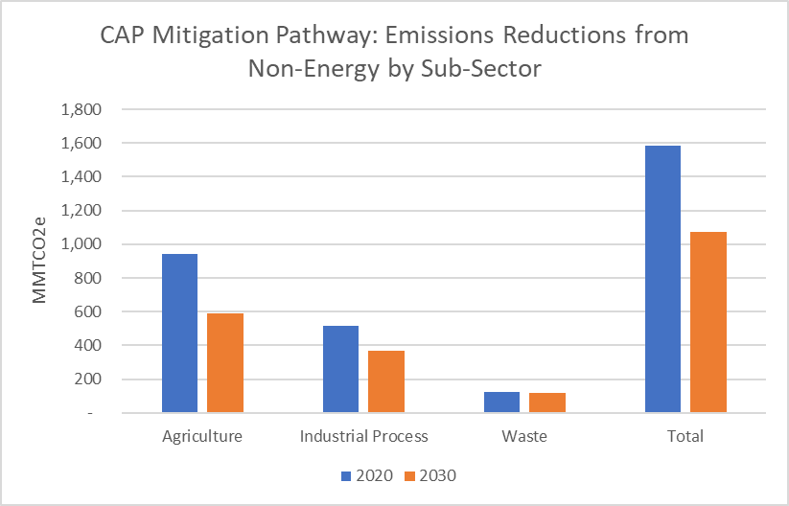
Non-Energy Sector – CAP Mitigation Pathway
Emissions reductions from 2020 to 2030 32%, and by 2050 53%.
~2/3rds of the reductions are from Agriculture, 1/3rd Industrial Processes

Slide 27
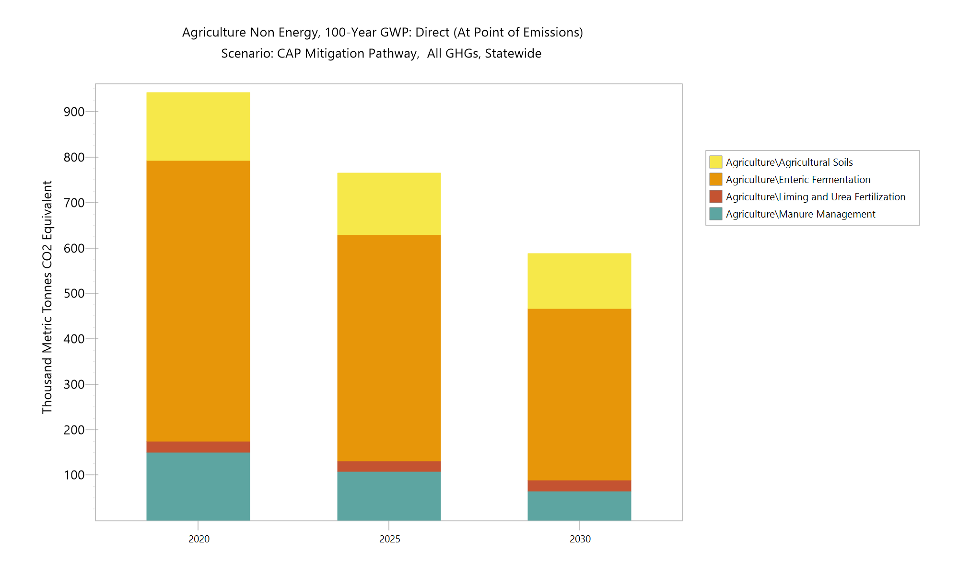
CAP Mitigation Non-Energy Agriculture
By 2030:
  Adoption of alternative feed practices to reduce emissions from enteric fermentation.
  Adoption of manure management practices.
  Increased sequestration by agricultural soils.
  Value of reduced emissions of 350,000 Metric Tonnes CO2e by 2030 has social cost of carbon value of more than $40 million.
  Increased research on feasibility, adoption and impacts all required.

Slide 28
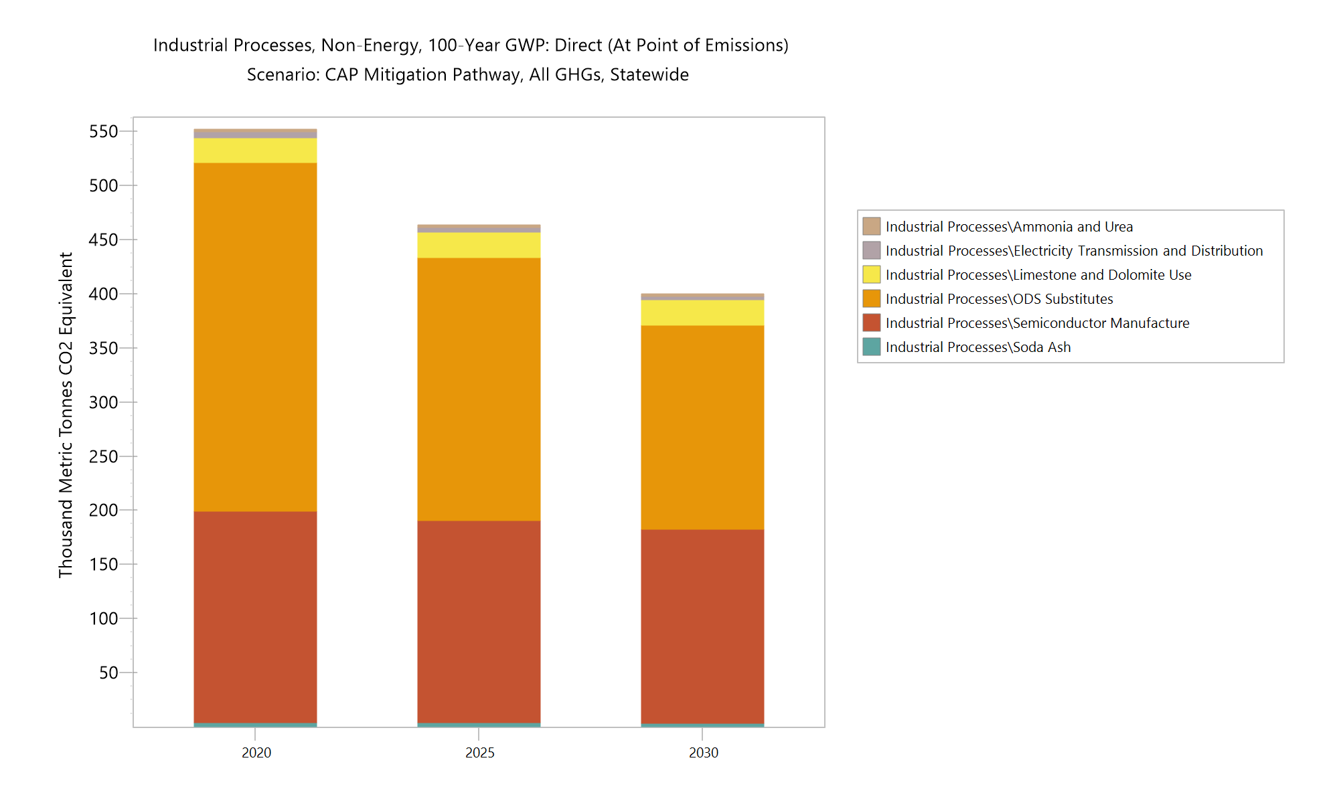
CAP Mitigation Non-Energy Industrial Processes
By 2030:
  The reduction in emissions from ODS substitutes are in line with Vermont’s Hydrofluorocarbons (HFC) Rule, which mandates a phase down of the use of HFCs to meet the goal of a 40% reduction from the 2013 level of use by 2030.
  Federal initiative to phase down HFC production and consumption by 85% over next 15 years.
  Refrigerant management, leak reduction and alternative refrigerants
  Modest (8% by 2030) reduction for semi-conductor manufacturing based on historic trend.

Slide 29
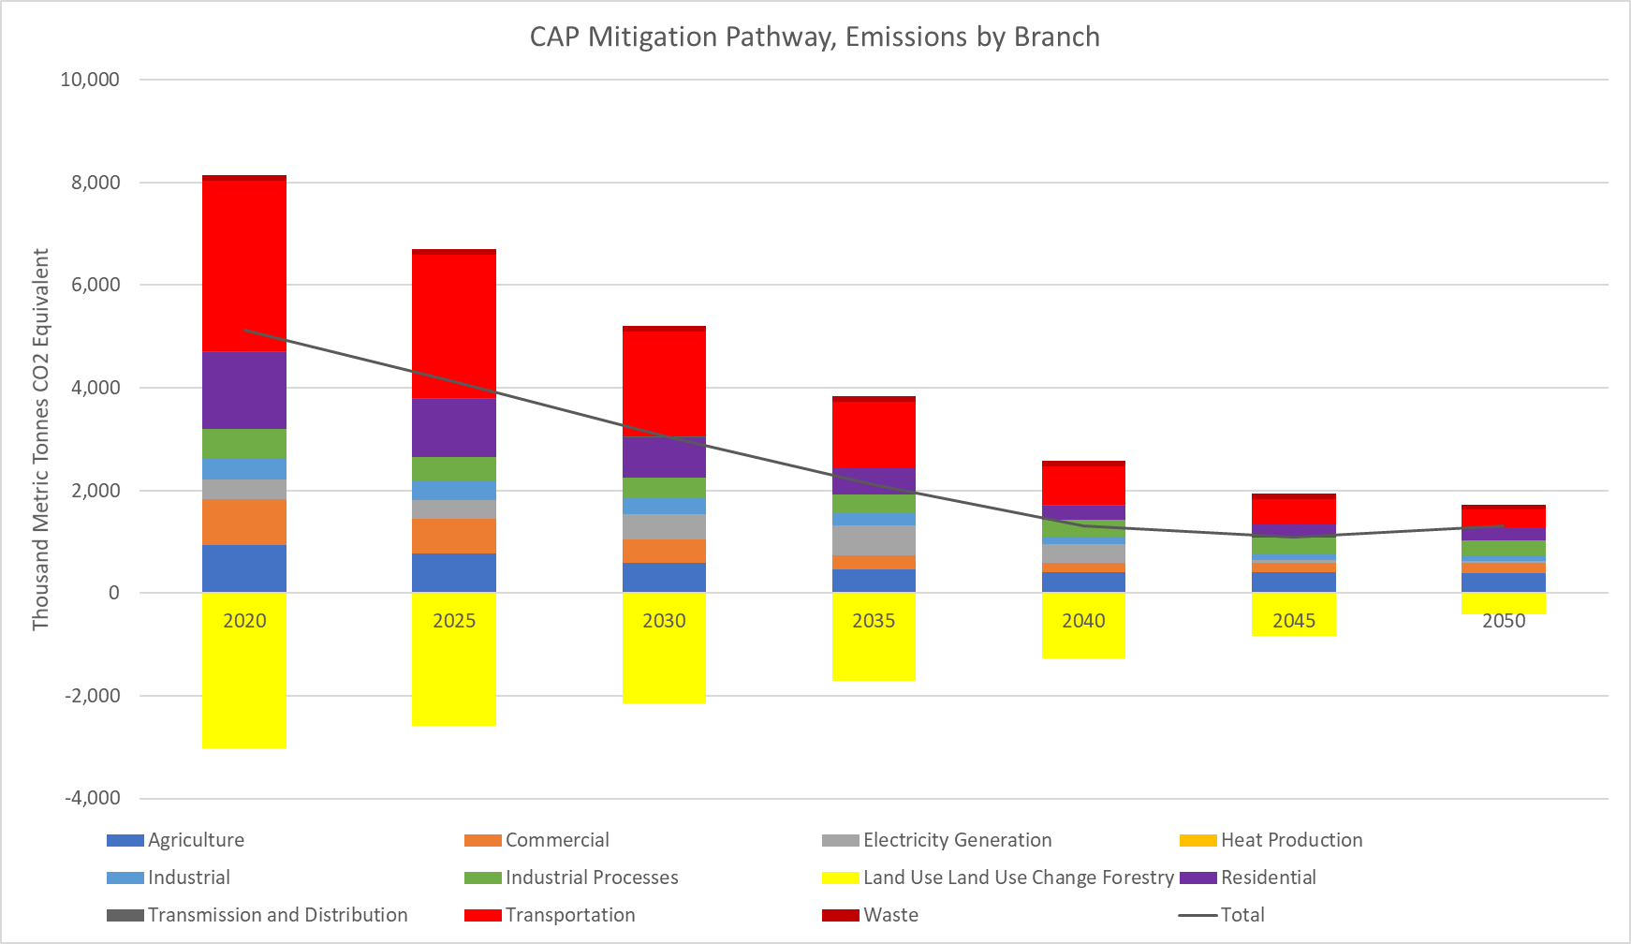
CAP Mitigation Non-Energy 2050 Net Zero
By 2050:
  Sequestration from Land Use Change and Forests is estimated based on Cadmus Team/UVM Carbon Budget Report
  Lower starting level of sequestration based on Carbon Budget Research.
  Steady linear decline in sequestration based on historic trends
  Necessary to reduce loss of sequestration and maintain at or above projected 2035 level to attain net zero target.
  Natural and Working Lands Need Focus to Meet Net Zero!

Slide 30

Non-Energy Pathway Key Policies, Strategies & Actions
CAP Mitigation Pathway reflects new findings from the Carbon Budget Report.
CAP Mitigation Pathway supported by:
Practices to reduce enteric fermentation emissions,
Manure management initiative,
Practices to increase soil carbon sequestration,
ODS substitutes including refrigerant management,
Target reductions for semi-conductor manufacturing
Research and actions to maintain sequestration to achieve net zero in 2050.

Slide 31
Sector Modeling
Electricity

Slide 32
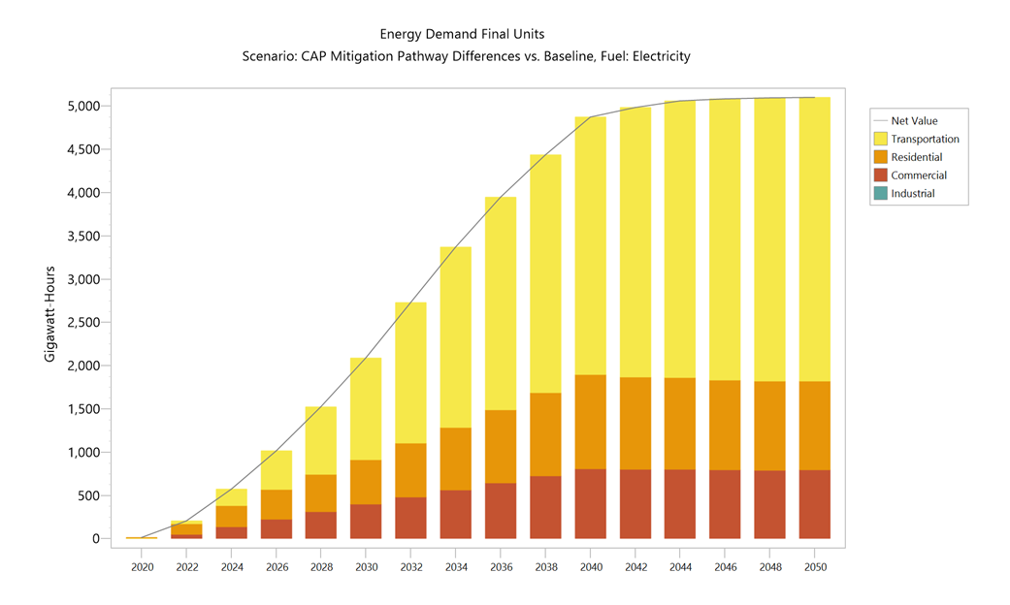
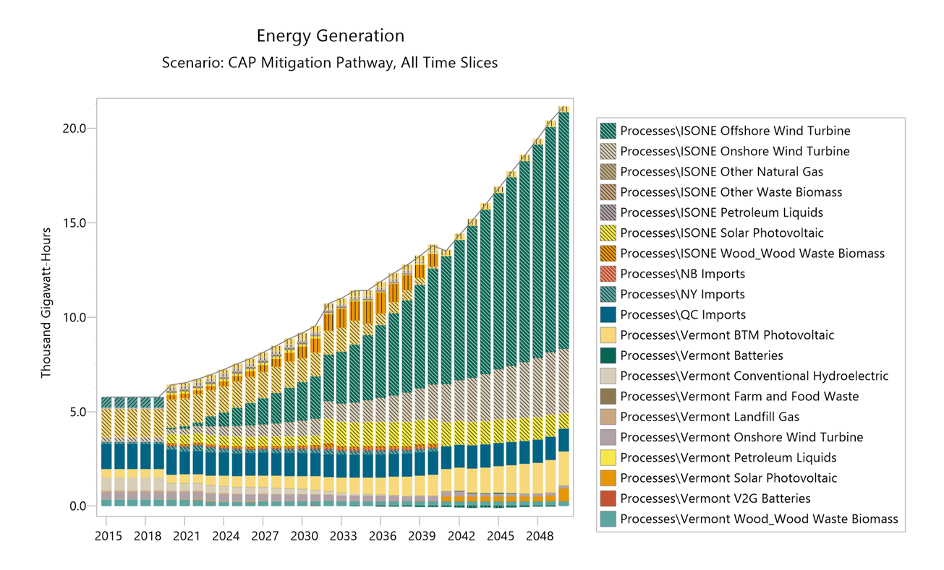
Electricity Sector – CAP Mitigation Pathway
Significant increase in electricity demand to meet the electrification demands from transportation and buildings.
Electric Generation mix continues trend toward renewables, and 100% Renewable Energy Standard by 2050.
Load management, flexible and coordinated loads and storage all key strategies.

Slide 33
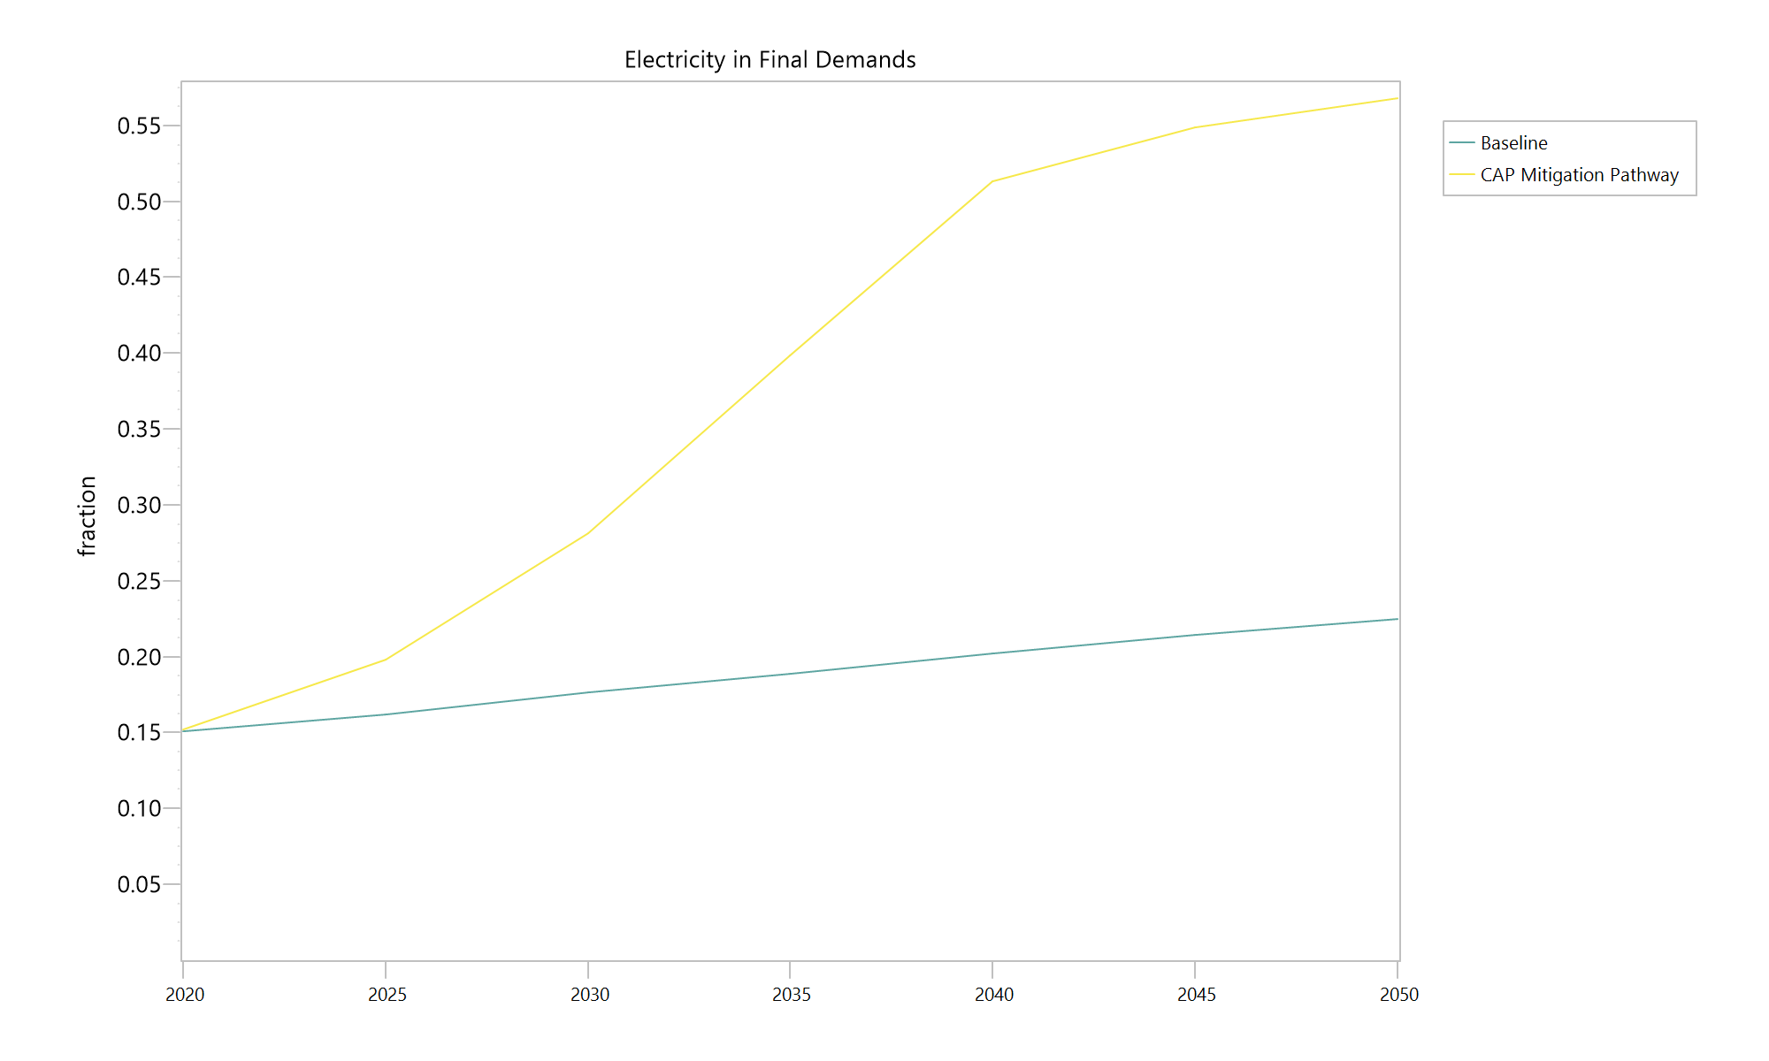
Electricity Sector – CAP Mitigation Pathway
By 2025:
Increase of electric demand over baseline of 796,000 MWh.
Electricity meeting 20% of final demands by 2025, reaching more than 55% by 2050
Potential upgrades to serve close to 80,000 heat pumps, 60,000 heat pump water heaters, and more than 40,000 EVs.
Equity and access to electrification for all.
Continued growth of customer sited solar, 600 GWh by 2025.

Slide 34
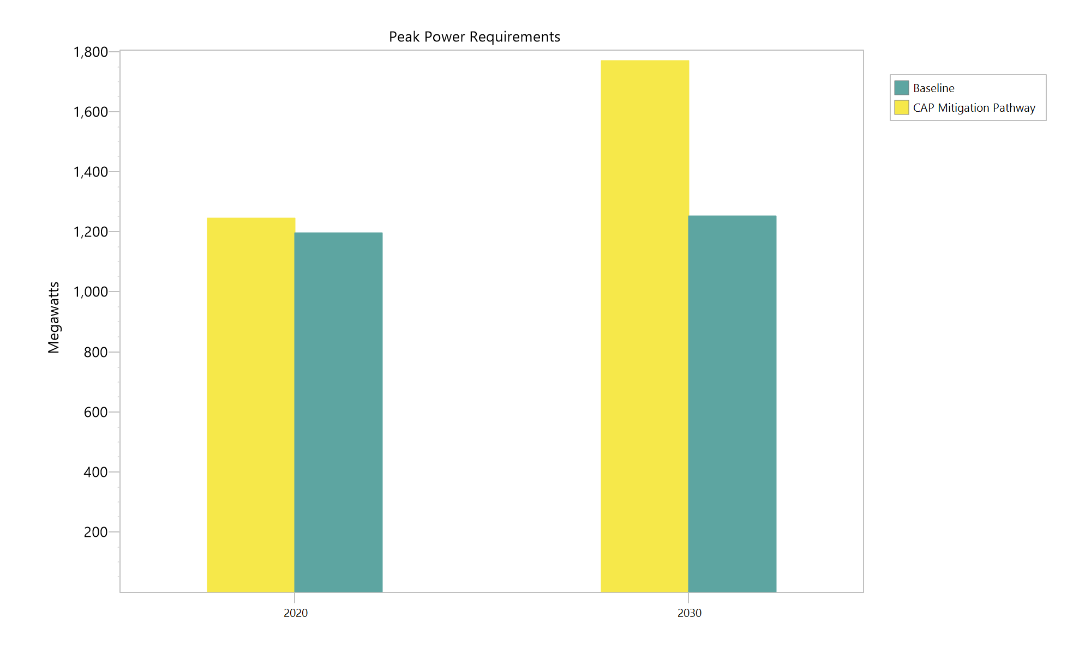
Electricity CAP Mitigation Pathway
By 2030:
Peak power requirements increase by more than 40% over baseline.
Offshore wind providing more than 2,000 GWh, Onshore wind 1,200 GWh.
50% of EV charging is managed.

Slide 35
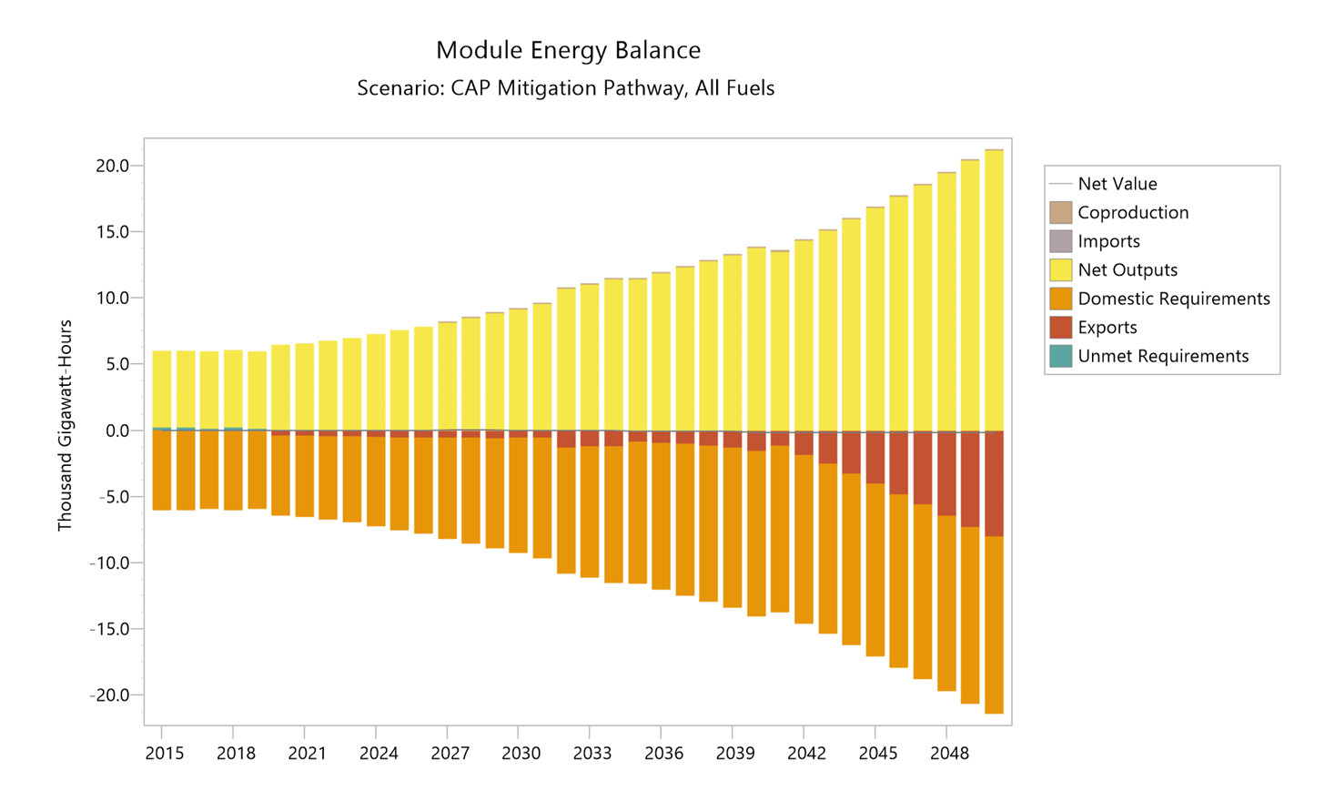
Electricity CAP Mitigation Pathway
By 2050:
8,000 GWh of “export” or curtailed power in order to meet demand in all time slices.
Opportunities for coordinated and flexible load management to reduce the over-generation.
May also provide strategic electrification for industry.

Slide 36
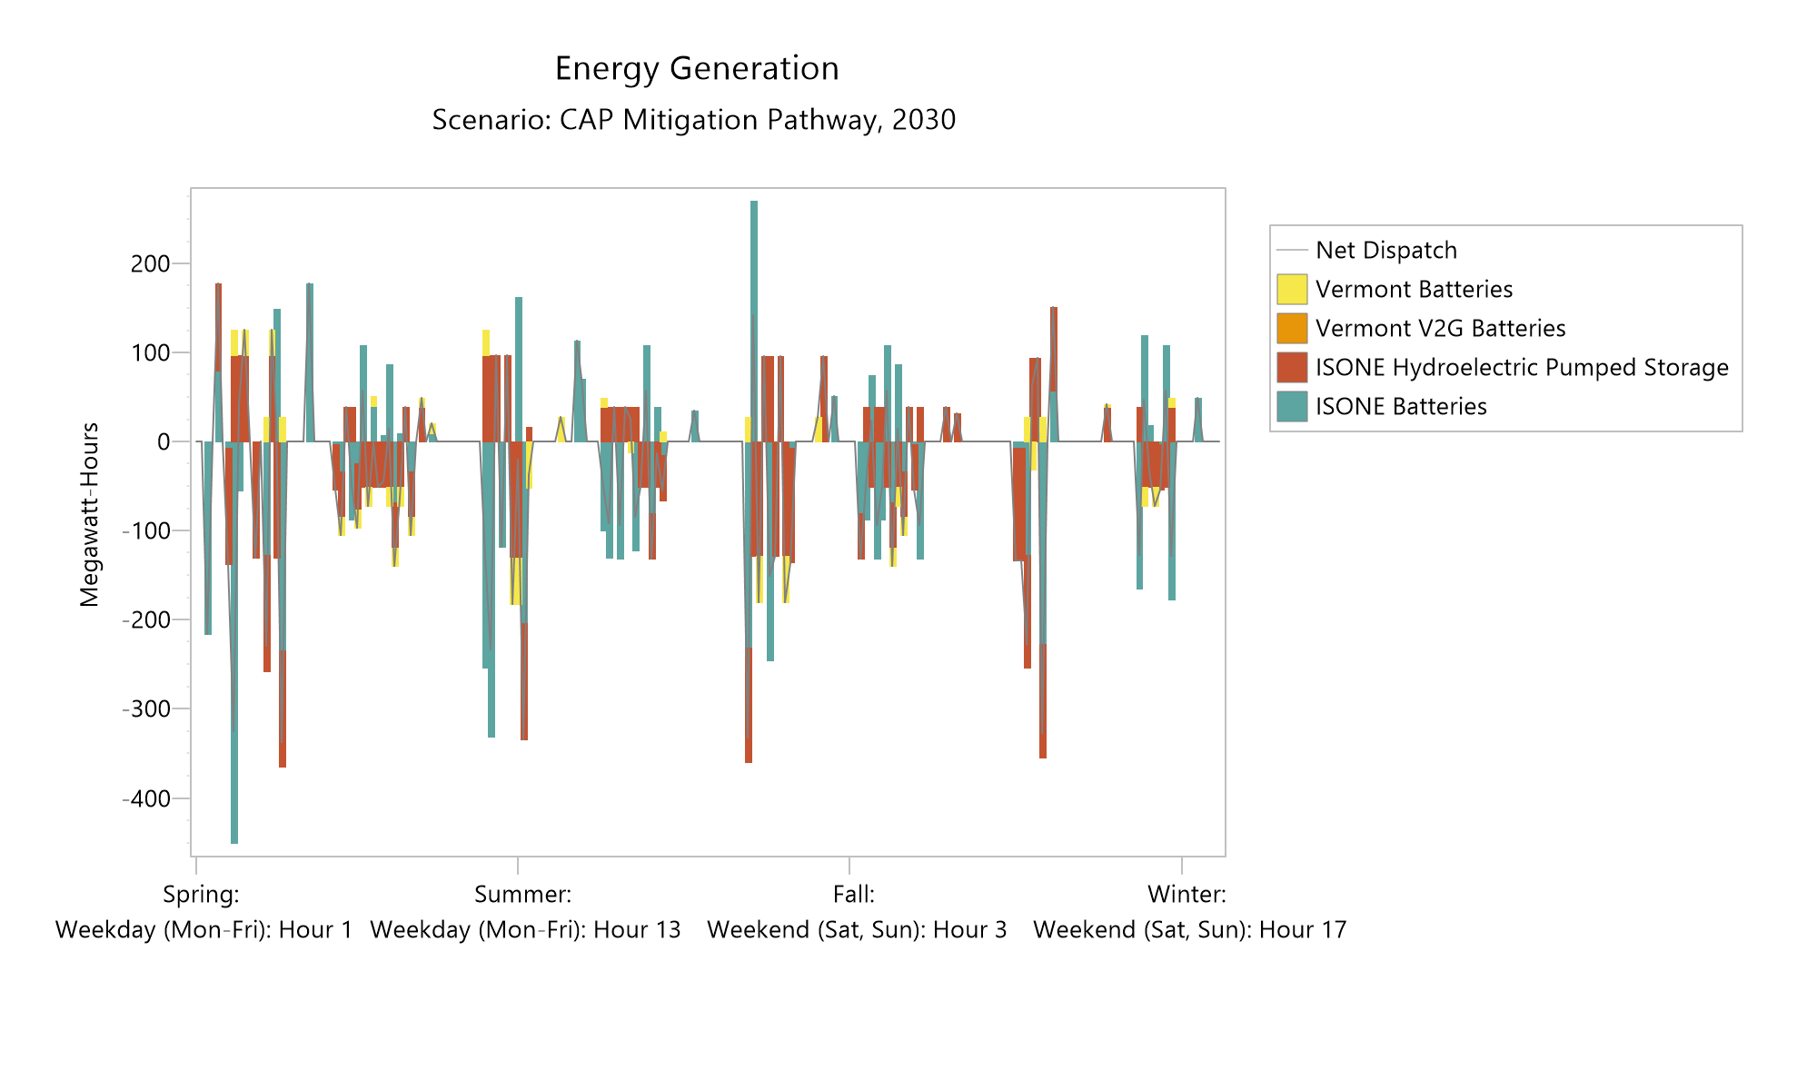
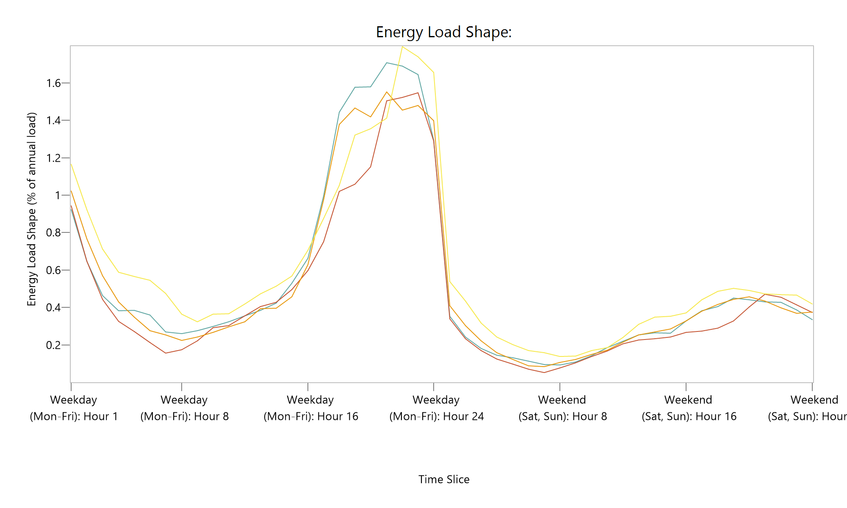
Electricity Pathway Key Policies, Strategies & Actions
CAP Mitigation Pathway supported by:
Expansion of renewable energy standard to reach 100% by 2050
Investigation of demand response, flexible load management, and storage to address curtailment
Potential for additional strategic electrification in industry
Consideration of Local renewables focus

Slide 37
Cross Cutting Results

Slide 38
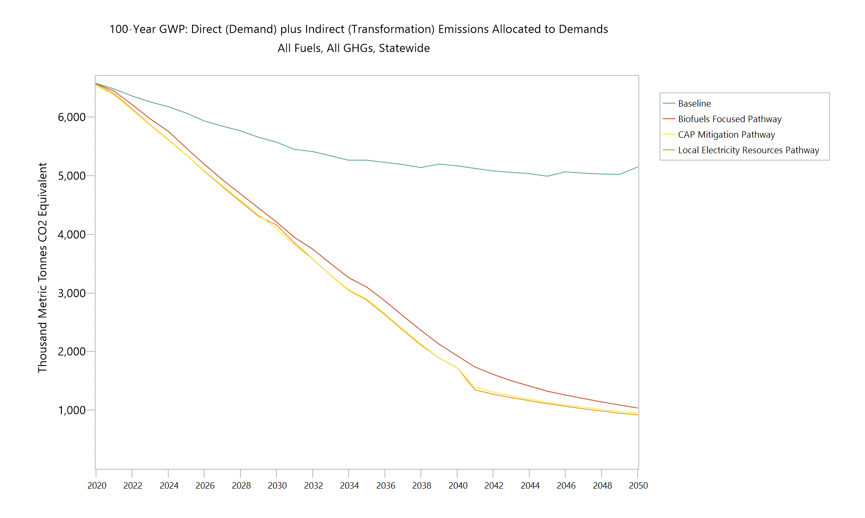
All Pathways Reflect Deep Multi-Sectoral Action

Slide 39
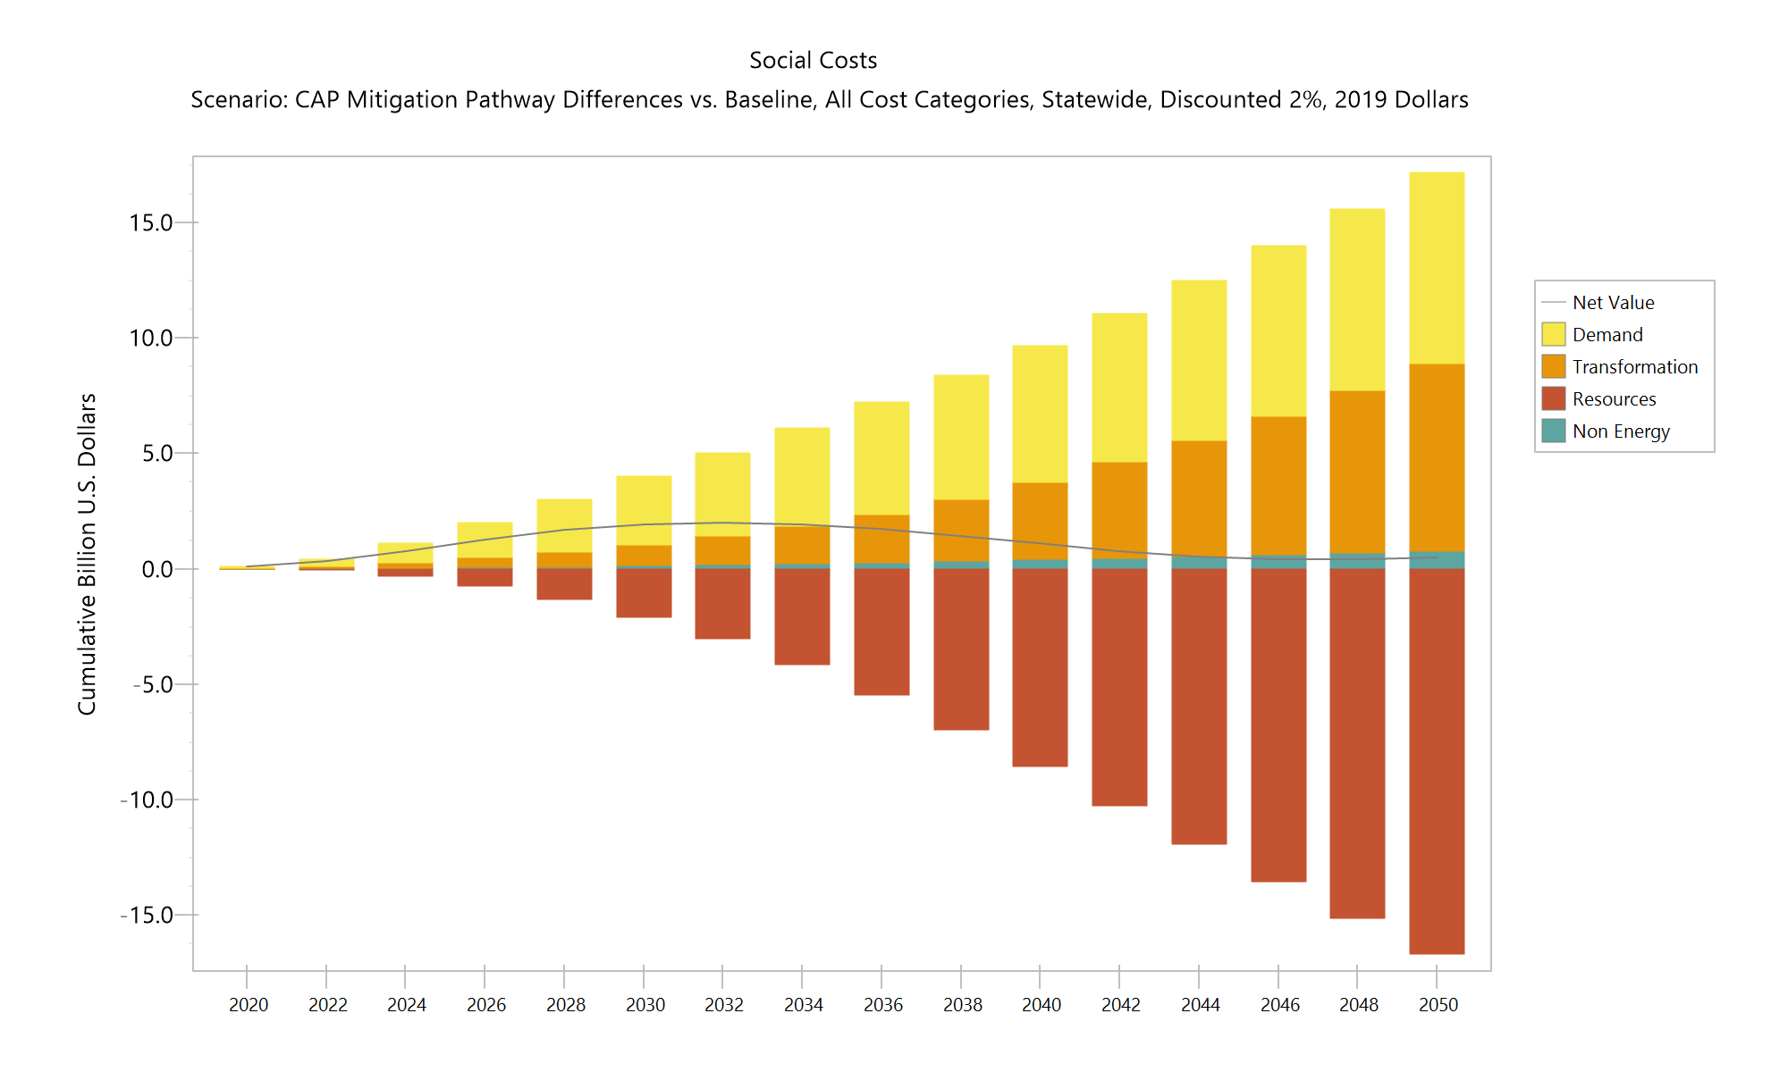
Economic: Early Demand Investments, Later Transformation

Slide 40
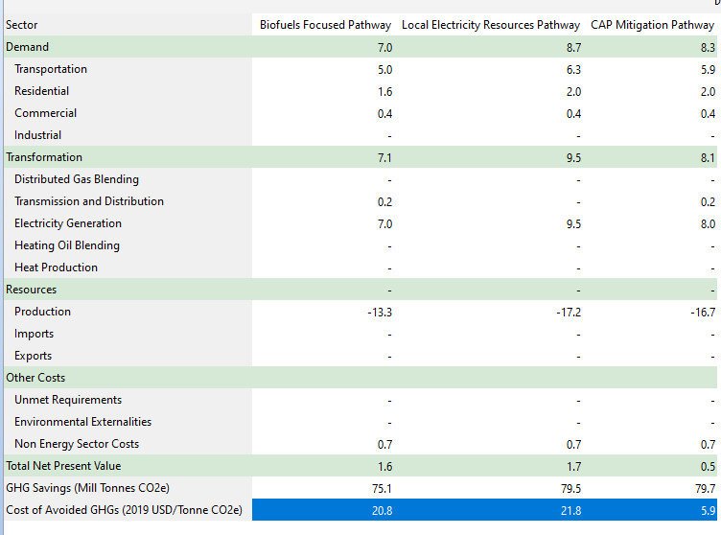
Economic: Net costs of $22 to $6/tonne CO2e
Economic Summary: Cumulative Costs-Benefits 2015-2050, Relative to Baseline
Discounted 2% to year 2019, Units Billion 2019 US Dollars

Slide 41
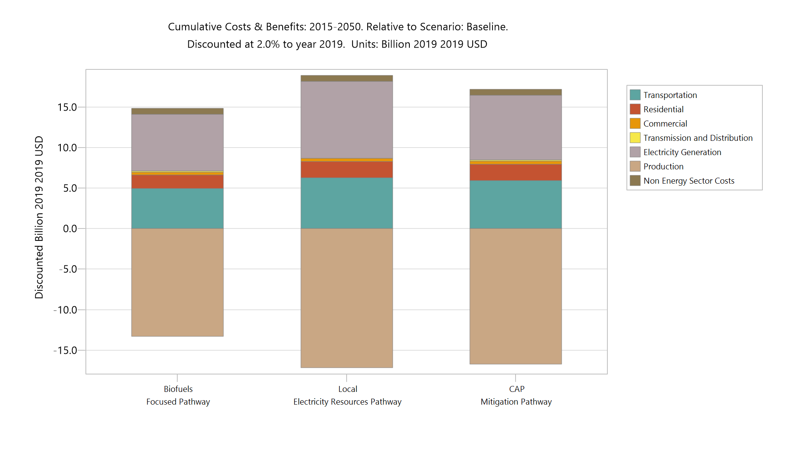
Economic: All Pathways Strong Net Economic Benefits including Social Cost of Greenhouse Gases

Slide 42
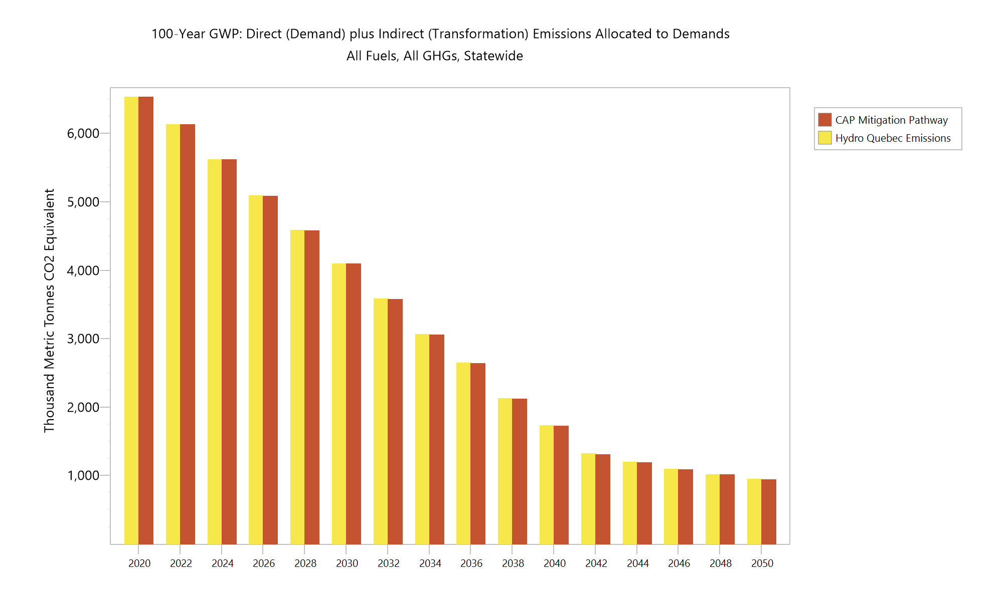
Sensitivities: Hydro Quebec Emissions
Based on Science and Data Subcommittee recommendation and citation from a literature reference by A. Levasseur.
Net biogenic emissions values of 16.5 gCO2/kWh, and 0.29gCH4/kWh included in a sensitivity for Large Hydro emissions
Cumulative difference of 250,000 metric tonnes CO2e by 2050.

Slide 43
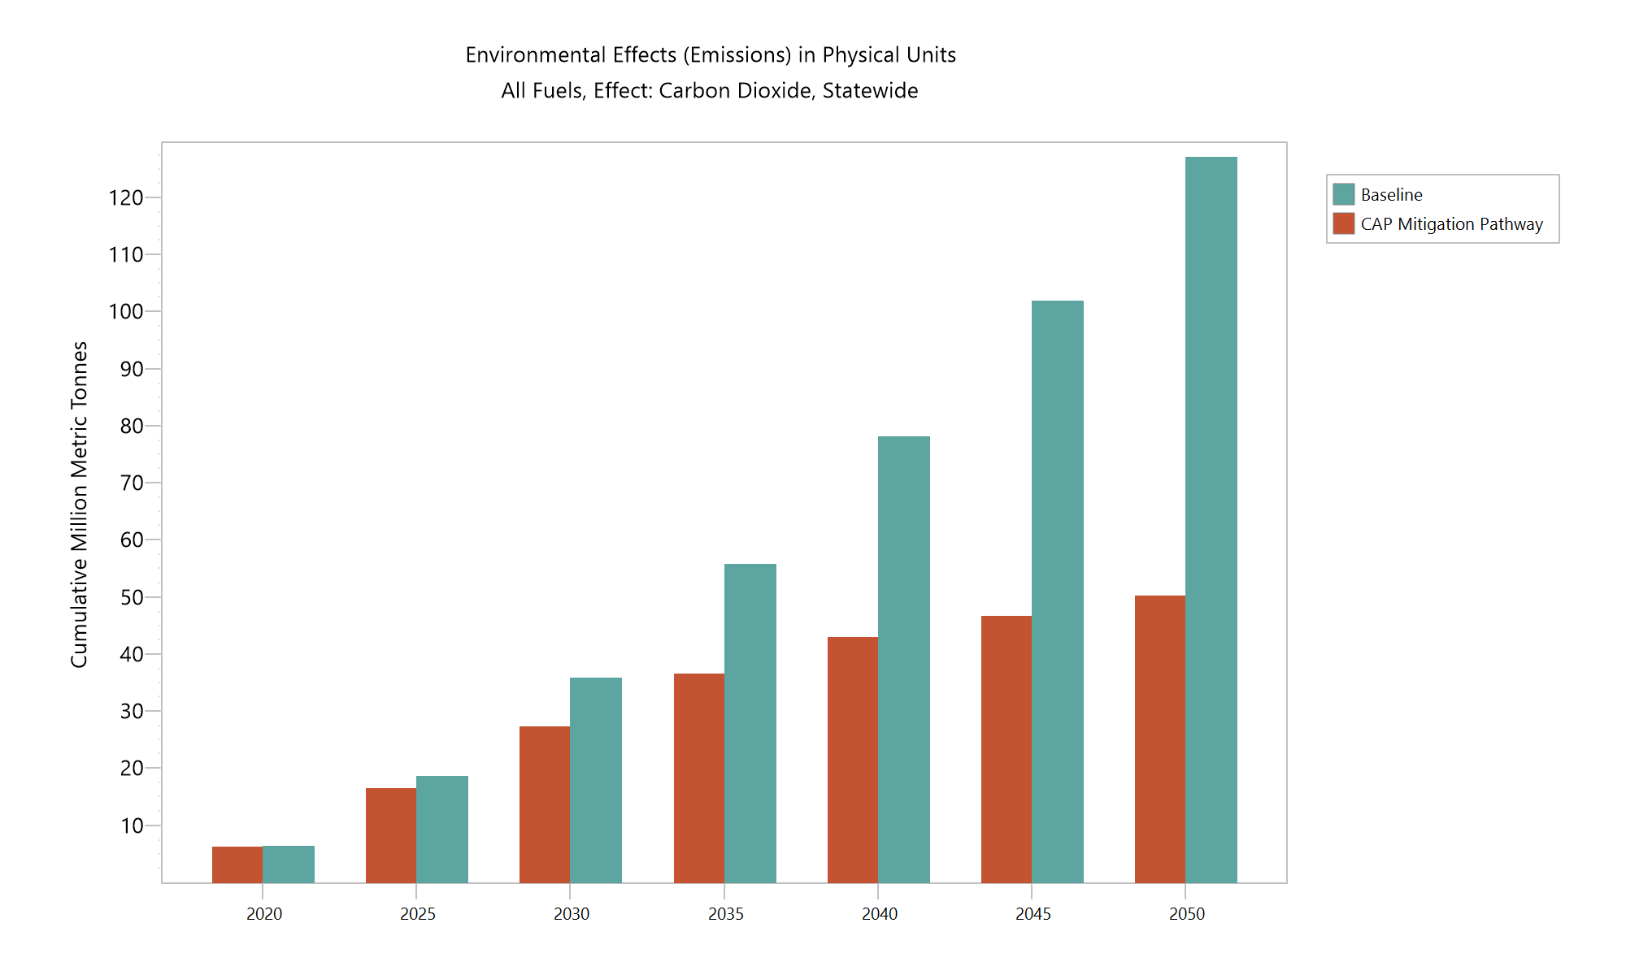
Sensitivities: Biogenic CO2
Based on Science and Data Subcommittee recommendation report on Biogenic C02 for CAP mitigation Pathway.
Net cumulative reductions decrease from 77 million tonnes if biogenic is not counted to 74 million metric tonnes if it is included.

Slide 44
Questions and Discussion

Slide 45
Thank You!

