Slide 1
Bennington and the Revolutionary War 1777
K-3 Activity Guide
Notes:
A battle is a fight between two or more groups where each group is trying to defeat (beat) the others. Battles are most often fought during wars, or two or more people fighting. If two armies fight many battles over period of time it is called a war.

Slide 2
The Battle Monument
Kindergarten Activity
Notes:
A battle is a fight between two or more groups where each group is trying to defeat (beat) the others. Battles are most often fought during wars, or two or more people fighting. If two armies fight many battles over period of time it is called a war.

Slide 3
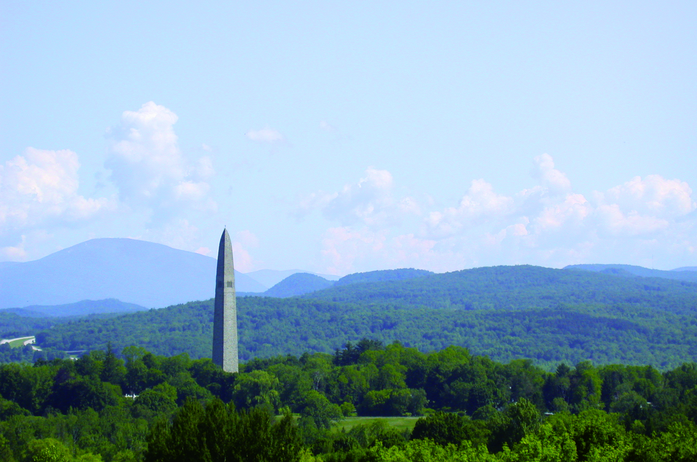
Notes:
The Battle Monument was built to help us remember a battle called ”The Battle of Bennington.” This battle was part of a war called the Revolutionary War.
Have you seen the Bennington Battle Monument? Have any of you been inside the Battle Monument?

Slide 4
Design your own monument!
Here is an outline of our Battle Monument.
What colors should the monument be?
What other shapes would you add?
Notes:
If you were creating your own monument for the battle, what color would you make it?
Would you add any different shapes?
Go ahead and use the coloring outline of the monument and create a monument of your own.

Slide 5
A Soldier’s Uniform
First Grade Activity
Notes:
The people who fought at the Battle of Bennington wore many different uniforms. Some just wore regular clothes!

Slide 6
An American Uniform
Notes:
Here is a picture of how American soldiers were dressed in the Revolutionary War.
They were part of what was called the “Continental Army”

Slide 7
An American Uniform
Create your own colorful uniform!
Notes:
Unforms can help you tell who is on each side in a battle. This is important so you don’t fight people on your own side by mistake!
The Battle of Bennington happened during a war called The Revolutionary War. The war was between what is now the United States and a country called England. People from England are called British people.
The people fighting to defend Bennington called themselves Americans or Patriots. The British people called us rebels because we were rebelling against British control of our country.

Slide 8
A British Uniform
Notes:
Here is a picture of how British soldiers were dressed in the Revolutionary War at the Battle of Bennington

Slide 9
A British Uniform
Create your own colorful uniform!
Notes:
The British were invading Vermont during the Revolutionary War. They wanted to capture Bennington, Vermont!
British soldiers were sometimes called “red coats” because their jackets were often red.

Slide 10
A German Uniform
Notes:
Here is a picture of how German soldiers were dressed in the Revolutionary War at the Battle of Bennington

Slide 11
A German Uniform
Create your own colorful uniform!
Notes:
The British hired German soldiers to help them fight the Battle of Bennington.
MOST of the people at the Battle of Bennington fighting against the Americans were actually GERMAN soldiers!
These German soldiers had tall hats that made them look bigger in battle.

Slide 12
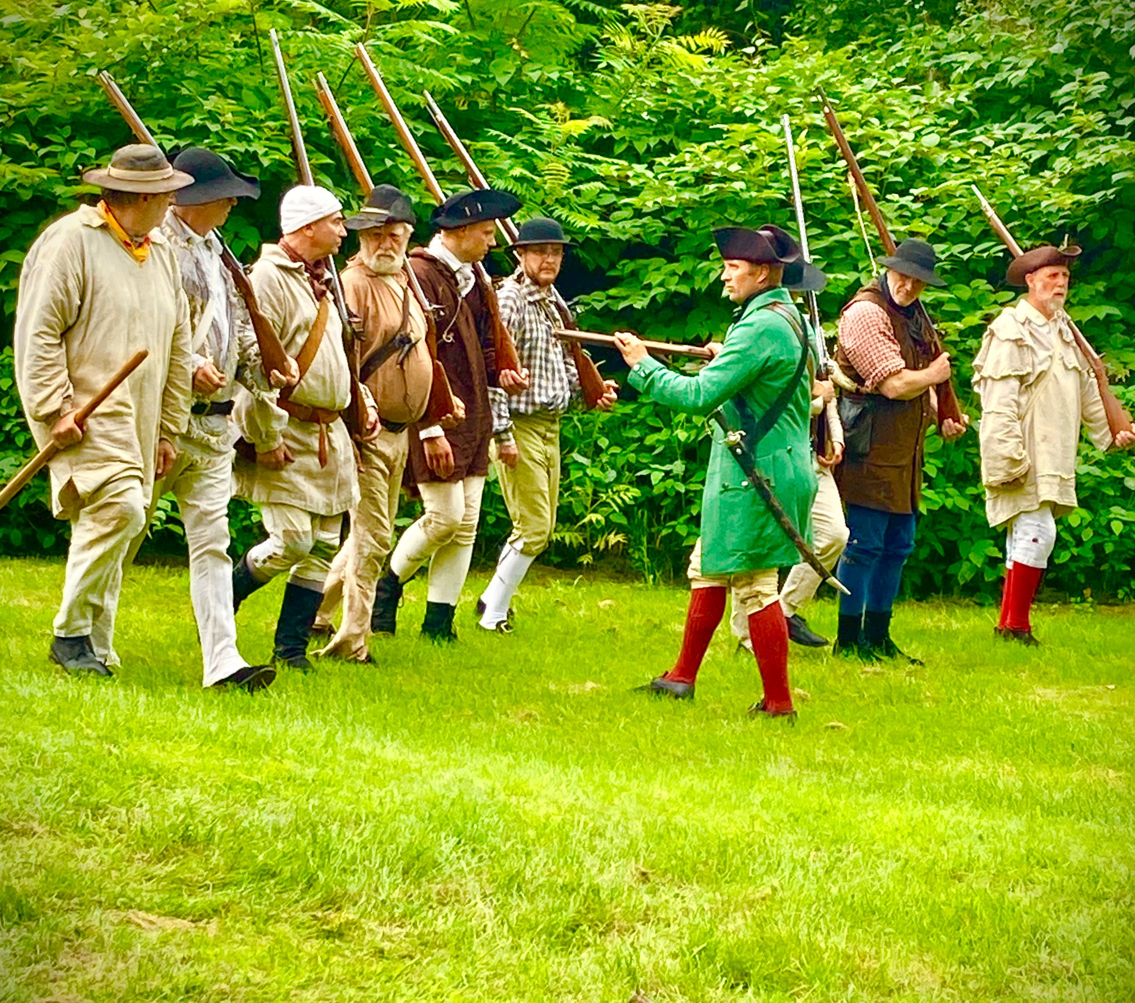
Milia did not have uniforms
Notes:
Some people at the battle of Bennington on both sides wore regular clothes.
These clothes look different from regular clothes today, but it was how people dressed during the Revolutionary War which was almost 250 years ago!

Slide 13
Some People Wore Regular Clothes
People wore different looking clothes at that time.
What colors would you like to see on the clothes?
Notes:
Because they still needed to tell each other apart during the battle… the people wearing regular clothes on each side added something to their hats.
For people fighting for the British, they put a piece of white paper on the brim of their hats.
For people fighting for the Americans, they put a piece of corn leaf on the brim of their hats.

Slide 14
Vermont Map and Green Mountain Boy Flag
Second Grade Activity
Notes:
Before Vermont existed, the land here was originally called the New Hampshire Grants.
It was settled by people who bought land from the Governor of New Hampshire.
Vermont became an independent country in 1777… in the middle of the Revolutionary War!
Vermont would not become part of the United States for another 14 years.

Slide 15
This is a map of Vermont
Can you color the map and the pictures inside it?
Notes:
Vermont chose to be an independent Republic when it was established.
A republic is a type of country that is run by the people who live there who vote to choose who will represent them.
The new republic was originally called “New Connecticut” but the name was changed to Vermont five months later.

Slide 16
This is the Green Mountain Boy Flag
Can you color the flag?
This flag was probably created AFTER the Battle of Bennington, but it became the official flag of the Green Mountain Boys
Notes:
The Green Mountain Boys were led by a person named Ethan Allen who lived in Bennington.
Their job was to protect the land owned by people in Vermont.
The flag is now used by the Vermont National Guard.

Slide 17
This is the ‘76 Bennington Flag
Can you color the flag?
The Bennington Flag is unique:
It has a white stripes at the top and bottom.
It has a larger blue area (9 stripes tall instead of 7)
Notes:
The ‘76 flag is also known as the “Bennington Flag.”
For many years it was thought that this flag flew at the Battle of Bennington.
Further research showed that was not true.
A very old ‘76 flag is at the Bennington Museum.

Slide 18
Vermont Regional Map
Third Grade Activity
Notes:
Both New Hampshire and New York claimed the land that is now Vermont.
Ethan Allen and the Green Mountain Boys defended the settler’s ownership of the land that was originally called the New Hampshire Grants.
Vermont declared it’s independence in 1777… during the Revolutionary War.

Slide 19
Vermont is surrounded by other States
Can you color the map?
Notes:
The states of New York and New Hampshire both claimed the lands where Vermont is now.
Before it became its own state, these lands were known as the New Hampshire Grants.
While New York had the better legal claim to the lands, New Hampshire was quicker to act.
They sold land, called grants, to settlers who began building farms and houses.
Vermont would become its own independent country in 1777. Vermont later joined the United States in 1791.

