Slide 1
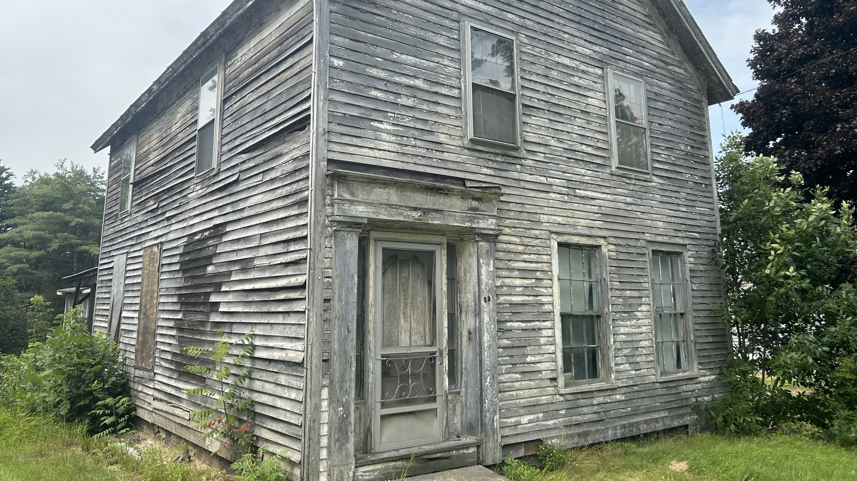

Creating a
Statewide Land Bank
Tactical Plan & Draft Legislation
Legislative Update Summary
February 23, 2026

Slide 2
How We Got Here
The legislature asked DHCD to complete a study on the feasibility to create a statewide land bank in the 2024 Session. This was submitted on January 15, 2025.
DHCD was then directed to complete a tactical plan & draft legislation to create a land bank.
This plan is due on November 1, 2026. A Progress Report was provided to the legislature on January 15, 2026.

Slide 3
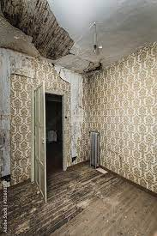
What is a Land Bank?
A public entity with accountability.
Community driven, not profit driven.
Has unique powers to put vacant, abandoned, deteriorated, and tax-delinquent properties back into productive use.
Notes:
10 years of working with Cuyahoga County land bank. 65 rehabbed houses, dry cleaner, land fill transformed to a park

Slide 4
What can a Land Bank Do?
Acquire tax foreclosed property cost effectively.
Extinguish liens and clear title.
Hold property tax exempt.
Generate and collect revenue.
Make flexible disposition decisions, driven not by highest price but by best outcome.
A land bank is a tool for the most challenging redevelopments.

Slide 5
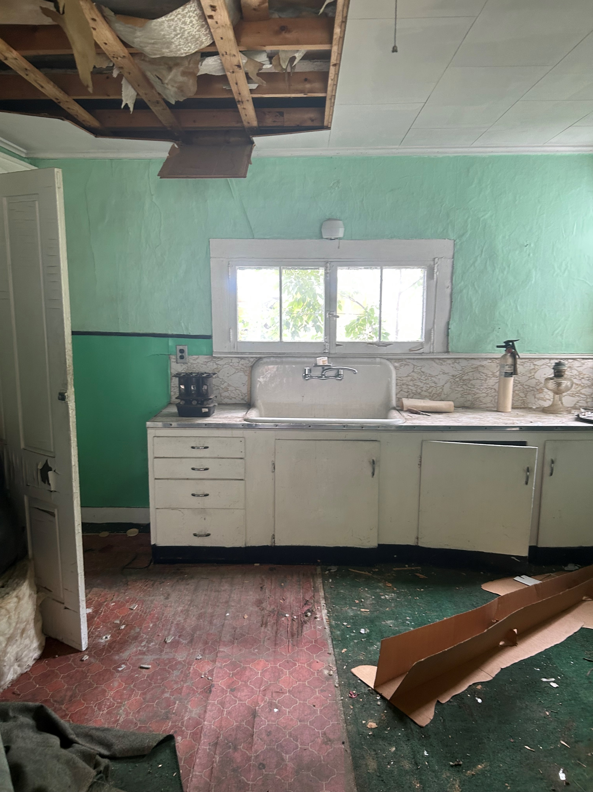
Feasibility Study Findings:
Barriers for Developers
Lack of resources to buy and hold properties while getting financing in order.
Sellers can be impatient, making a project more expensive or even unrealistic.
Vacant and abandoned properties can be difficult to acquire.
Purchasing a property can be a “choice limiting action,” making a project ineligible for HUD funding.

Slide 6
Feasibility Study Findings:
Barriers to Redevelopment & Reuse
Cloudy titles & tax delinquency make purchasing at risk properties expensive and time consuming.
Many municipalities often do not have staff or financial capacity to address vacant, abandoned, and tax delinquent properties.
The current process for development in Vermont requires coordination of various federal, state, and local entities which can prolong the development process.

Slide 7
Feasibility Study Findings:
How a Land Bank Can Help
A developer can apply for HUD funding with an option on a land bank property without triggering a “choice limiting action”.
A land bank can step in when sellers are impatient.
Having a land bank purchase and hold property for redevelopment frees up time and resources.
A land bank can “cure” liens and clean up cloudy titles.

Slide 8
DHCD’s Approach to Developing the Tactical Plan
Create a working group and subcommittees to discuss the various aspects of a statewide land bank.
The working group includes professionals in a variety of disciplines including housing, community development, planning, law, economic development, etc.
The goal is to have representation from collective interests, industry interests, and regional interests from all over the state.

Slide 9







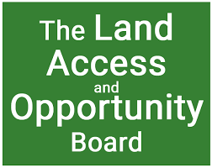
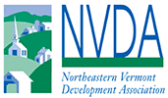

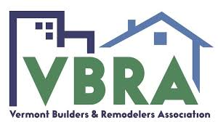
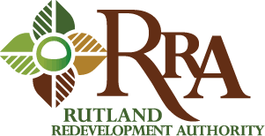

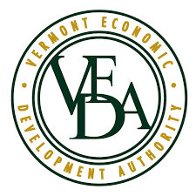
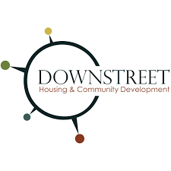




The Land Bank Partners
Rep. Herb Olsen
Rep. Thomas Charlton

Slide 10
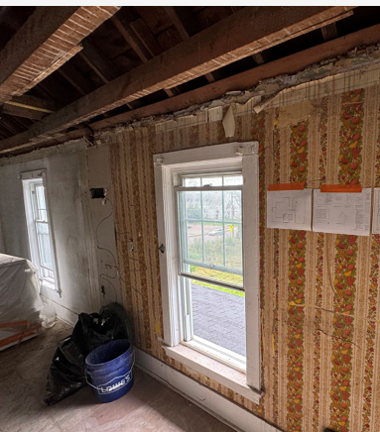
The Land Bank Working Group
The group has been been meeting monthly since July 2025.
The following subcommittees have also met:
  Defining Key Terms
  Creating a Mission Statement & Goals
  Addressing Contaminated Properties

Slide 11
Progress Report Highlights
Land bank activities should primarily be locally driven, in keeping with community planning and goals, and the activities should support projects for all types of land use.
Vermont possesses many of the necessary tools for redevelopment. However, these tools require considerable time and energy to fit together.
A properly funded land bank can deploy multiple development tools to move projects forward faster than the current development process.

Slide 12
Draft Mission statement
The Land Bank is an economic tool for all of Vermont that supports growth and investment within our community by returning vacant and abandoned, and distressed real property to beneficial use more rapidly than might have been possible otherwise.
The Vermont State Land Bank Authority will partner with local communities, public and private organizations, regional authorities, and state agencies to undertake initiatives that promote vibrant and healthy communities. These efforts include but are not limited to: creating new housing; increasing tax bases and employment through commercial and industrial redevelopment; mitigating environmental risks; historic preservation; and other land use related activities desired by cities and towns.

Slide 13
Upcoming Discussions
Determine how a land bank should be structured, agreements needed with various partners, board make-up, etc.
Discussion with regional development & planning organizations and municipalities on how a partnership with a land bank could/should work.
Identify one or more sustainable funding sources.
Draft legislation to enable a state land bank.

Slide 14
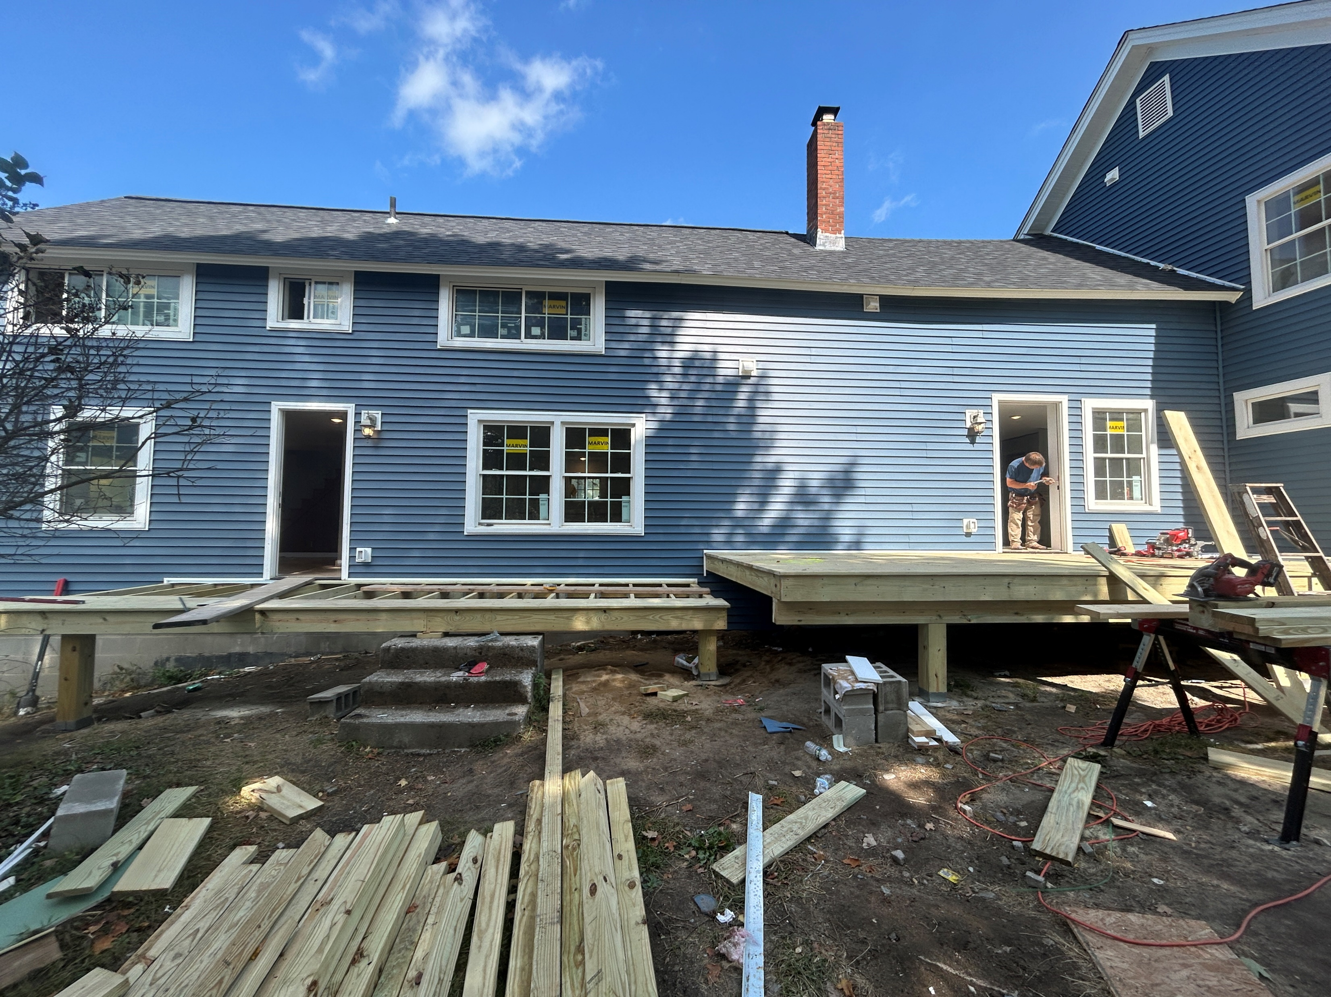
How YOU can Get Involved
Participate in an upcoming Subcommittee.
Offer testimony to the legislature in support of a statewide land bank.
Share the update report & feasibility study with your colleagues & communities.

Slide 15
Thank you!
Link to the 2024 Land Bank Feasibility Study: 2024 Land Bank Feasibility Study
Link to the Tactical Plan Progress Report: 1-15-26 Land Bank progress report
Email: jayme.bauer@vermont.gov
A land bank is a tool for the most challenging redevelopments.

