Slide 1
HUD 2025-2029 5-Year Consolidated Plan Outreach Meetings
Vermont Department of Housing & Community Development

Slide 2
Agenda
Consolidated Plan Overview
What is it? What programs are covered? Goals, priorities and funding.
5-Year Update
Public outreach and opportunities for comment.
Community Profile Data
Discussion and Questions

Slide 3
Who Works on the Consolidated Plan?
Developed by:
Agency of Commerce and Community Development (ACCD), Department of Housing & Community Development (DHCD)
Vermont Housing & Conservation Board (VHCB)
Agency of Human Services (AHS), Office of Economic Opportunity (OEO)

Slide 4
What is the Consolidated Plan?
Often called the “Con Plan.”
Submitted to the federal Department of Housing and Urban Development.
This update covers a 5-year span from 2025 to 2029.
Updates on priorities and goals outlined in this document are published annually.
Establishes priorities for four state programs.

Slide 5
Programs Included in the Con Plan
Community Development Block Grant (CDBG)
Administered by the Department of Housing & Community Development
Provides funding for housing, economic development, public facilities, and public service projects
Emergency Solutions Grants (ESG)
Administered by the AHS – Office of Economic Opportunity
Focuses on shelters and services for homeless
Currently funding shelter and Homeless Management Information System (HMIS) projects
ESG guidance and training and technical assistance is utilized across the network of Vermont housing and homelessness providers
Notes:
Talking points for ESG –
ESG represents less than 1% of the total Housing & Opportunity Grant Program budget
No more than 60% of ESG funds can be used for emergency shelter projects in a year
Currently the award is utilized in three different grants 1) Samaritan House (a shelter in St. Albans) 2) funding for the Homeless Management Information System (HMIS) with Institute for Community Alliances 3) and the Network to End Domestic Violence to support their HMIS comparable database that complies with safety and confidentiality statutes that prohibit them from entering directly into the HMIS
The HMIS & comparable database are key tools for state and local partners (reporting, planning, needs assessment, etc.)

Slide 6
Programs Included in the Con Plan
HOME Investment Partnership (HOME)
Administered by the Vermont Housing and Conservation Board
Focuses on multi-family rental housing
National Housing Trust Fund (HTF)
Administered by the Vermont Housing and Conservation Board
Focuses on service and housing development for low and extremely low-income households

Slide 7
HUD Goals
Provide Decent Housing
Provide a Suitable Living Environment
Expand Economic Opportunities

Slide 8
Vermont Con Plan Goals & Priorities
Increase Supply and Quality of Affordable Housing
Create and Retain Jobs
Decrease the Number Experiencing Homelessness
Strengthen Communities and Improve Quality of Life

Slide 9
Annual Action Plans
Updated annually, due to HUD by May 15
Developed with input from the Consolidated Plan Advisory Board
DHCD follows public participation process
Outlines State’s specific objectives and activities for the upcoming program year
Includes specific requirements for the four programs, CDBG, HOME, ESG, and HTF

Slide 10
Annual Funding Fiscal Year 2024
CDBG = $7,461,397
HOME = $3,000,000
ESG = $705,905
HTF = $3,144,833
HOPWA - Vermont is ineligible to receive formula funds and applies for competitive funding
City of Burlington receives funding directly from HUD as an Entitlement Community

Slide 11
Other Organizations Involved
States are encouraged to include Public Housing Authority’s (PHA) plans in the State Consolidated Plan.
PHA plans must be consistent with State Consolidated Plan.
Continuum of Care, 13 regional homelessness providers outside Burlington, that apply for HUD funds through one application.

Slide 12
5- Year Con Plan Update
Regional public outreach meetings
Online survey of priorities
Con Plan Advisory Board
Housing Needs Assessment (available on DHCD website)
Draft Con Plan published by March 15
Further opportunity for public comment
Final Plan approved by July 2025

Slide 13
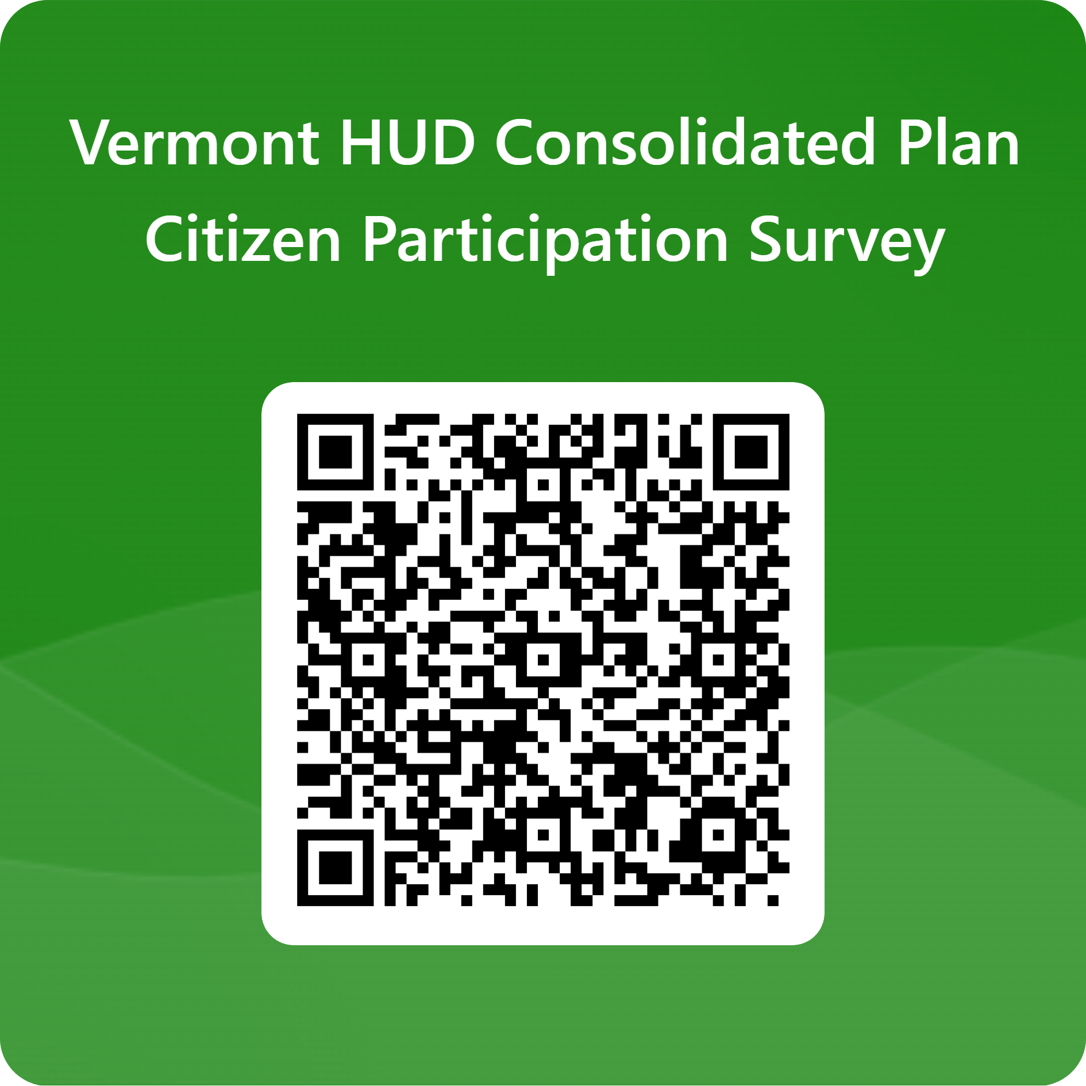
Public Survey
158 responses as of January 8th
Top groups to respond:
90 – members of the public
22 – affordable housing providers
20 – work for municipality
17 - human services provider

Slide 14
Community Profile Data
Learn more information about your community’s housing stock and needs at HousingData.org/profile
Datasets are vetted and analyzed by the Vermont Housing Finance Agency

Slide 15
Income & Housing Wage

Slide 16
Cost Burdened Households

Slide 17
Home Sale Prices

Slide 18
Affordability Calculators
This tool estimates the home purchase price likely to be affordable to the average homebuyer in Vermont.

Slide 19
Comments & Discussion
What needs in your community should we know about?
Contact Us
Con Plan Webpage: https://accd.vermont.gov/housing/plans-data-rules/hud/how
Public Input Survey: https://forms.office.com/g/TE08KuUx3w
Shaun Gilpin, Housing Division Director, shaun.gilpin@vermont.gov

Slide 20
Please Share Your Input!

