Slide 1
Housing Deficit Data and Demographic Trends Presentation 12/15/23
Alex Farrell - Commissioner, Department of Housing and Community Development
Mat Barewicz – Director, Economic & Labor Market Information Division Director

Slide 2
The Economic & Labor Market Information Division online @ VTLMI.info
Housed in the Vermont Department of Labor
State partner to the Federal Government
95% federally funded
Thank you to the USDOL Employment & Training Administration!
Purpose: to produce, explain and disseminate economic data for the benefit of the State of Vermont, educational institutes, employers, students, job-seekers, researchers, and the general public.
Notes:
Keep this to under 30 seconds.

Slide 3
MOMENT OF APPRECIATION
Thank you for all you do
for Vermonters and
the Vermont economy

Slide 4
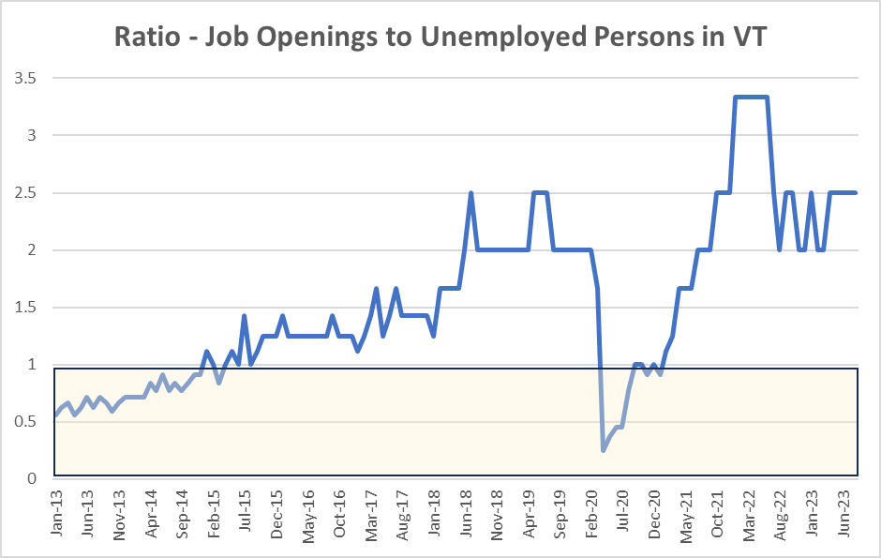

Slide 5
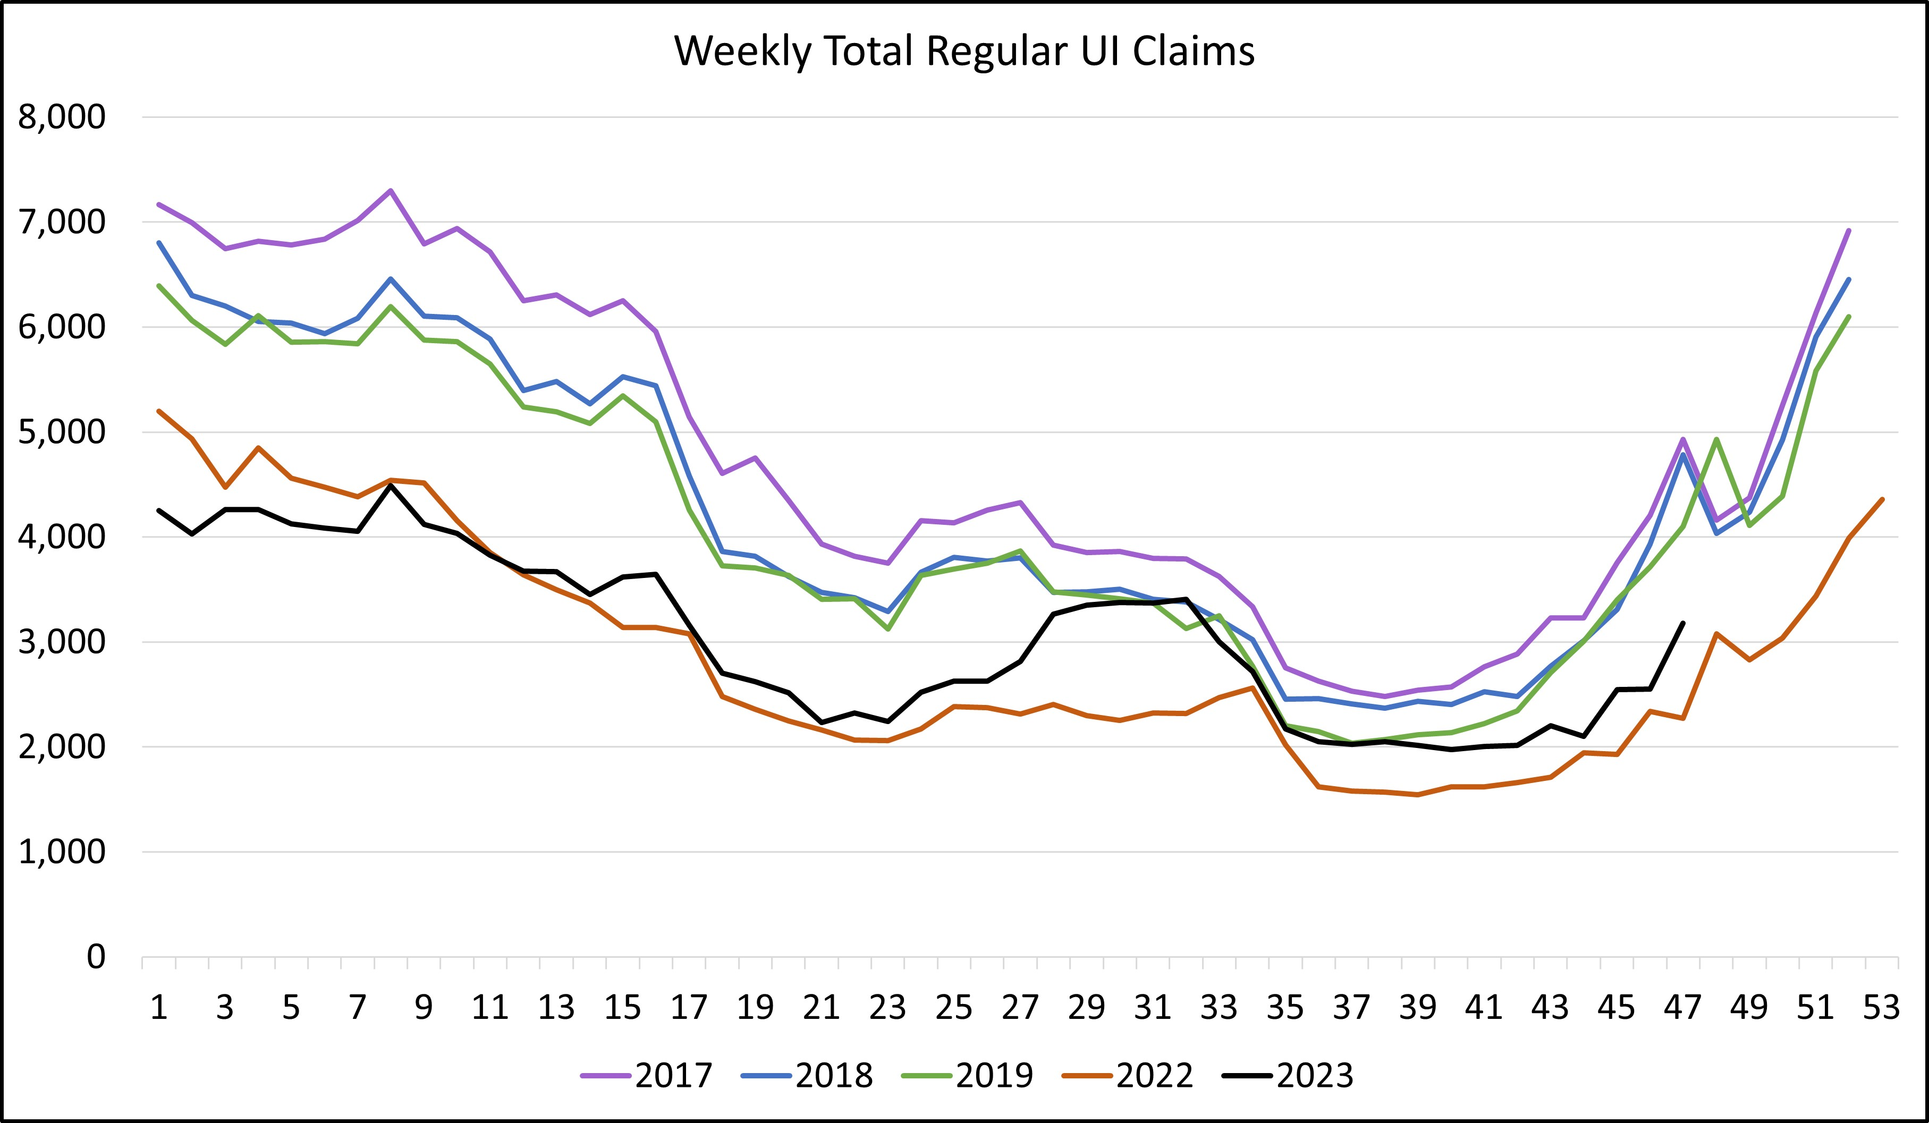

Slide 6
Population by Age 2000, 2010 and 2021
The population of Vermonters aged 65+ increased by 47,621 (61.4%) between 2000 and 2021
The population of Vermonters aged 20-34 increased by 9,654 (8.6%) between 2000 and 2021
In 2021 Vermonters aged 55+ made up 34.8% of the state population verses 22.1% in 2000.
In 2021 Vermonters under the age of 20 made up 21.9% of the state population verses 27.3% in 2000
In 2021 there were 8,378 (2.2%) fewer Vermonters aged 20-64 than there were in 2010.
 | Numbers |  |  | Share
Age | 2000 | 2010 | 2021 | 2000 | 2010 | 2021
0-4 | 33,989 | 31,952 | 29,168 | 5.6% | 5.1% | 4.5%
5-14 | 86,498 | 72,291 | 67,722 | 14.2% | 11.6% | 10.6%
15-19 | 45,770 | 46,012 | 43,586 | 7.5% | 7.4% | 6.8%
20-34 | 112,419 | 113,473 | 122,073 | 18.5% | 18.1% | 19.0%
35-54 | 195,721 | 180,962 | 155,725 | 32.1% | 28.9% | 24.2%
55-64 | 56,920 | 89,973 | 98,232 | 9.3% | 14.4% | 15.3%
65+ | 77,510 | 91,078 | 125,131 | 12.7% | 14.6% | 19.5%
Source: American Community Survey 5-year estimates; US Census Bureau.

Slide 7
State-Wide Education Enrollment 2004 to 2022
Year | PK-12 | K-12
2004 | 93,326 | 91,758
2005 | 91,740 | 89,922
2006 | 91,824 | 89,698
2007 | 90,470 | 88,331
2008 | 89,066 | 86,798
2009 | 87,355 | 84,997
2010 | 86,059 | 83,651
2011 | 85,003 | 82,371
2012 | 83,900 | 81,124
2013 | 85,979 | 80,300
2014 | 85,276 | 79,459
2015 | 84,453 | 78,239
2016 | 84,379 | 77,078
2017 | 84,345 | 76,230
2018 | 83,136 | 75,479
2019 | 83,701 | 75,045
2020 | 83,230 | 74,564
2021 | 78,854 | 72,181
2022 | 80,692 | 73,788
State-wide K-12 enrollment has fallen 19.6% since 2004.
When Pre-K enrollment is included, state-wide enrollment has fallen by 13.5% since 2004.
Source: Vermont Agency of Education

Slide 8
Labor Force & Population
Year | Labor Force¹ | Population² | LF : POP ratio
2000 | 334,055 | 608,827 | 54.9%
2001 | 338,145 | 612,223 | 55.2%
2002 | 343,261 | 615,442 | 55.8%
2003 | 346,380 | 617,858 | 56.1%
2004 | 347,352 | 619,920 | 56.0%
2005 | 349,521 | 621,215 | 56.3%
2006 | 355,394 | 622,892 | 57.1%
2007 | 353,268 | 623,481 | 56.7%
2008 | 353,986 | 624,151 | 56.7%
2009 | 359,282 | 624,817 | 57.5%
2010 | 359,692 | 625,741 | 57.5%
2011 | 357,676 | 626,431 | 57.1%
2012 | 353,947 | 626,011 | 56.5%
2013 | 350,175 | 626,630 | 55.9%
2014 | 348,697 | 626,562 | 55.7%
2015 | 346,512 | 626,042 | 55.3%
2016 | 345,851 | 624,594 | 55.4%
2017 | 355,385 | 623,657 | 57.0%
2018 | 356,456 | 626,299 | 56.9%
2019 | 355,950 | 623,989 | 57.0%
2020 | 341,137 | 642,495 | 53.1%
2021 | 328,216 | 645,570 | 50.8%
2022 | 342,119 | 647,064 | 52.8%
The ratio of labor force to population peaked in 2009 & 2010 with 57.5% of the population working or actively seeking work
As of 2022 the labor force to population ratio stood at 52.8%
The Annual Average Labor Force declined by 17,573 between its 2010 peak and 2022.
Sources:
Local Area Unemployment Statistics, Vermont Department of Labor
American Community Survey, US Census Bureau
Note: 2017 - 2022 were recalculated in 2023. Years prior to 2017 were not impacted by this process.

Slide 9
County Labor Force Data 2000 – 2022
Year | Addison | Bennington | Caledonia | Chittenden | Essex | Franklin | Grand Isle | Lamoille | Orange | Orleans | Rutland | Washington | Windham | Windsor
2000 | 19,728 | 19,835 | 15,413 | 84,777 | 3,250 | 24,406 | 3,767 | 13,294 | 15,462 | 12,885 | 33,431 | 32,677 | 24,265 | 30,843
2001 | 20,490 | 20,076 | 15,683 | 85,354 | 3,259 | 24,754 | 3,871 | 13,470 | 15,736 | 13,320 | 34,062 | 32,744 | 24,150 | 31,152
2002 | 20,767 | 20,169 | 15,952 | 86,159 | 3,285 | 25,108 | 3,984 | 13,814 | 16,140 | 13,558 | 34,545 | 33,472 | 24,718 | 31,562
2003 | 21,057 | 19,976 | 16,300 | 86,624 | 3,248 | 25,500 | 4,121 | 14,029 | 16,287 | 13,846 | 34,719 | 33,935 | 24,733 | 32,003
2004 | 20,976 | 19,757 | 16,365 | 86,961 | 3,239 | 25,708 | 4,183 | 14,307 | 16,146 | 13,959 | 35,079 | 33,866 | 24,699 | 32,105
2005 | 21,483 | 20,018 | 16,391 | 86,931 | 3,212 | 25,844 | 4,232 | 14,535 | 16,100 | 14,035 | 35,649 | 34,056 | 24,905 | 32,129
2006 | 21,798 | 20,583 | 16,867 | 88,082 | 3,277 | 26,310 | 4,306 | 15,084 | 16,595 | 14,502 | 35,949 | 34,381 | 24,777 | 32,871
2007 | 21,528 | 20,450 | 16,706 | 88,226 | 3,260 | 25,928 | 4,190 | 15,089 | 16,462 | 14,338 | 35,653 | 34,110 | 24,670 | 32,661
2008 | 21,611 | 20,483 | 16,768 | 88,773 | 3,250 | 25,926 | 4,256 | 15,095 | 16,268 | 14,192 | 35,629 | 34,257 | 24,761 | 32,709
2009 | 21,880 | 20,572 | 16,738 | 90,297 | 3,309 | 26,578 | 4,252 | 15,659 | 16,614 | 14,536 | 35,572 | 34,789 | 25,228 | 33,274
2010 | 21,257 | 20,359 | 16,805 | 94,608 | 3,180 | 27,704 | 4,139 | 14,518 | 16,739 | 14,240 | 33,635 | 35,143 | 25,456 | 31,913
2011 | 21,072 | 19,933 | 16,579 | 95,373 | 3,058 | 27,866 | 4,162 | 14,537 | 16,577 | 14,158 | 33,254 | 34,819 | 24,953 | 31,333
2012 | 20,815 | 19,608 | 16,087 | 95,623 | 2,923 | 27,787 | 4,121 | 13,997 | 16,409 | 14,071 | 32,706 | 34,544 | 24,604 | 30,650
2013 | 20,770 | 19,260 | 15,744 | 95,009 | 2,838 | 27,469 | 4,051 | 13,873 | 16,164 | 13,813 | 32,256 | 34,555 | 24,075 | 30,300
2014 | 20,914 | 18,758 | 15,344 | 95,964 | 2,782 | 27,595 | 4,085 | 13,818 | 15,965 | 13,680 | 31,918 | 34,412 | 23,623 | 29,835
2015 | 20,801 | 18,671 | 15,158 | 95,366 | 2,770 | 27,438 | 3,955 | 13,848 | 15,978 | 13,661 | 31,435 | 34,236 | 23,577 | 29,621
2016 | 20,925 | 18,503 | 14,946 | 95,560 | 2,708 | 27,448 | 3,988 | 13,961 | 15,951 | 13,572 | 31,554 | 34,014 | 23,294 | 29,429
2017 | 21,348 | 18,781 | 15,110 | 99,460 | 2,770 | 28,404 | 4,174 | 14,471 | 16,378 | 13,988 | 31,966 | 35,215 | 23,460 | 29,856
2018 | 21,325 | 18,834 | 15,104 | 99,939 | 2,770 | 28,375 | 4,188 | 14,369 | 16,397 | 13,887 | 31,641 | 35,519 | 23,119 | 29,880
2019 | 21,205 | 18,682 | 14,883 | 99,583 | 2,753 | 28,303 | 4,269 | 14,355 | 16,429 | 13,657 | 31,391 | 35,508 | 22,640 | 29,845
2020 | 20,443 | 17,635 | 14,509 | 95,851 | 2,702 | 27,268 | 4,069 | 13,859 | 15,820 | 13,050 | 30,201 | 33,871 | 21,616 | 28,918
2021 | 20,413 | 17,320 | 14,347 | 95,121 | 2,672 | 27,361 | 4,036 | 13,728 | 15,544 | 13,042 | 29,597 | 33,129 | 20,874 | 28,638
2022 | 20,868 | 17,636 | 14,641 | 97,153 | 2,679 | 27,723 | 4,127 | 14,058 | 15,762 | 13,347 | 29,836 | 33,906 | 21,221 | 29,164
Change Since Peak | - 1,012 | -2,947 | -2,226 | -2,786 | -630 | -681 | -179 | -1,601 | -977 | -1,189 | -6,113 | -1,613 | -4,235 | -4,110
Peak annual labor force in blue
Source: Local Area Unemployment Statistics, Vermont Department of Labor

Slide 10
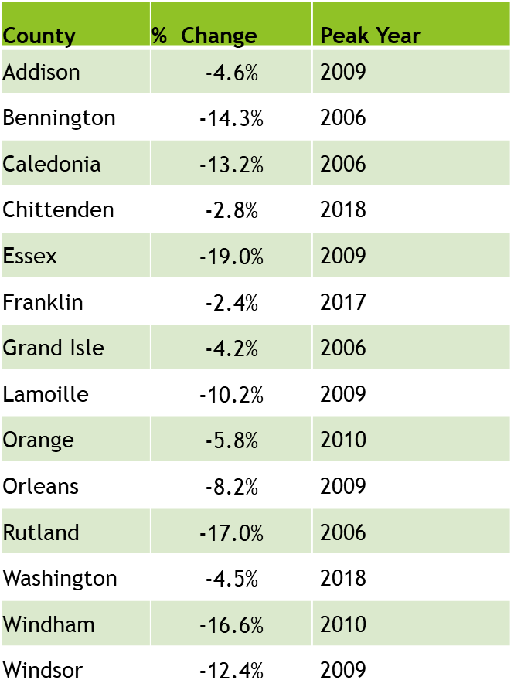
County Labor Force Data: Percent Change since Peak
All counties have seen a decline in labor force since their most recent peak.
Franklin County has lost the least, 2.4% of its peak labor force. It is followed by northwest neighbors Chittenden (-2.8%) and Grand Isle (-4.2%).
Seven counties have seen a 10%+ decline in labor force from their previous peak
Bennington, Caledonia, Essex, Lamoille, Rutland, Windham, Windsor
Source: Local Area Unemployment Statistics Vermont Department of Labor

Slide 11
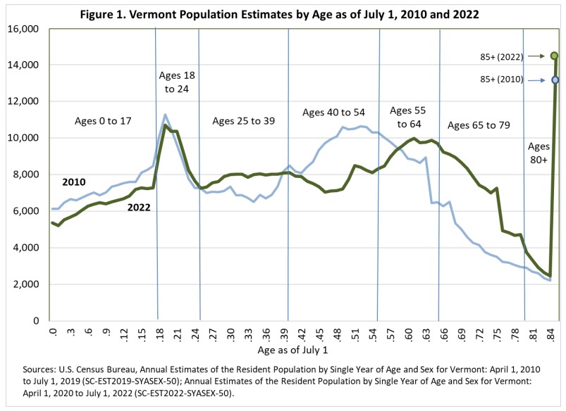
https://ljfo.vermont.gov/assets/Subjects/Demographics/eafc5a1be4/Issue_Brief_VT_Demographics_in_2022.pdf

Slide 12
Thank you! (visit VTLMI.info)
Mathew Barewicz
Economic and Labor Market Information Division
Vermont Department of Labor
mathew.barewicz@Vermont.gov
www.VTLMI.info

Slide 13
Estimate of Vermont’s Current Housing Deficit

Slide 14
Methodology
Establish regionalized current-state data
Calculate Vacancy Rates based on U.S. Census Bureau ACS Estimates (2021)
Establish Target Vacancy Rates for Healthy Market
3% for Ownership
5% for Rentals
Account for units needed for pandemic Hotel/Motel Program population
100 High Acuity Beds
1500 additional Residential Units

Slide 15
Regional Vacancy Rates Based on U.S. Census Bureau year-end estimates
Location | Owned Vacancies (Seasonally adj) | Owned Vacancy Rate | Seasonally Adjusted Rental Vacancies | Rental Vacancy Rate
Addison | 116 | 1.05% | 144 | 4.24%
Bennington | 110 | 1.02% | 237 | 6.37%
Caledonia/Essex | 196 | 1.66% | 145 | 4.17%
Chittenden | 214 | 0.50% | 397 | 1.56%
Franklin/Grand Isle | 162 | 0.93% | 233 | 4.98%
Lamoille | 91 | 1.15% | 98 | 3.37%
Orange/Windsor North | 232 | 1.11% | 311 | 5.97%
Orleans/Northern Essex | 78 | 0.85% | 80 | 3.52%
Rutland | 245 | 1.34% | 245 | 3.64%
Washington | 281 | 1.57% | 120 | 1.65%
Windham South | 130 | 1.17% | 155 | 3.41%
Windsor S/Windham N | 107 | 1.03% | 254 | 6.83%
Vermont Total | 1,962 | 1.04% | 2,419 | 3.30%

Slide 16
Context & Caveats
U.S. Census bureau vacancy rates are high, making these estimates conservative
This is a static (point-in-time) estimate; housing market is dynamic
Does not look to future Housing need:
Need for workforce expansion
Population growth
Inward migration
Does not account for housing stock atrophy (2,000 – 3,000 units lost to disrepair each year)

Slide 17
Unit Deficit vs. Current Annual Production Annual Production based on 5-yr average
Location | Unit Deficit | Avg. Annual Production | Deficit to Production Factor
Addison | 290 | 110 | 2.7
Bennington | 350 | 50 | 6.6
Caledonia/Essex | 260 | 100 | 2.7
Chittenden | 2300 | 880 | 2.6
Franklin/Grand Isle | 440 | 180 | 2.4
Lamoille | 260 | 190 | 1.4
Orange/Windsor North | 520 | 90 | 5.8
Orleans/Northern Essex | 250 | 170 | 1.5
Rutland | 580 | 50 | 11.1
Washington | 770 | 160 | 4.7
Windham South | 440 | 100 | 4.2
Windsor S/Windham N | 280 | 60 | 4.5
Vermont Total | 6740 | 2110 | 3.2

