Slide 1

Resilience on Main Street:
Helping Downtown Businesses Prepare for Disruption
2026 Downtown & Historic Preservation Conference

Slide 2



Resilience on Main Street
Helping Downtown Businesses Prepare for Disruption
Peter Plumeau, Reframe Lab
Molly Rand, VBSR
VT Downtown Conference
St. Albans, VT
June 4, 2026

Slide 3
Today’s ClimateReadyVT Micro-workshop
PURPOSE
Experience the core ClimateReadyVT method
Learn how to help small businesses in your community build their climate resilience
AGENDA
  Introduction and Context
  Overview of Resilience Plan Framework
  Activity 1 – Asset Inventory
  Understanding Climate Risk
  Activity 2 – Risk Matrix
  From Risk Matrix to Action Plan
  Activity 3 – Use What You’ve Learned
  Future Full Workshops
Notes:
Here's our roadmap for the next 70 minutes. The full ClimateReadyVT workshop is a day-long deep dive. What we're doing today is a micro-version — enough for you to understand the method, experience it firsthand, and think about how you might use it with businesses in your own community. We have three short activities built in, each about five minutes, which will give you some additional insight into what participants actually do in the full workshop.

Slide 4





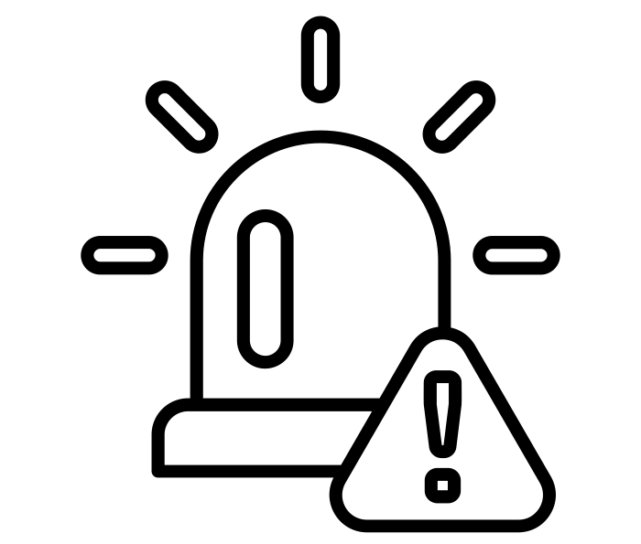
Vermont’s Changing Climate Conditions
Warmer Year-round
More Total Precipitation
Less Snowy Winters
More Drought & Smoke Conditions
More Extreme Events with Less Predictability
Impacts on Built & Natural Environments
Notes:
Before we dive into the planning tools, let's ground ourselves in why this matters.
As you probably know, Vermont's climate is already changing. We're seeing warmer temperatures year-round, more total precipitation, less reliable snow in winter, and more intense events: flooding, drought, ice storms, and wildfire smoke.
The key word on that last bullet is predictability. It's not just that extreme events are more frequent — it's that the old patterns businesses relied on are becoming unreliable. That's the planning challenge.

Slide 5




SMALL BUSINESSES ARE THE ECONOMY
Why This Matters
Nearly half of all U.S. private sector workers are employed by small businesses.
In rural states like Vermont, that share exceeds 60%.
When small businesses fail to recover, the damage ripples outward into jobs, municipal revenues, housing, community vitality.
Notes:
The stakes here are enormous. Small businesses employ nearly half of all private sector workers in the United States. In Vermont, it's over 60%.
But these aren't just economic statistics. When the local hardware store, the diner, or the gallery doesn't come back after a disaster, the whole community feels it — in lost jobs, declining tax revenues, and eroded social fabric.
In other words, small business resilience IS community resilience. That's why this work matters beyond the individual firm.

Slide 6

ClimateReadyVT: From Anxiety to Agency
    Practical tools and strategies to anticipate and respond to disruption
    Clear priorities for maintaining operations and cash flow
    Guided planning that turns concern into concrete next steps
    Long-term resilience built into everyday decisions
80+
Small businesses & organizations served to date
Notes:
ClimateReadyVT exists to turn that anxiety into action. What we offer isn't a report or a generic checklist — it's a guided planning process that gives business owners specific, actionable priorities they can actually implement.
As Molly said, we've now worked with over 80 businesses and organizations across Vermont, plus several from New York and New Hampshire. And what we consistently hear is that the process itself — the thinking it prompts — is as valuable as the plan it produces.

Slide 7





The Climate Resilience Plan
FIVE STEPS. ONE PLAN.
1.
2.
3.
4.
5.
Understand Exposure
Assess Vulnerability & Risk
Investigate Options
Prioritize & Plan
Take Action
Notes:
Here's the framework we take every business through - Five steps, one integrated plan.
Today, we’ll touch on Steps 1 and 2 in depth — understanding exposure and assessing vulnerability and risk — because those are the analytical foundation everything else builds on.
Steps 3 through 5 move from assessment into action: investigating options, setting priorities, and doing the work. In the full workshop, participants work through all five steps with their own business in mind.

Slide 8

Illustrative Example
Meal-prep service firm
Pick-up and home delivery
Located in Montpelier’s Winooski River 100-year flood plain
Key assets include refrigerators and freezers, cooking equipment, internet access, skilled staff (12)
Notes:
To give the framework a more concrete underpinning, we use a fictional example business throughout the workshop.
Meet Pete's Pick and Pack — a local meal-prep and home delivery service, a bit like a smaller, community-based Blue Apron. They're located in Montpelier's Winooski River flood plain, they rely heavily on refrigeration, cooking equipment, and internet connectivity, and they have 12 skilled employees who are essential to operations.
Pete's is a useful illustration because they face multiple, overlapping hazard exposures, similar to what many Vermont business face.

Slide 9
ACTIVITY 1
What does a business need to protect?
Tangible (Physical) Assets
Intangible Assets
Infrastructure (Supportive) Assets
  Office equipment
  Vehicles
  Computers
  Machinery
  Other?
  Employees (Expertise & Retention)
  Customers
  Suppliers
  Other?
  Supply chains
  Internet
  Customer access
  Other?
Notes:
Now, let's start with a fundamental question: what does a business actually need to protect? Before you can assess risk or build a plan, you need a clear-eyed inventory of your most critical assets.
We organize those into three categories — tangible physical assets like equipment and vehicles; intangible assets like your employees, your customer relationships, and your supplier relationships; and infrastructure assets like utilities, internet, and customer access. Notice that last column: intangible and infrastructure assets are often overlooked, but they're frequently the most vulnerable.

Slide 10
ACTIVITY 1
Identify High Priority Assets from Your Handout
Tangible (Physical) Assets
Intangible Assets
Infrastructure (Supportive) Assets
  _________________
  _________________
  _________________
  _________________
  _________________
  _________________
  _________________
  _________________
  _________________
  _________________
  _________________
  _________________
  _________________
  _________________
  _________________
Notes:
[ACTIVITY 1 ~5 minutes]
Now it's your turn.
You each have a handout with info on our example business – Pete’s Pick & Pack. Take a few minutes to look it over and jot down the three to five most critical assets in each category. Don't overthink it — you're looking for the assets that, if lost, would threaten the business's ability to operate.
[Give ~4 minutes. Then ask one or two participants to briefly share what they identified before moving on.]

Slide 11
Understanding Climate Risk
What hazards does a business face – and which assets are at risk?
Notes:
Now that we know what our business has to protect, the next question is: what threatens those assets?
This is where we shift from inventory to risk assessment.
A hazard on its own isn't enough information — you need to understand which specific assets are at risk from which specific hazards, and what the consequences would be. And building insights into asset risk is the key analytical move we make in Step 2.

Slide 12

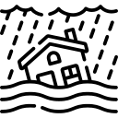
From Hazard Exposure To Risk
Risk
Possibility of Climate Risk Hazard Impact on Business
Likelihood of a Hazard Event
Consequence for Business Continuity
Notes:
Risk is a function of two things: one, the likelihood that a hazard will occur, and two, the consequence for the business if it does.
For instance, a flood that's rare but would shut you down completely may still rank as a higher risk than a heat wave that's occasional but manageable.
Our challenge — and the value of this process — is helping you think clearly about both dimensions at once, rather than defaulting to either "it'll never happen to us" or "everything is catastrophic." Remember, this is all about helping you build your sense of agency.

Slide 13

Closing The Vulnerability Gap = Resilience
Vulnerability
(The Gap)
HazardRisk
Ability to Adapt / Continue Operating
Notes:
This diagram captures the core concept - the vulnerability gap is the distance between the hazard risk a business faces and its ability to adapt or continue operating.
A business with strong redundancies, backup systems, and trained staff has a smaller gap and is therefore more resilient. In contrast, a business that's highly exposed with no contingency planning has a much larger gap.
The workshop helps you see exactly where that gap exists and what it would take to close it. And closing that gap is the definition of resilience.

Slide 14
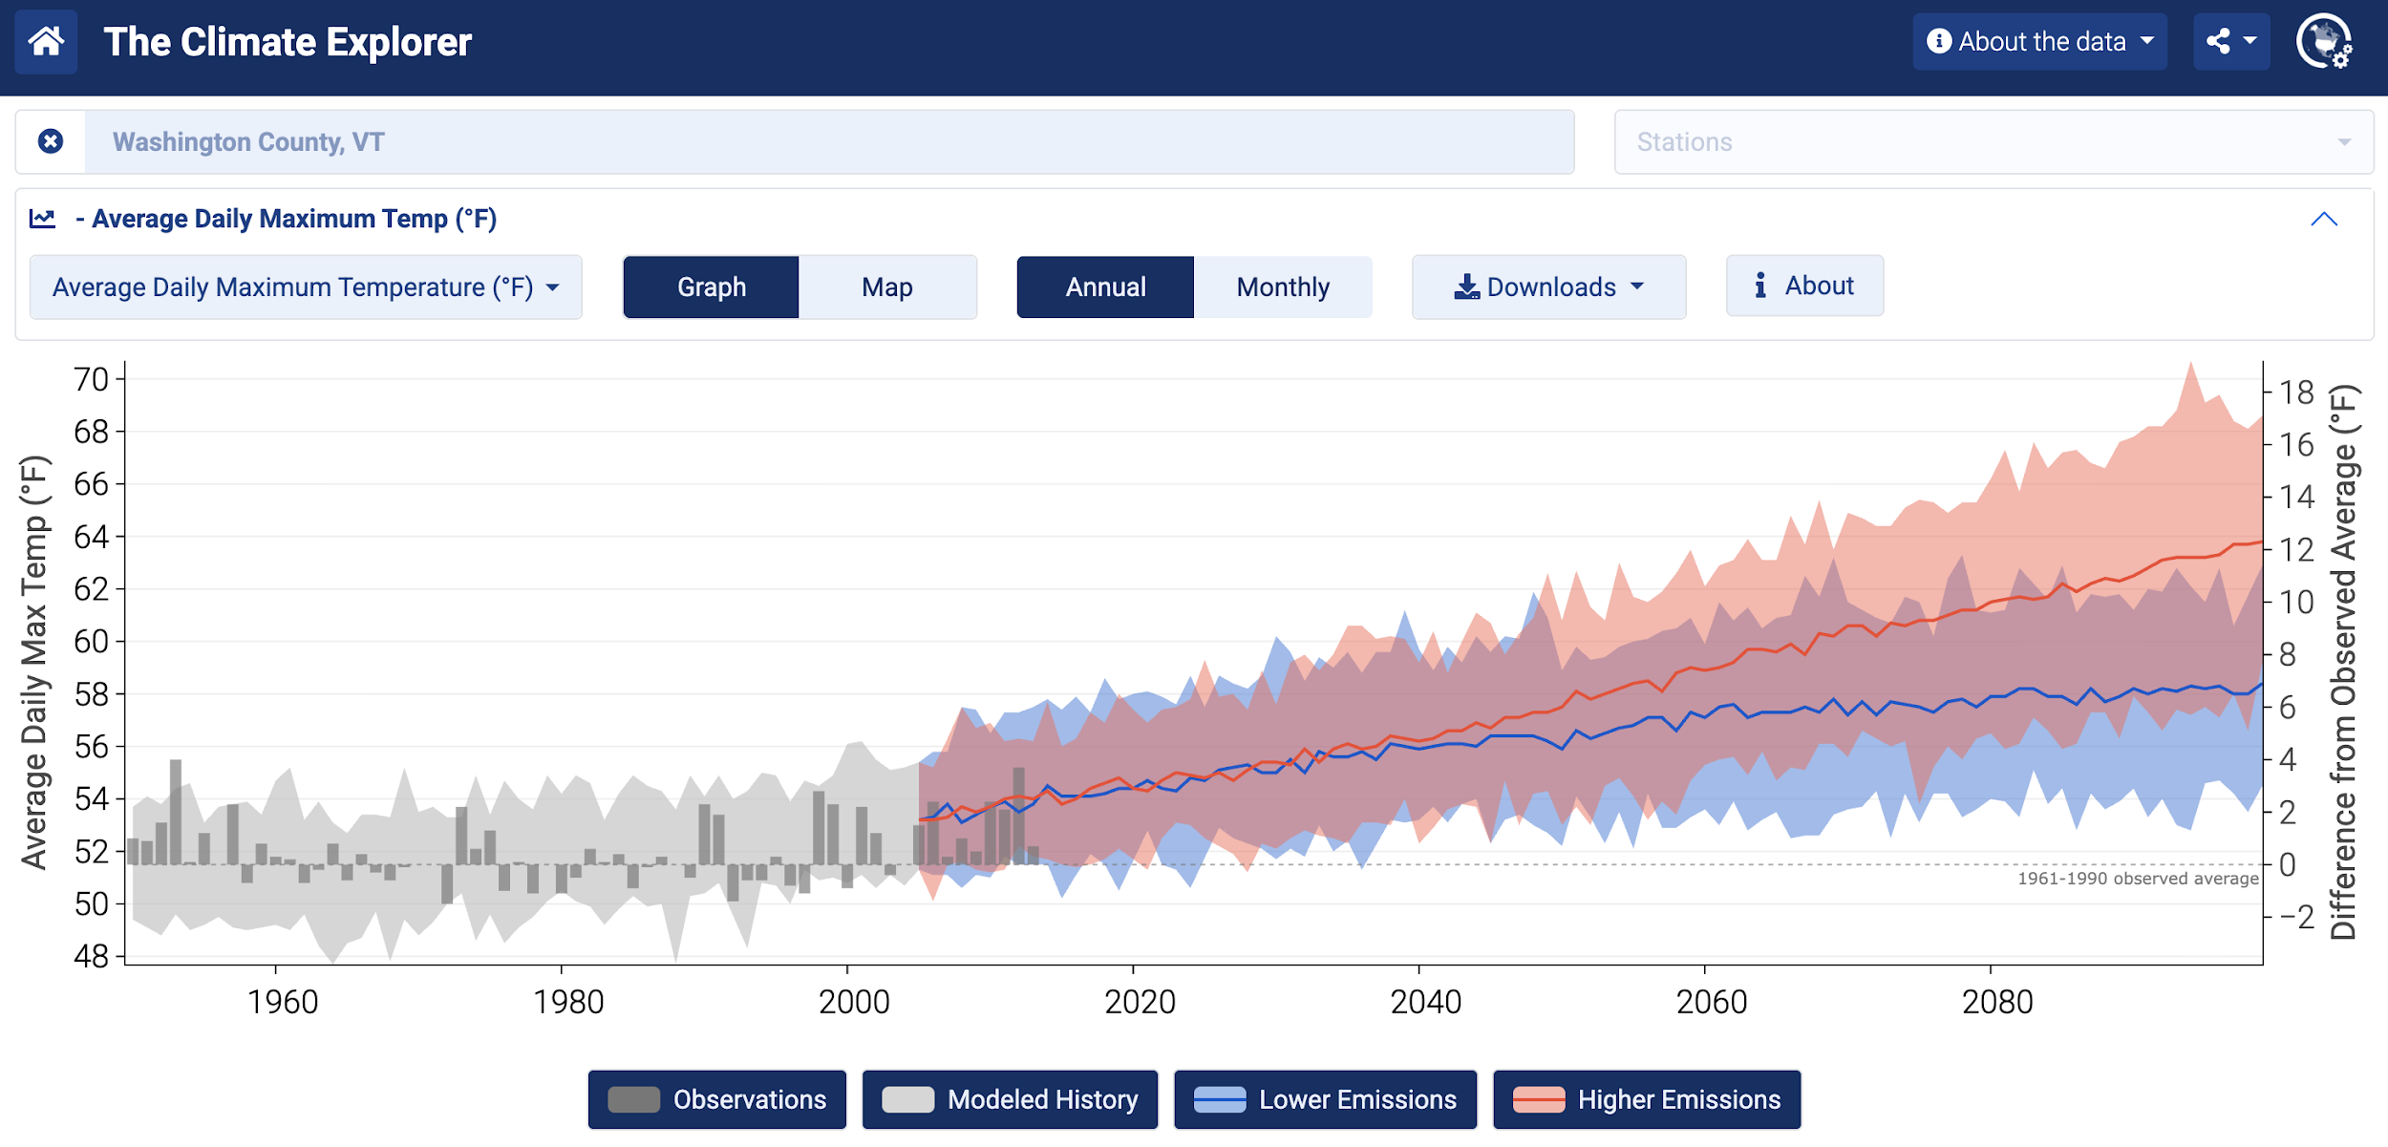
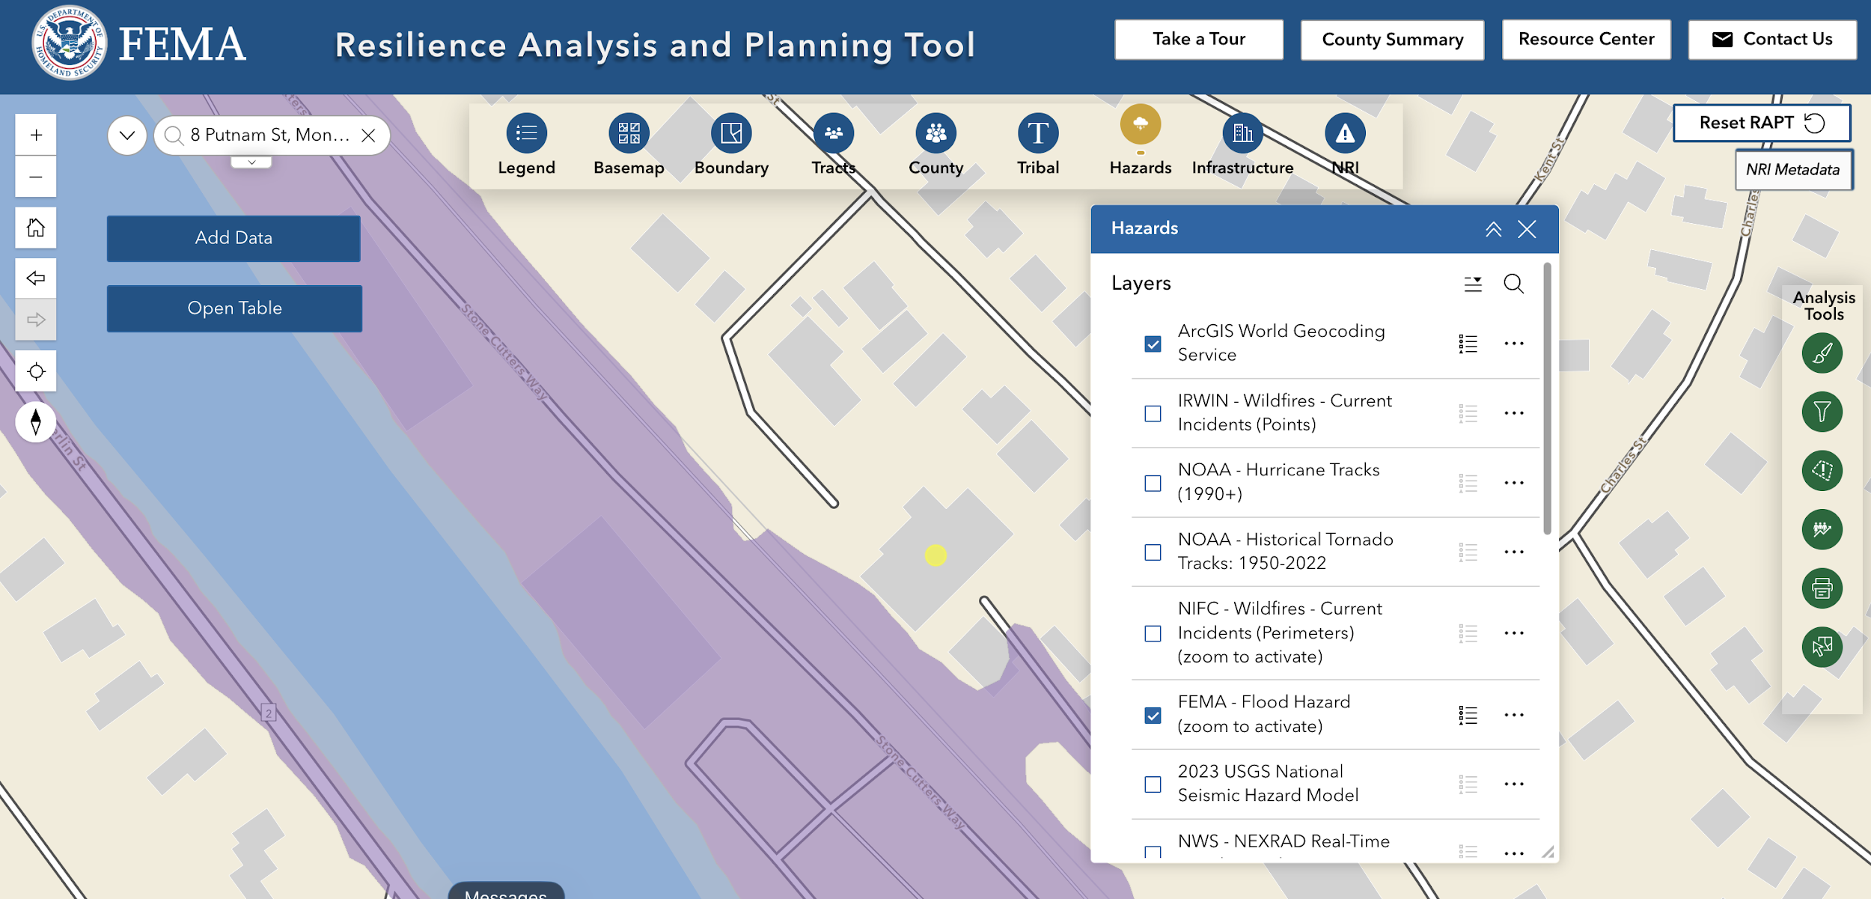

Step 1: Understand Exposure
INFORMATION RESOURCES
HAZARDS IDENTIFIED
Climate Explorer
More extreme heat days
FEMA RAPT Tool
More flooding events
Notes:
Step 1 in the resilience plan framework is understanding whether and how your key assets are exposed to hazards We generally use two key data sources:
The first is the Climate Explorer — a free, web-based tool that provides county-level climate projections out to 2100. For Montpelier, where Pete's is located, it would show increasing extreme heat days.
The second is FEMA's Risk Assessment Planning Tool — RAPT — which provides historically-based projections of natural hazard risk by location. We can see here that Pete’s is at risk for flooding.
In the actual workshop, participants look up their own location. And I should note that there are other data sources – both public and private - out there. These two were selected because they are easy to access and provide well-documented information.

Slide 15

Step 2: Assess Vulnerability & Risk
?
Asset-Hazard
Pairing
Pair each of your priority assets with climate-related hazard(s) that are likely to affect it
Consequence
Understand whether and how you can operate after being impacted by a climate-related hazard
Notes:
In Step 2, the analytical work begins. For each priority asset we identified, we ask: which climate hazards could affect it? And if that hazard occurs, what are the consequences for the business's ability to operate? This is the asset-hazard pairing. And each pair is a potential resilience investment opportunity.
It sounds technical, but in practice it's really a structured conversation — one that forces you to think through your actual vulnerabilities rather than speaking in generalities.

Slide 16
Step 2: Assess Vulnerability & Risk
ASK:
Which 3–5 assets, if lost or disrupted, would halt your operations?
HIGHEST PRIORITY ASSETS
Inventory Storage Room (Tangible Asset)
Staff (Intangible Asset)
Utilities (Infrastructure Asset)
Notes:
Here are the highest priority assets I would identify for Pete's Pick and Pack — the storage room, the staff, and electric utilities. The logic is simple: if any of these were severely impacted or lost, the business would likely halt, possibly permanently.
In the actual workshop, each participant builds their own list. The answers often surface things business owners hadn't explicitly thought about before.
[ASK FOR VOLUNTEERS to share what they identified in Activity 1 — which assets did they flag as most critical, and why?]

Slide 17
Step 2: Assess Vulnerability & Risk
ASSET-HAZARD PAIRING
Step 1: Identify Hazards for Each Asset
List the climate and weather-related events that could damage each priority asset
Step 2: Create Asset-Hazard Pairs
Pair each asset with every hazard that could affect it
Asset-Hazard Pairs
Inventory Storage Room - Flooding
Inventory Storage Room - Extreme Storms
Staff - Extreme Heat
Staff - Extreme Storms
Electric, etc. Utilities - Extreme Storms
Electric, etc. Utilities - Flooding
Your “best bet” resilience investments
Notes:
Here's the asset-hazard pairing process laid out step by step.
First, identify the hazards for each priority asset. Then create the pairs — each asset matched to each hazard that could affect it. [Walk through the example pairs.]
These pairs — in my case, storage room and flooding, staff and extreme heat, utilities and extreme storms — become my roadmap for the risk matrix. They also tell me where your resilience investments are most likely to pay off. In other words, you're not guessing; you're targeting.

Slide 18

Step 2: Assess Vulnerability & Risk
FOCUS ON CONSISTENCY – NOT PRECISION
Estimating hazard risk is difficult and imprecise
Typically based on historic patterns and events
Use a simple set of rules to apply probability consistently
Notes:
Before we move on, I’d like to give you a quick but important reality check: risk estimation is not a precise science.
Climate projections carry uncertainty. Local conditions vary. And business owners are not hydrologists or meteorologists. So we don't ask for precision — we ask for consistency. The goal is to apply the same lens to every hazard and every asset pair, so that the comparisons you make are fair and internally coherent.
What we hope to convey is that a rough but consistent risk profile is far more useful than a precise estimate of a single hazard.

Slide 19
Step 2: Assess Vulnerability & Risk
PROBABILITY
MAGNITUDE
The likelihood of a hazard occurring
Severity of impact on your firm if hazard occurs
Measure of Time
Impact on Firm/Organization Operations
5 Years | 5 to 20 Years | 20 Years or More
High Probability | Medium Probability | Low Probability
Stop business completely? | Slow business significantly? | Continue business w/minor disruption?
High Magnitude | Medium Magnitude | Low Magnitude
Measure of Probability
Measure of Magnitude
Notes:
In assessing risk, we use two scales:
Probability asks: how likely is this hazard to occur in the planning horizon? We simplify it to three levels — high, meaning within five years; medium, five to twenty years; and low, more than twenty years out.
Magnitude asks: if it does occur, how severely would it affect operations? Again, three levels — high stops the business completely, medium slows it significantly, and low allows continued operation with minor disruption. [Pause.]
These scales are simple by design. The power isn't in the scale — it's in the conversation that applying the scale forces you to have.

Slide 20
Step 2: Assess Vulnerability & Risk
THE RISK MATRIX
Allows one to consider probability and business impacts of different hazards together
Provides a climate risk profile and guidance on where, how, and when to invest in resilience actions
High
Med
PROBABILITY
Low
Low
Med
High
MAGNITUDE OF CONSEQUENCE
Notes:
Now we come to the risk matrix — our core analytical tool.
When you plot each asset-hazard pair by its probability and magnitude, you get an immediate visual picture of your risk profile. Pairs that land in the upper right corner — high probability, high magnitude — are your top priorities. Pairs in the lower left can be accepted or monitored.
The matrix doesn't tell you what to do. But it gives you a shared, defensible basis for making those decisions.

Slide 21
Step 2: Assess Vulnerability & Risk
THE RISK MATRIX
High
Inventory Storage Room
Most Vulnerable Priority Assets | Probability of a Loss (high, med, low) | Magnitude of the Loss (high, med, loss)
Inventory Storage Room | High | Medium
Staff | Medium | High
Electric + (Utilities) | Medium | Medium
Med
PROBABILITY
Electric+ (Utilities)
Staff
Low
Top Priority - Act First / Act Soon
Medium Priority - Monitor / Watch
Low
Med
High
Low Priority - Accept
MAGNITUDE OF CONSEQUENCE
Notes:
Here are my priority assets mapped onto the matrix: The storage room sits at high probability and medium magnitude — that's a top priority. Staff is medium probability but high magnitude — also a priority, and potentially the most critical single investment. Utilities land in the middle.
The result is a clear picture of my assessment’s resulting investment priorities: the storage room and staff resilience are where Pete's should focus first. That's the kind of clarity that's hard to get from a general conversation — but straightforward to arrive at with this tool.

Slide 22
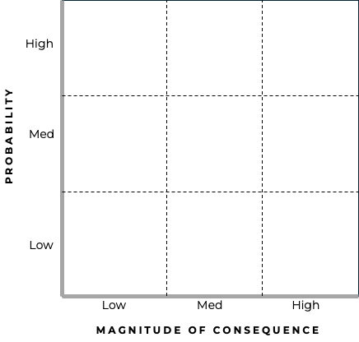
Build Your Own Risk Matrix
ACTIVITY 2
1
Read about Pete’s Pick and Pack
With two pre-identified hazards and multiple possible priority assets
2
Rate each asset-hazard pair
Discuss probability and magnitude
3
Plot and decide
Place pairs on the matrix. Agree on the most urgent resilience investment(s).
Notes:
[ACTIVITY 2 ~5 minutes]
Now it's your turn. Look at your handout – you have Pete’s Pick & Pack shown two pre-identified climate hazards. And you have the priority assets you identified earlier. Now, work through the steps: create your asset-hazard pairs (using your own priority assets), rate each asset-hazard pair for probability and magnitude, then plot them on the matrix on your handout and decide which pair represents the most urgent resilience investment.
[Give ~5 minutes. Then ask one or two pairs to share their placement and reasoning before continuing.]

Slide 23
From Risk Matrix to Action Plan
Translating the risk assessment into a clear set of action steps
Notes:
The risk matrix is a powerful diagnostic tool. But a diagnosis without a treatment plan isn't much help.
Steps 3 through 5 of the framework translate the risk matrix into a structured action plan — investigating options, setting priorities with an eye on feasibility and cost, and then actually doing the work.
In the full workshop, participants leave with a draft action plan for their business.

Slide 24
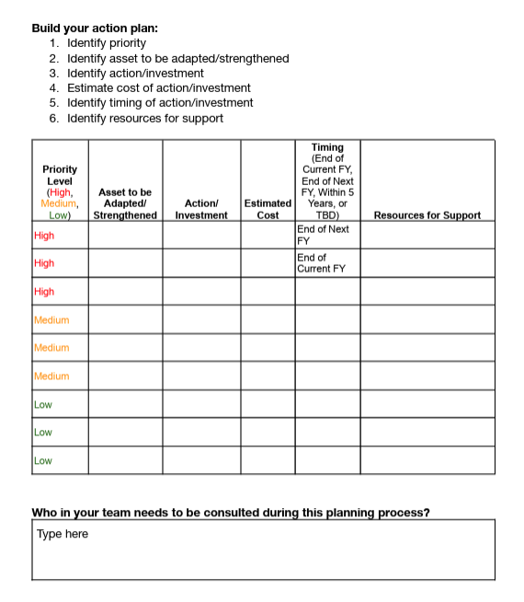
Example Of Action Plan Template
WORKBOOK
Notes:
We provide you with templates for developing your resilience action plan.
For example, here’s a view of the workbook format that you receive in the full workshop. Each row corresponds to an asset-hazard pair, and the columns walk through the key decisions: What's the action? Who owns it? What does it cost? When will it happen? [Briefly describe what's visible.]
The workbook becomes the your firm's living resilience plan — something you can update as you take action and as conditions change.

Slide 25
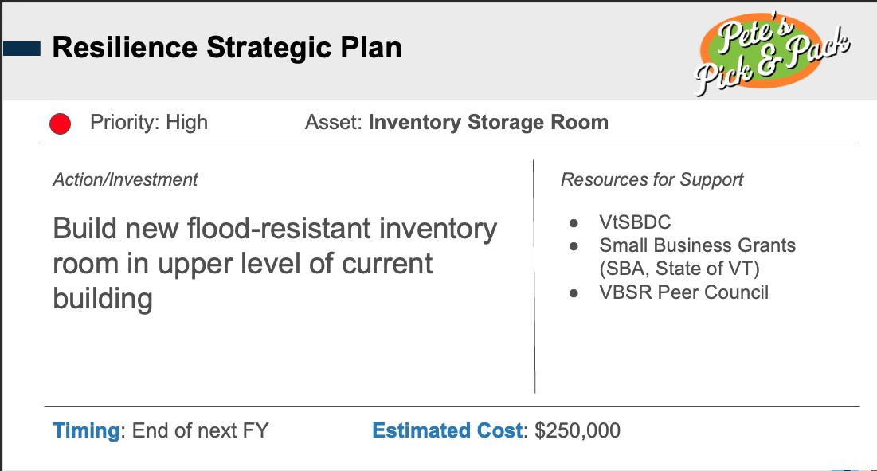
Sharing the Action Plan for Buy-in
CRVT provides a ready-to-use slide template to communicate the plan to any audience
Consistent format helps audiences quickly grasp priorities and costs - making it easier to secure support
EXAMPLE ACTION PLAN SLIDE
Notes:
One of the tools we provide is a ready-to-use slide template businesses can use to present their action plan to any audience — their bank, their landlord, their employees, their town's emergency manager.
Consistent format matters here. When the structure is familiar, audiences can focus on the content: what the risks are, what the business is doing about them, and what support they might need. It lowers the barrier to having those conversations.

Slide 26
Key Takeaways
THE FRAMEWORK
THE APPROACH
THE URGENCY
  Understand critical assets
  Identify asset exposure
  Assess risk on a simple matrix
  Build a plan
  Resilience planning works best as a facilitated conversation, not a delivered product
  Your job isn't to hand them a plan. It's to walk them through the thinking.
  Businesses that survive the next decade are the ones that plan before the next disaster - not after
Notes:
Let's bring it all together:
The ClimateReady framework gives you a systematic, repeatable process.
The approach reminds us that this works best as a conversation, not a deliverable — our role isn't to hand businesses a plan, it's to walk them through the thinking.
And the urgency: businesses that are still here in 10 years will largely be the ones that planned before the next disaster, not after it.
Now, I'd be happy to answer some questions before we do our last activity.

Slide 27
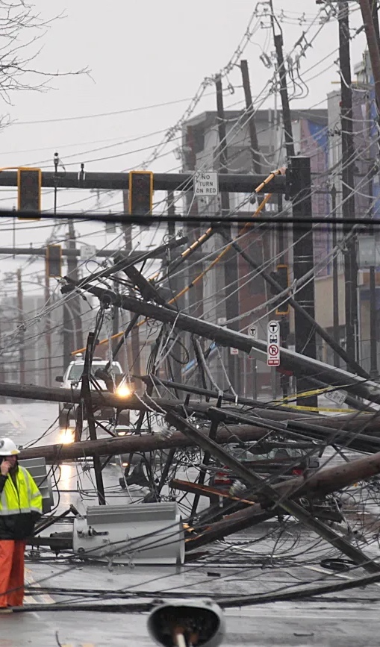




What is one thing you will do in the next 30 days to help a business in your community build its climate resilience?
ACTIVITY 3
Notes:
And here is our final activity — and it's a reflective one. Think about a business or two in your community — real ones, if you like. What is one concrete thing you will do in the next 30 days to help that business start building its climate resilience? It could be a conversation, a referral, sharing a resource, or proposing a workshop.
[Give participants 2–3 minutes to think and jot something down, then invite a few to share.]
This question is how the full workshop ends too — with a commitment, not just a takeaway.

Slide 28
Tools & Resources
CLIMATE DATA
FLOOD RISK
Climate Explorer
FEMA Risk Index (RAPT)
crt-climate-explorer.nemac.org · Localized projections to 2100
tinyurl.com/RAPT-Access · National risk assessment by location
FLOOD MAPPING
STATE & REGIONAL PLANNING
Flood Ready Vermont
Vermont Climate Risk Toolkit
floodready.vermont.gov · Click 'Vermont Flood Atlas'
climatechange.vermont.gov/climate-toolkit · One-stop regional planning hub
BUSINESS ADVISING
FINANCING
VtSBDC
VEDA Disaster Recovery
vtsbdc.org · No-cost advising, all counties
veda.org · Loan fund for declared disasters
BUSINESS ADVISING
EMERGENCY MGMT
Vermont Small Business Law Center
VT Emergency Management
sblc.vermontlaw.edu · Free consultations · Attorney referrals
vem.vermont.gov/plans · Business continuity templates
ENERGY RESILIENCE
Efficiency Vermont
efficiencyvermont.com · Backup power + weatherization
Notes:
These are some of the key resources Vermont businesses can draw on as they work through their resilience planning:
We've already introduced the Climate Explorer and FEMA RAPT.
VtSBDC offers no-cost advising in every county and makes a great referral for businesses that need one-on-one support, and Vermont Small Business Law Center can provide consultations and referrals for a variety of legal matters.
And Efficiency Vermont is often an overlooked resource for backup power and weatherization.
Your handout has all of these and more with links.
[HAND BACK TO MOLLY HERE.]

Slide 29

Upcoming ClimateReadyVT Workshop
Brattleboro
October 29, 2026 (full-day workshop)
For more information:
climatereadyvt.org/

